Slide 1
Science
Learning Intention: To describe the life cycle of a bird

Slide 2
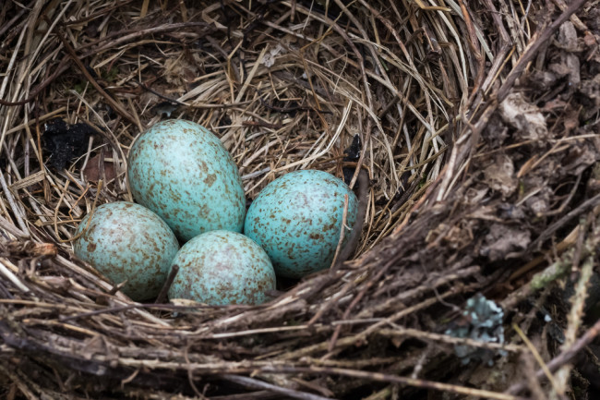
Life Cycle of a Bird
A bird starts life as an egg. It grows a special hard tooth on its beak to break the egg shell.

Slide 3
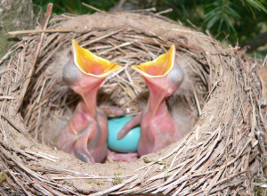
Life Cycle of a Bird
When the baby bird first breaks through the egg shell, it is called a ‘hatchling’.

Slide 4
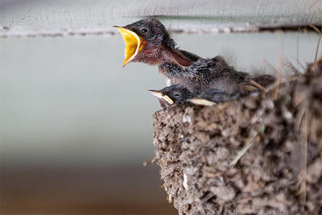
Life Cycle of a Bird
The baby bird grows stronger and gains more feathers but it stays in the nest and its parents bring it food. It is called a ‘nestling’.

Slide 5
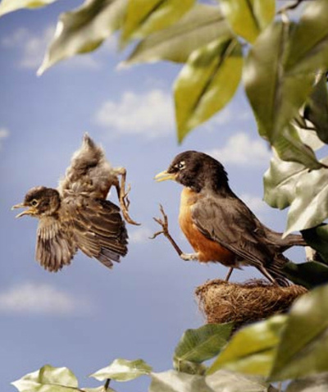
Life Cycle of a Bird
When a baby bird is ready to try to fly for the first time because its wing muscles have grown stronger, it is called a ‘fledgling’.

Slide 6
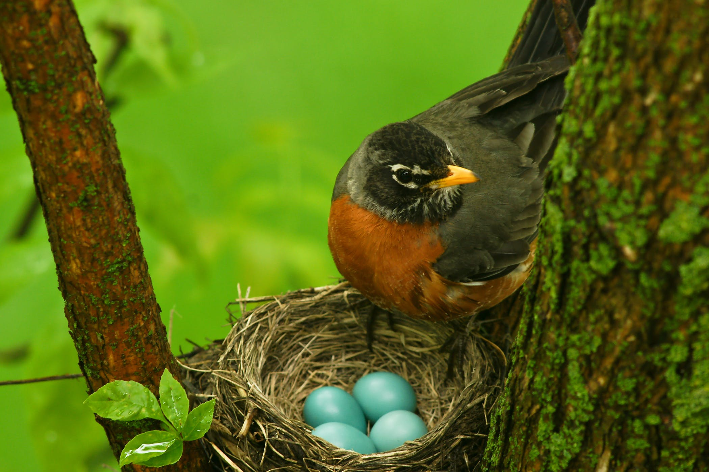
Life Cycle of a Bird
Finally, when the fledgling stops growing, it becomes an adult bird. It looks for a mate, builds its own nest and hatches eggs of its own so the cycle starts again.

