Slide 1
LI: To retell a traditional tale.
English
To develop our three new characters by acting as them.

Slide 2
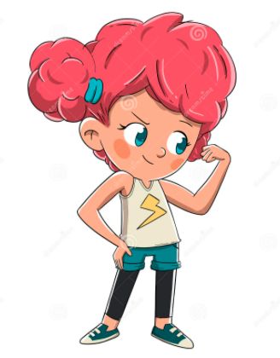
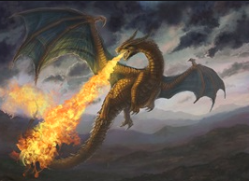
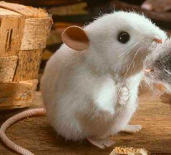
Here are my new characters:
Pip
Dragon
Mouse

Slide 3
I am Pip!
Let me tell you about me:
I am brave
I have pink hair
I love to run
Books are fun
Pip

Slide 4
I am Dragon!
Let me tell you about me:
I am fierce
I have golden wings
I love to fly
Eating ducks is fun
Dragon

Slide 5
I am Mouse!
Let me tell you about me:
I am small but I am brave
I like to sing happy songs
Cheese is my favourite food
Dragons scare me a lot
Mouse

Slide 6
Your turn:

Slide 7
Your turn:

Slide 8
Your turn:

