Slide 1

Year 5
Art

Slide 2
29.1.21
Learning Objective
To remind ourselves who the artist Akie Nakata is
To recreate her art work using sketching

Slide 3
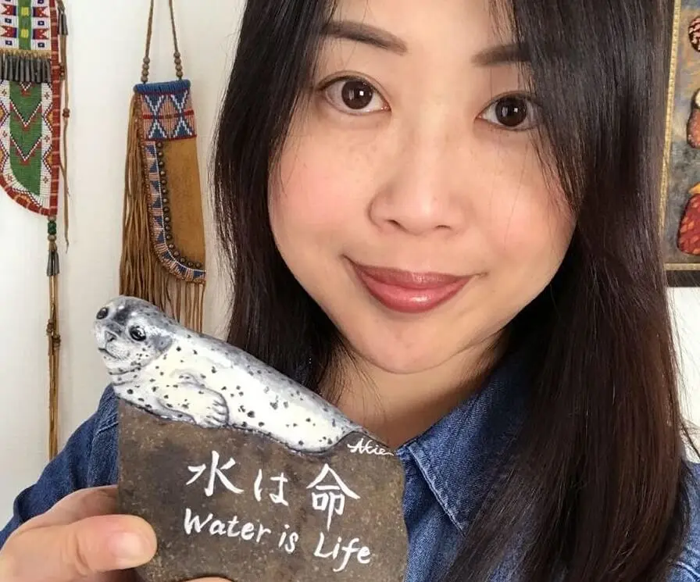
Let’s remember who the artist Akie Nakata is.

Slide 4
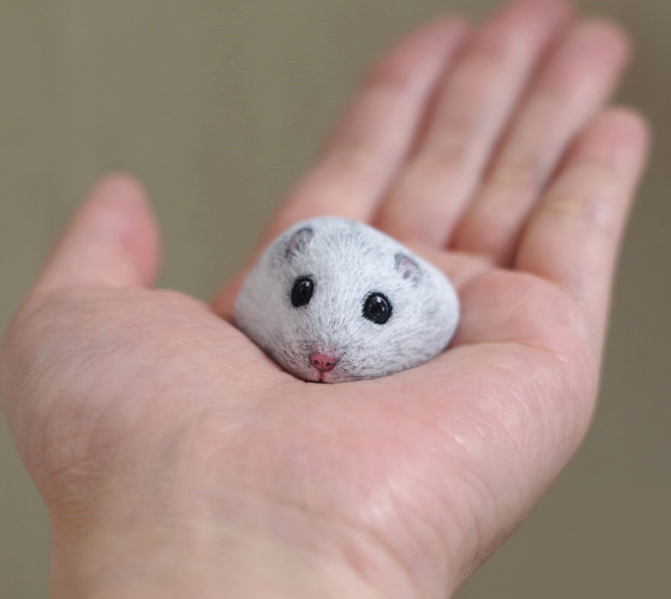
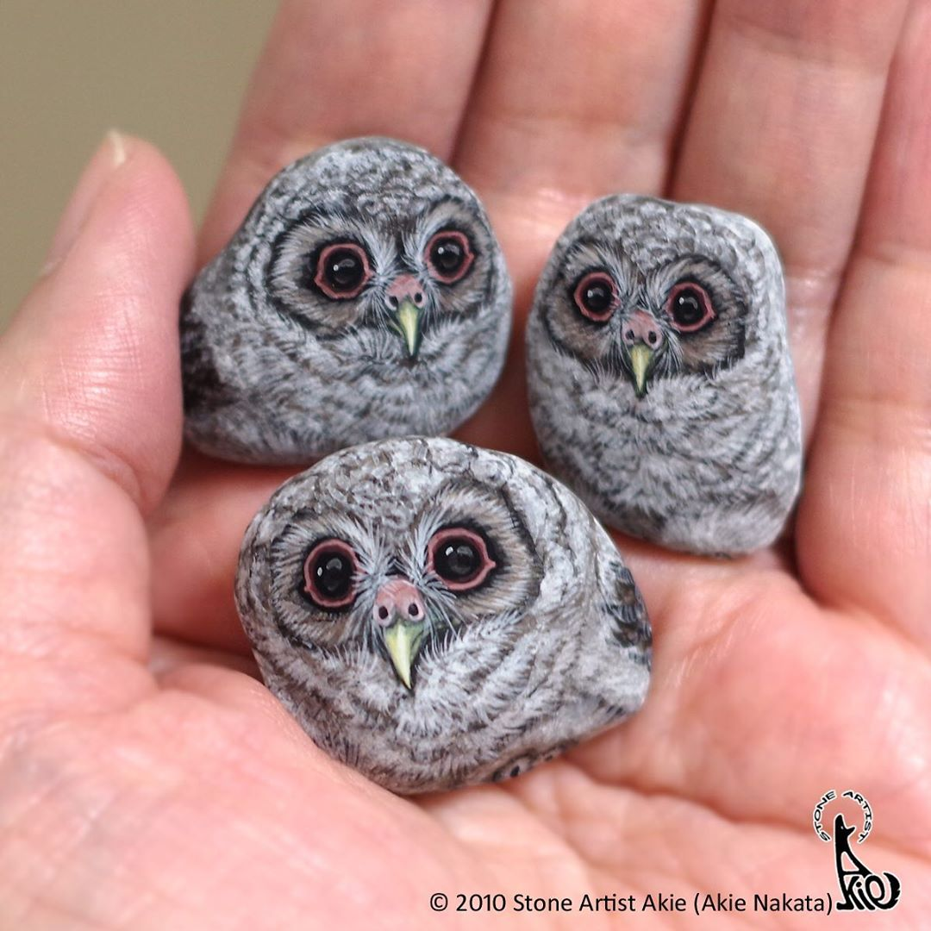
Akie creates animals on stones through sketching and painting.

Slide 5
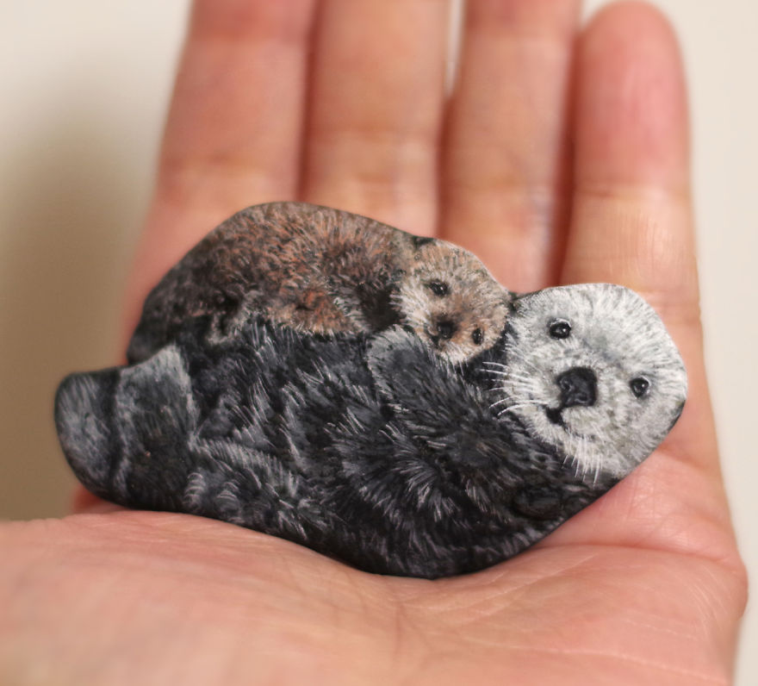
Akie looks at the stones and imagines which animals she can create using small brushes and acylic paints.

Slide 6
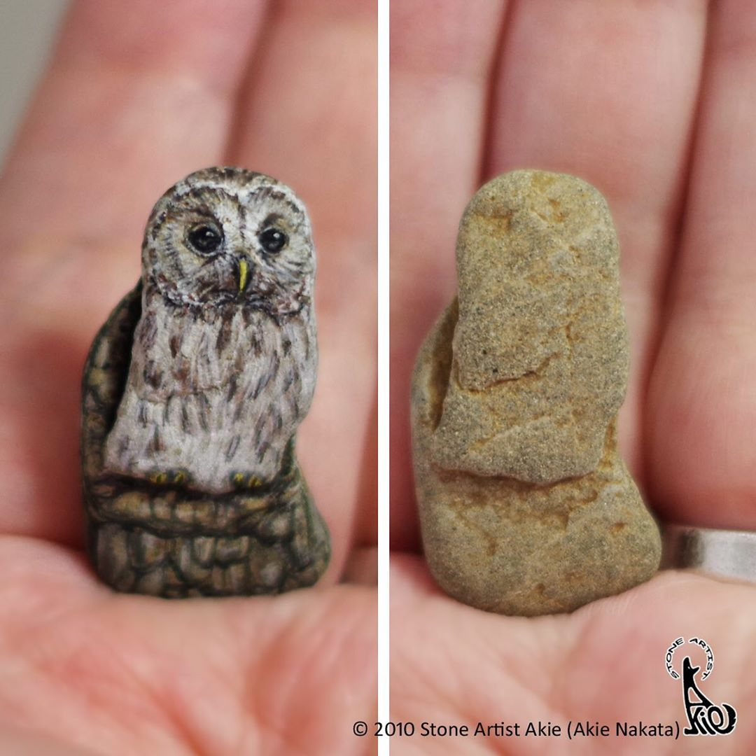
Lets remind ourselves what the before and after stone looks like.

Slide 7
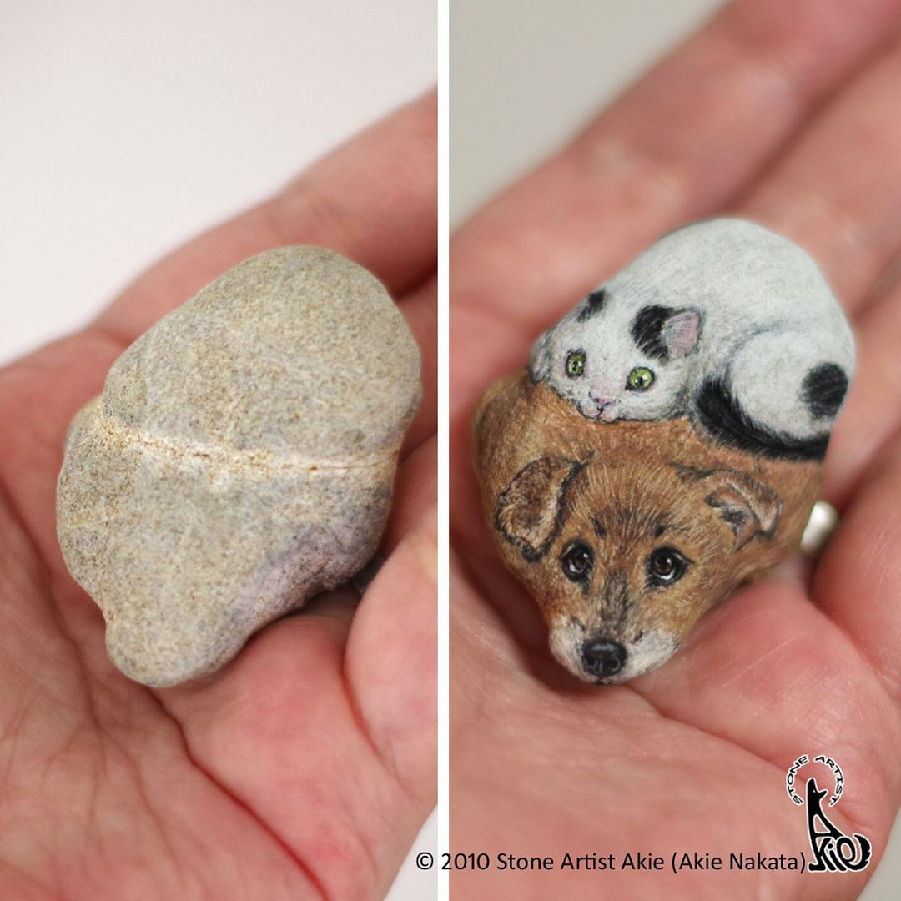

Slide 8
We are going to recreate an animal using sketching.

Slide 9
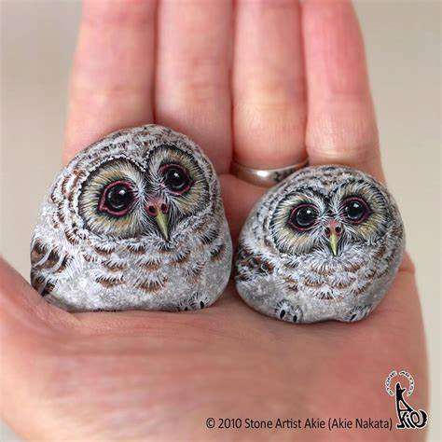
Lets look at the owls that Akie has created. What do you notice? Where is the sketching darker? How do we achieve that effect?

Slide 10
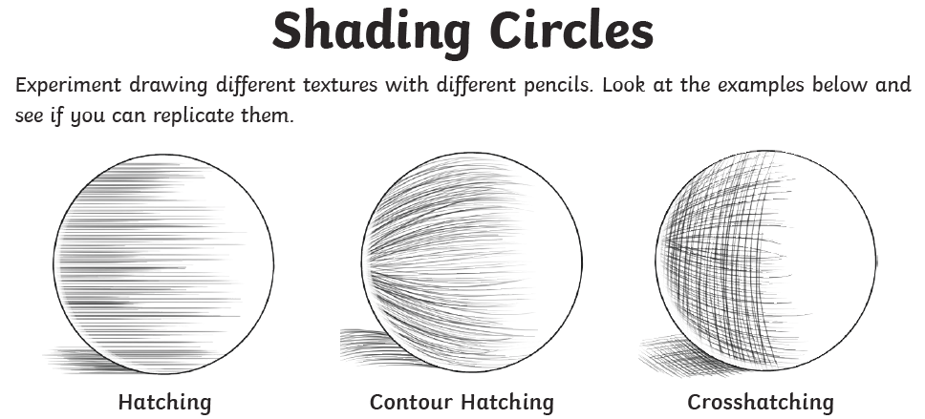
Lets remind ourselves of some shading techniques.

Slide 11

Could you have a go at creating hatching, contour hatching and crosshatching?

Slide 12
Now let’s look again at Akie’s art work and create a similar piece of work.

Slide 13


