Slide 1

Learning intention
Past and present tense

Slide 2


Present - something that is happening NOW, this second!

Slide 3
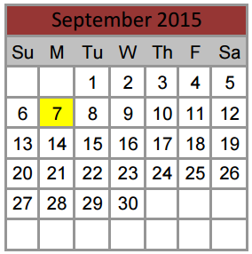
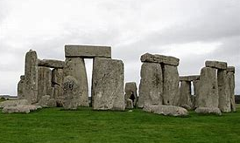

Past - something that has already happened
yesterday
today
Two minutes ago
This morning
Yesterday
Last week
A year ago
Thousands of years ago!
x

Slide 4
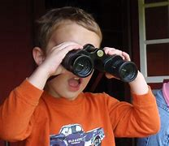
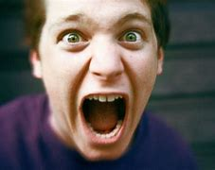


Most words ending –ed are past tense verbs
Look looked
Shout shouted
Walk walked
Move moved

Slide 5
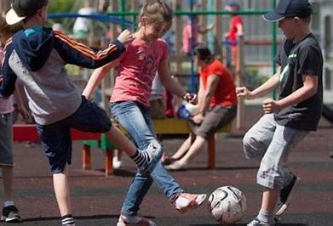
now yesterday
We play football.
We played football.

Slide 6
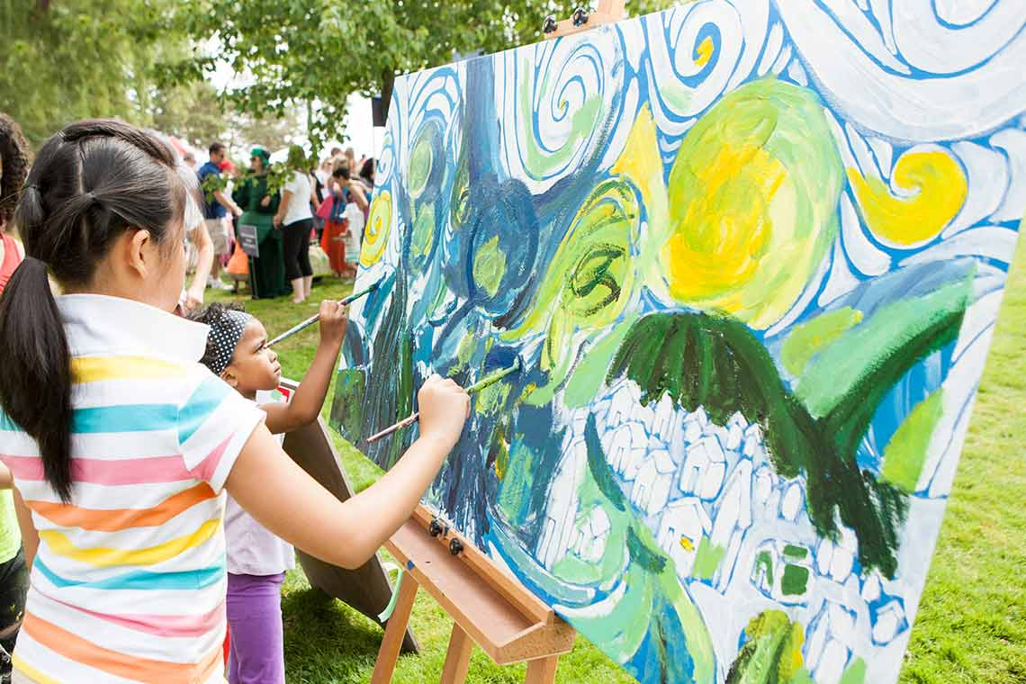
now last week
We paint a picture.
We painted tag.

Slide 7
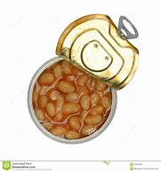
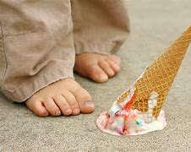
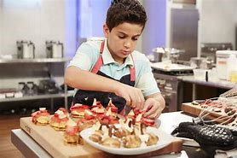

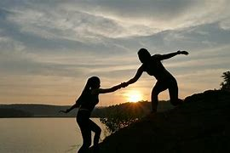
Task – which two words go with each.
drop
dropped
open
opened
Cook
cooked
cook kiss
help dropped
opened open
kissed cooked
drop helped
Help
helped
Kiss
kissed

Slide 8
Sometimes past tense verbs DO NOT end -ed
Run ran
Fall fell
Eat ate
Catch caught
Sing sang

Slide 9
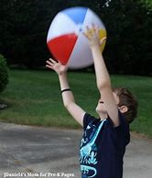
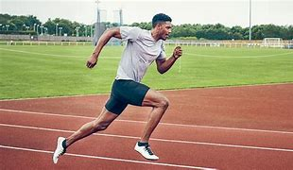
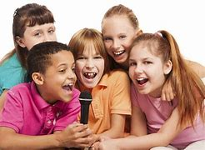
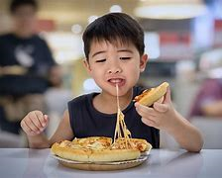
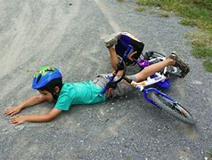
Task 2 – which verbs go with which picture?
Run
ran
Catch
caught
run fall
fell catch
ran sang
ate caught
sing eat
Sing
sang
Eat
ate
Fall
Fell

