Slide 1
Oh Otto
Final chapter

Slide 2
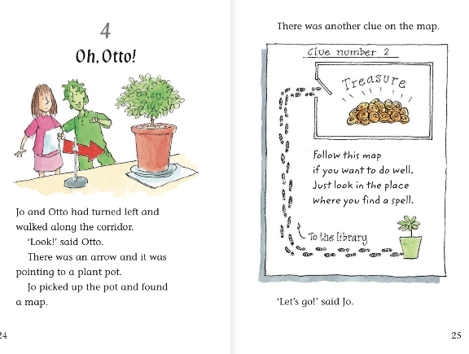
Can you remember why no-one else had found the second clue?
What room is the treasure hidden in?

Slide 3
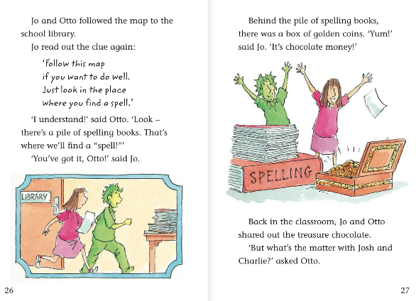
3) What was the treasure the two children found?
4) What word tells you that Jo and Otto were kind?

Slide 4
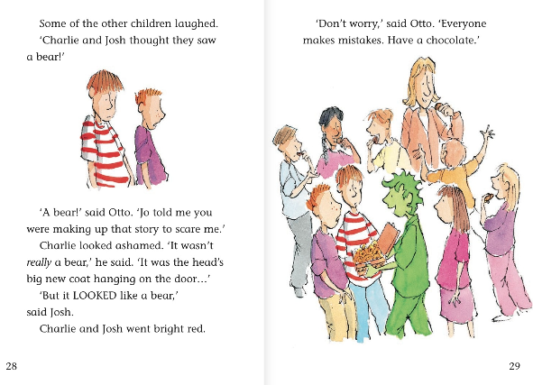
5) What does the word ‘ashamed’ mean?
6) Why did the two boys turn bright red? What emotion would you call that?

Slide 5
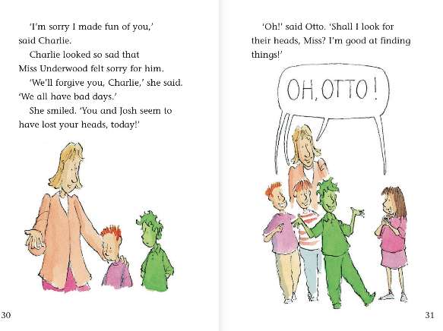
7) Why did Miss Underwood forgive Charlie?
8) What does it mean when it says the boys had ‘lost their heads’?

