Slide 1
Learning intention: To learn about time.

Slide 2
Today we are going to learn about ordering our day. First, I am going to show you the order of my morning.

Slide 3
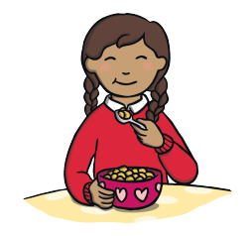
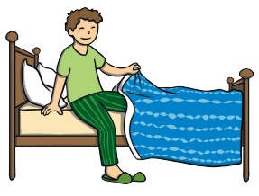
The order of my morning.

Slide 4
Can you tell your grown up the order of your morning?

Slide 5
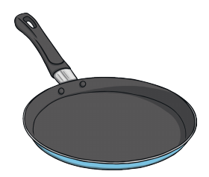
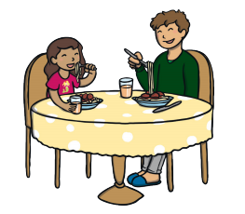
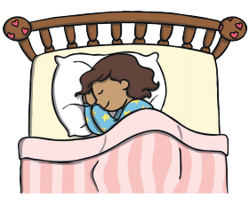
The order of my evening.

Slide 6
Can you tell your grown up the order of your evening?

