Slide 1
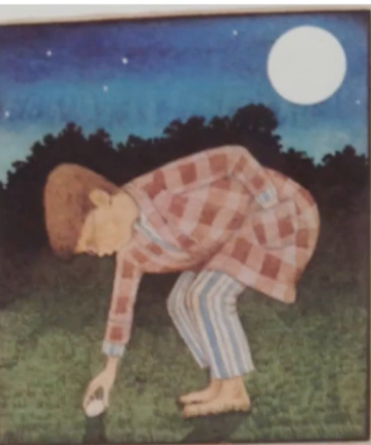
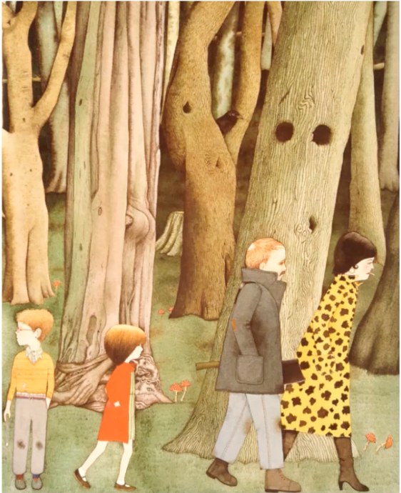
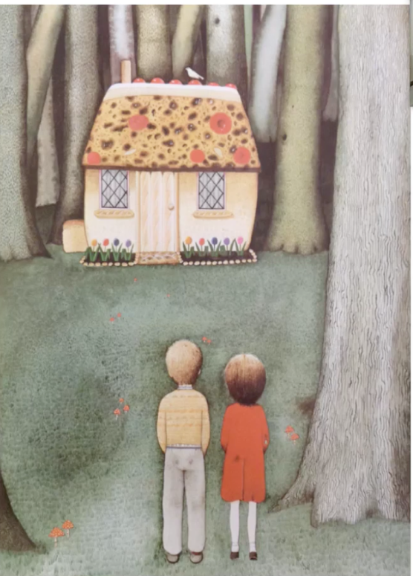
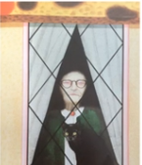
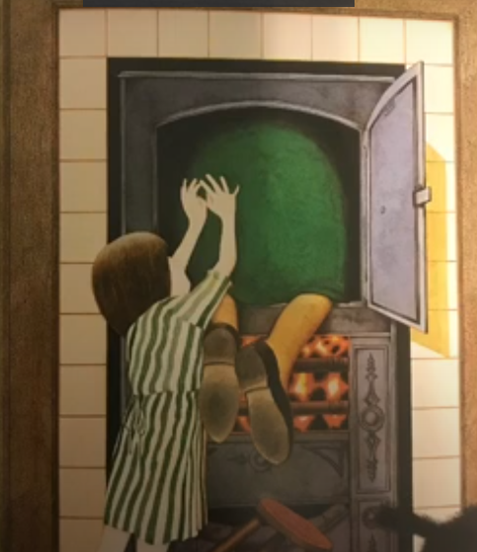
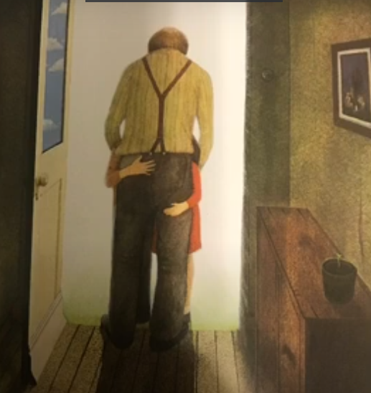

Learning intention: to write a witch story
Think about what happens in the beginning of the story.
What happens in the middle of the story?
What happened at the end?

Slide 2
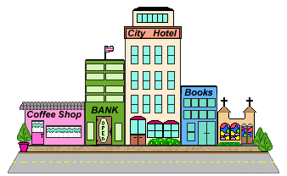
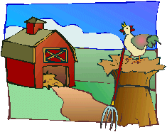

You are going to write your own witch story using some of the ideas from Hansel and Gretel.
You are going to change the setting – where might Hansel and Gretel be lost in your story?

Slide 3
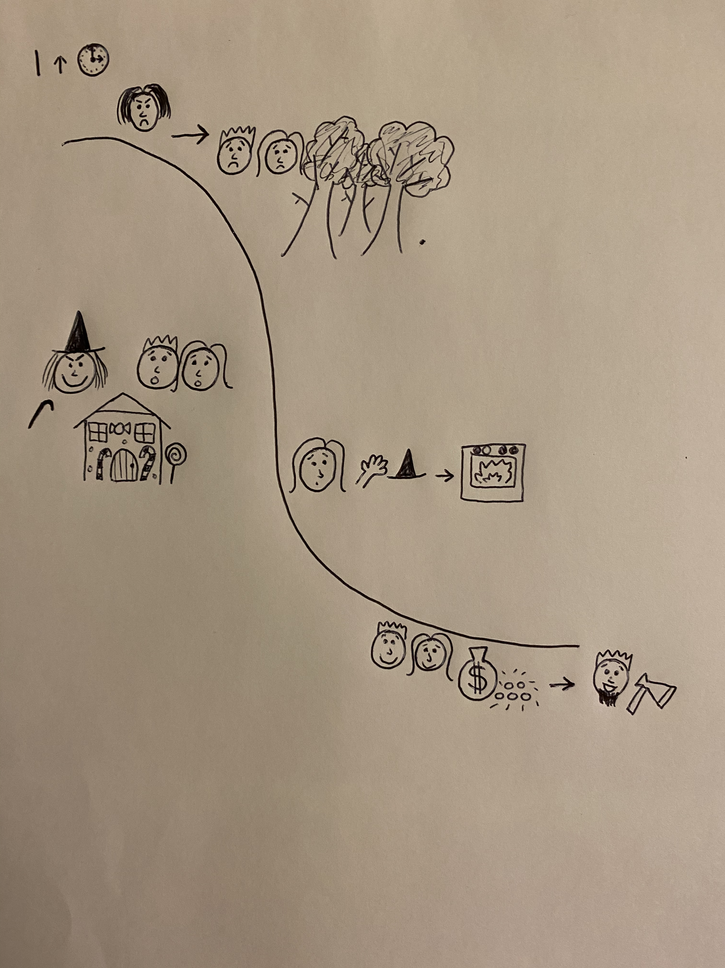
Use the story map and add pictures to show the beginning, middle and end of the story.
Your map might look something like this:
Setting
???
Beginning
Middle
End

Slide 4


