Slide 1
Nouns

Slide 2
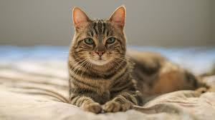
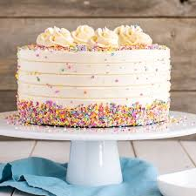
What is a noun?
Nouns are words that name things.
Common nouns are everyday words for things
lo
cake girl cat

Slide 3
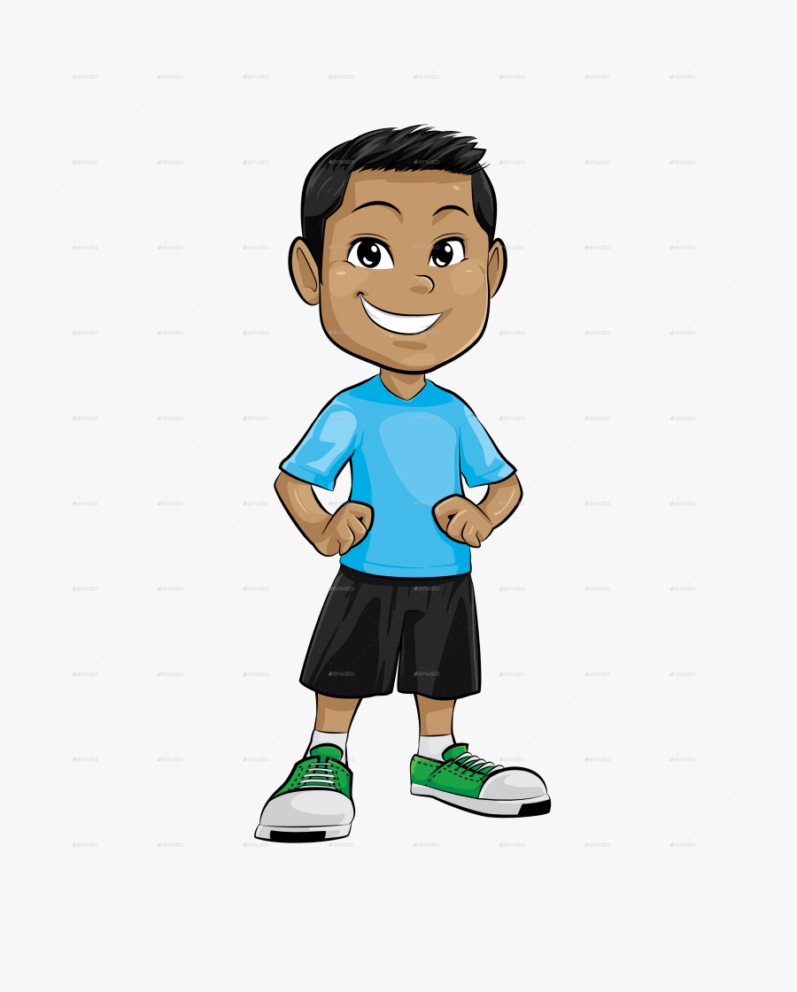
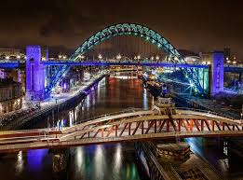
Proper nouns
Proper nouns are names for particular people, places or things.
Here are some examples
Monday
Tuesday
Wednesday
Thursday
Friday
Saturday
Sunday
Monday
Jack
Newcastle

Slide 4
Can we spot the nouns?
lion
England
she
pen
man
fast
run
Sarah
pizza
Friday

Slide 5
Can we spot the nouns?
lion
England
she
pen
man
fast
run
Sarah
pizza
Friday

Slide 6
Can we match the nouns to the correct label?
game
Wednesday
tree
money
Common nouns
Proper nouns
London
house
dog
Anna
January
book

Slide 7
Can we match the nouns to the correct label?
game
Common nouns
Wednesday
tree
money
London
house
dog
Proper nouns
Anna
January
book

Slide 8
So to recap
A noun is a naming word.
A common noun is the name of a “thing”.
A proper noun is the name of a person or a place, and needs a capital letter.
Now complete your written task Identify Nouns.

