Slide 1


Focus sound:
c - Make a curve.

Slide 2
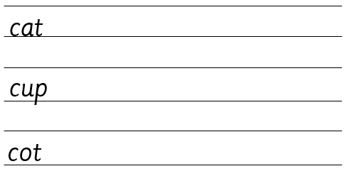
Your turn! Write c in your book using the lines.
Then try:

