Slide 1

Maths
Learning Intention: To translate shapes on a grid

Slide 2
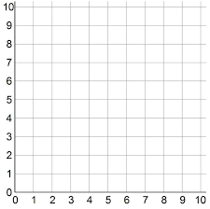

Slide 3






Translate this triangle 2 squares right and 4 squares down.

Slide 4








Translate this rectangle 1 square left and 3 squares up.

