Slide 1
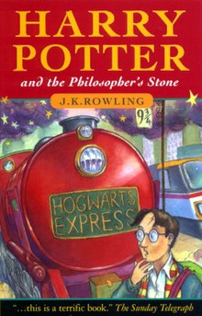
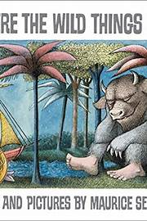

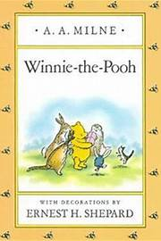
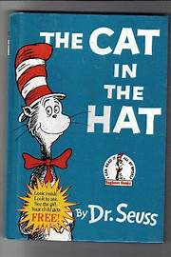
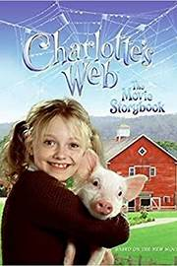
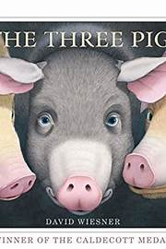
World Book Day
4th March 2021

Slide 2


What is World Book Day?
World Book Day began in 1998.
It is now celebrated every year in the month of March.
The aim of it is to celebrate authors, books, illustrators and - of course - reading!
All children in full time education are given vouchers on this day to spend on new books.

Slide 3

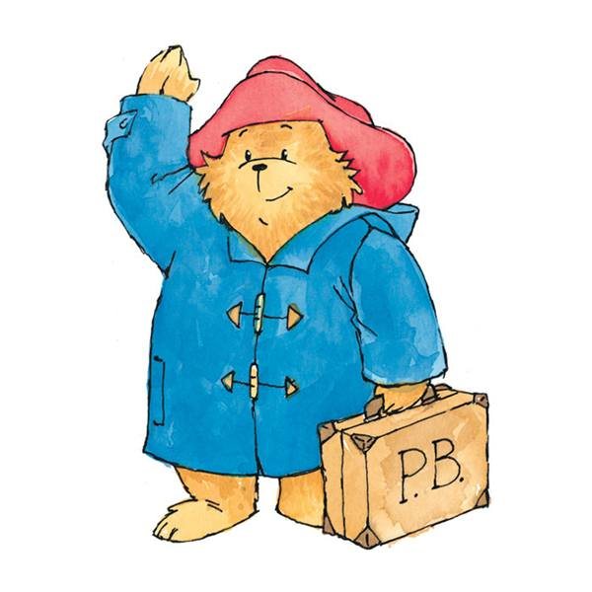

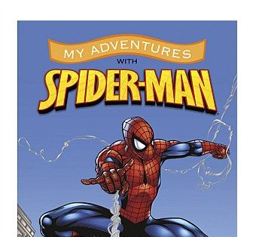
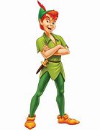
How is World Book Day celebrated?
There are lots of different ways to celebrate World Book Day.
Many schools have special events planned for it - whether it's a trip to the local library, classroom displays of famous literary characters or book-themed activities in lessons.
Many children dress up as their favourite story book characters.

Slide 4
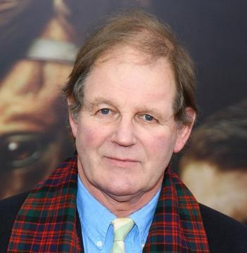
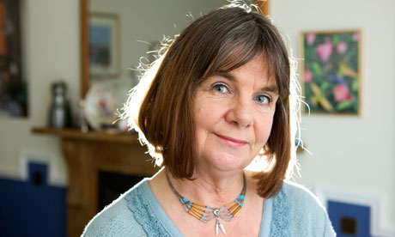


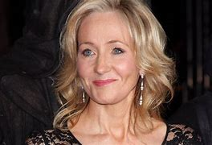
Well known Children’s Authors
Michael Morpurgo grew up in London during a war there. He was a teacher, but the book Poetry in the Making by Ted Hughes, made him decide to write instead of teaching. He is the author of over one hundred books, mostly for children, many of which have given many prizes and awards. Five of his books have been made into films.
Julia Donaldson is an English writer, playwright and performer. She is best known for her popular rhyming stories for children, especially those illustrated by Axel Scheffler, which include The Gruffalo.
David Edward Williams, known professionally as David Walliams, is an English comedian, actor, writer, and television personality. He is best known for his work on comedy shows and since 2012, he has been a judge on the television talent show competition Britain's Got Talent. He is a writer of children's books, having sold more than 37 million copies worldwide.
J.K. Rowling, is a British author and screenwriter best known for her seven-book Harry Potter children's book series. The series has sold more than 500 million copies and was adapted into a blockbuster film franchise.

Slide 5
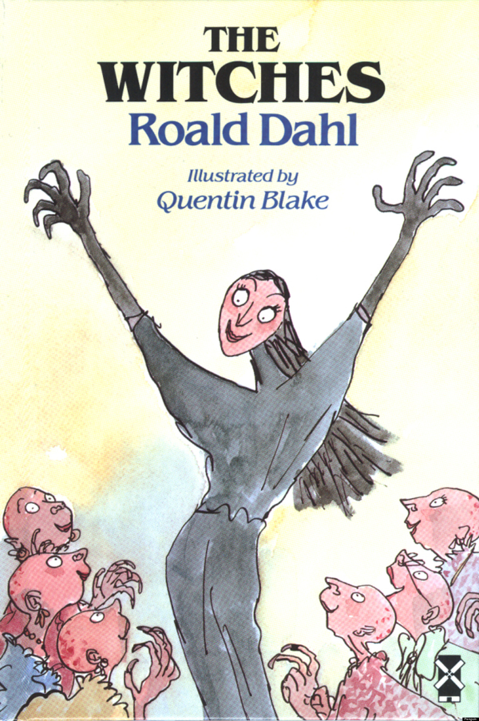
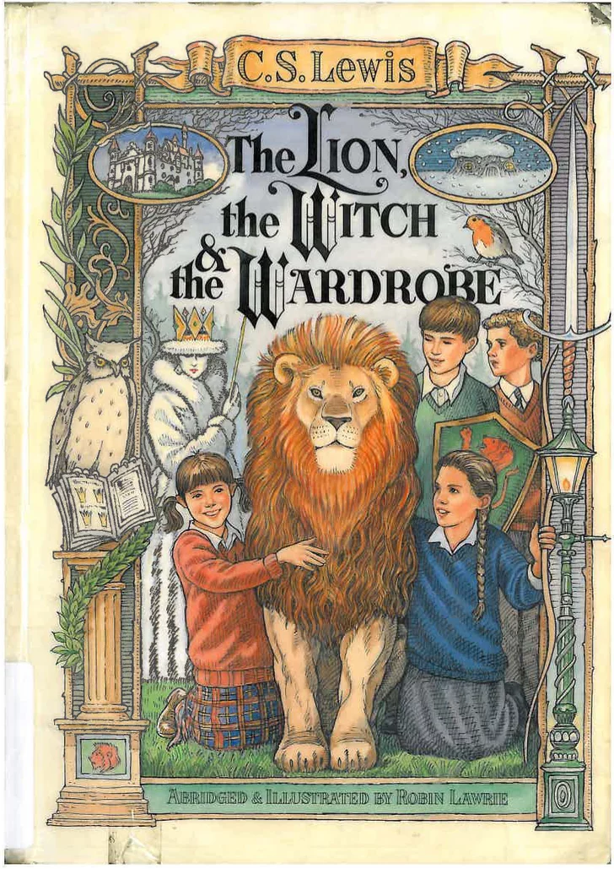
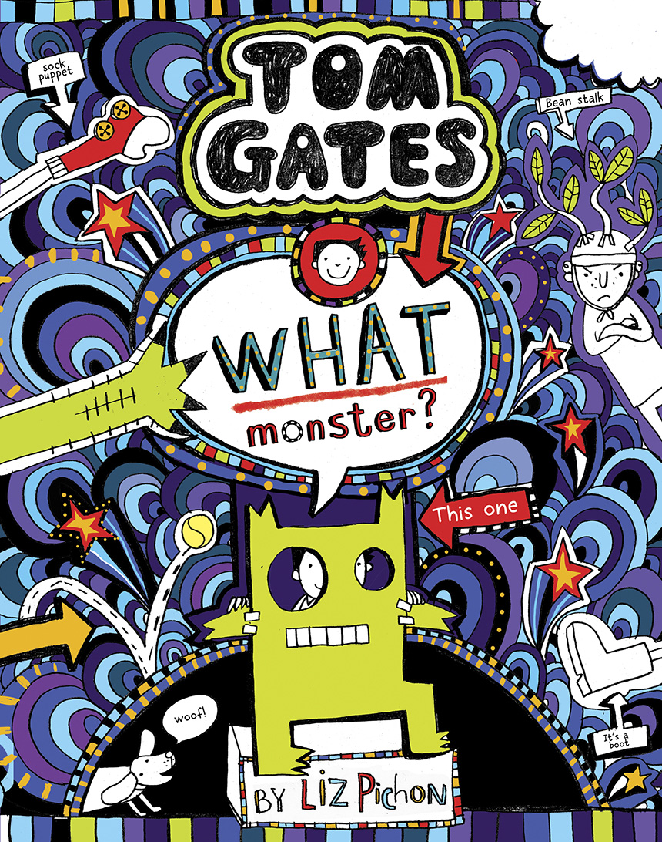
Well known Children’s Books
The Witches tells the story of a brave young boy and his Norwegian grandmother as they battle against England's child-hating witches. It continues to feature in lists dedicated to the scariest children's books more than 30 years after it was first published.
The Lion, The Witch, and The Wardrobe - Peter, Susan, Edmund, and Lucy are four siblings sent to live in the country with Professor Kirke during World War II. The children explore the house on a rainy day and Lucy, the youngest, finds an enormous wardrobe. Lucy steps inside and finds herself in a strange, snowy wood.
This book is from the Tom Gates series and is about monsters, mystery, a music festival and something important going missing. It involves a very strict supply teacher who is every child’s nightmare or could that be the monster?

Slide 6
Quiz!
Using the information from the PowerPoint, answer the quiz questions all about World Book Day!
In what year did World Book Day begin?
Which month is it held in?
What are children given on World Book Day?
What is the aim of this day?
Name three ways in which World Book Day is celebrated?
What sort of stories is Julia Donaldson best known for?
Name the book and the author that inspired Michael Morpurgo to write books?
How many copies of books has David Walliams sold worldwide?
What is the author J. K Rowling best known for?
Which list does The Witches still feature in 30 years after it was released?
In The Lion, the Witch and the Wardrobe, where does Lucy find herself aster stepping into the wardrobe?
Who could be the monster in the Tom Gates book?

