Slide 1
Learning intention: multiply numbers

Slide 2
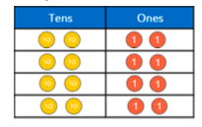
Repeated addition
To complete more difficult multiplication sums we can use our understanding of repeated addition.
For example:
22 + 22 + 22 + 22 = 88
22 x 4 = 88
80 8

Slide 3
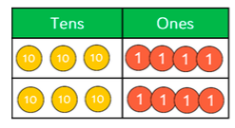
Repeated addition
Try this one:

Slide 4
Repeated addition
Answer:
34 + 34 = 68
34 x 2 = 68
60 8

Slide 5
We can then apply this to use the formal method of multiplication.
For example:
34 x 2 = 3 4
x 2

Slide 6
We can then apply this to use the formal method of multiplication.
First 3 4
x 2
4 x 2 = 8
30 x 2 = 6 0

Slide 7
We can then apply this to use the formal method of multiplication.
Then 3 4
x 2
8
8 + 60 = 68 6 0
6 8
+

Slide 8
Try this one:
42 x 3 = 4 2
x 3

Slide 9
Answer:
4 2
x 3
6
6 + 120 = 126 1 2 0
1 2 6
+

Slide 10
Task
Try these ones using short multiplication:
43 x 3 = 2. 81 x 4 = 3. 32 x 5 =
4. 31 x 8 = 5. 32 x 2 = 6. 54 x 2 =

