Slide 1
Reading
LO: To infer a character’s emotions and personality

Slide 2
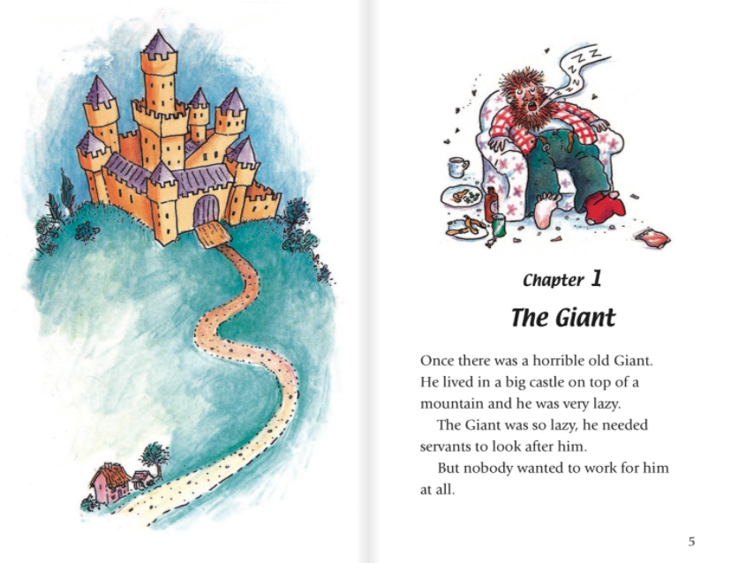
1.Why did the giant need servants?
2. Why do you think nobody wanted to work for him?

Slide 3
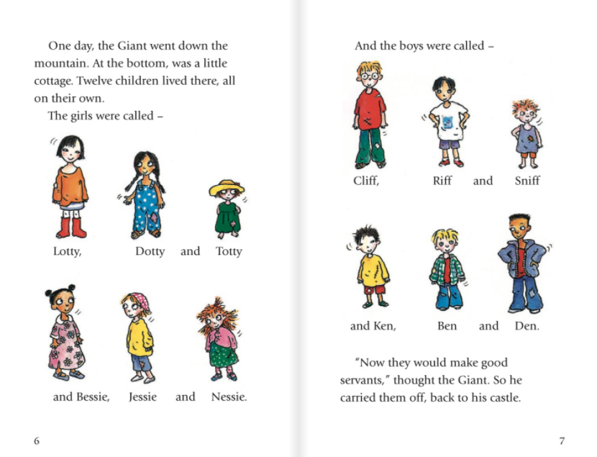
3. How do you think the Giant felt when he saw the children?
4. How do you think the children felt when the Giant carried them to his castle?

Slide 4
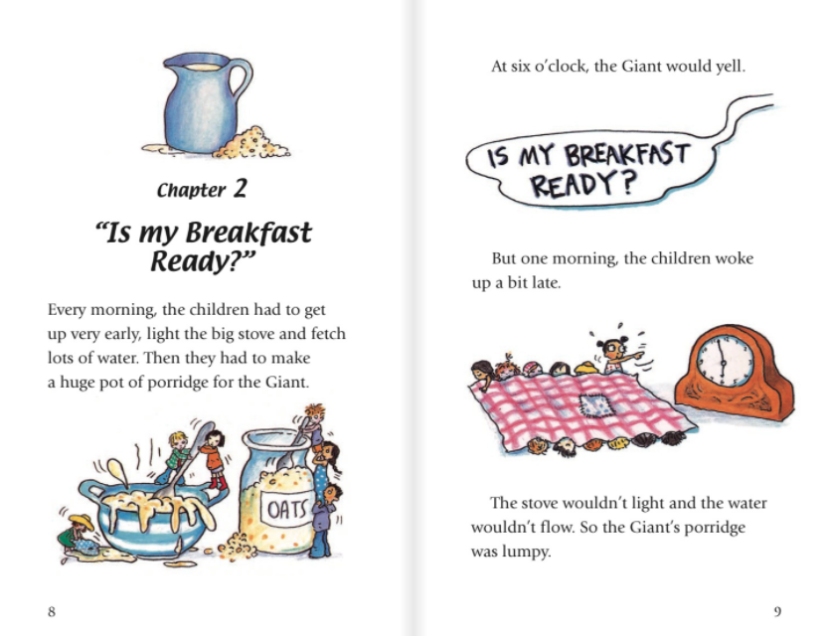
5. How do you think the Giant felt when his porridge was lumpy?

Slide 5
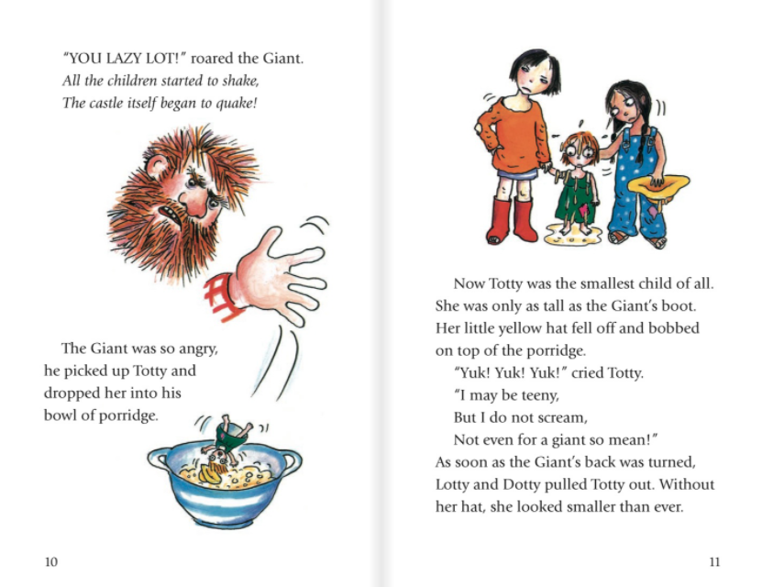
6. How do you know that Totty was brave?

