Slide 1

Learning Intention:
To recap ‘Peter and the Wolf’.
English
To recap the story of Peter and the Wolf.

Slide 2
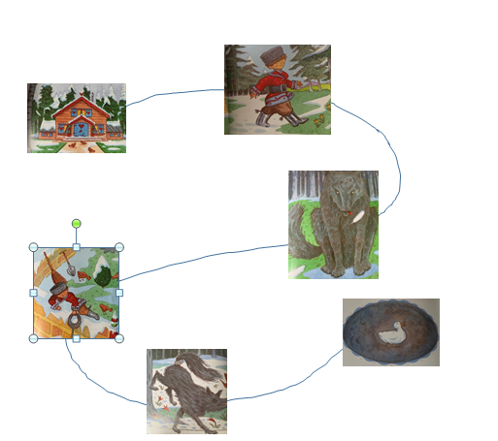
Listen back to the original story of ‘Peter and the Wolf’.

Slide 3
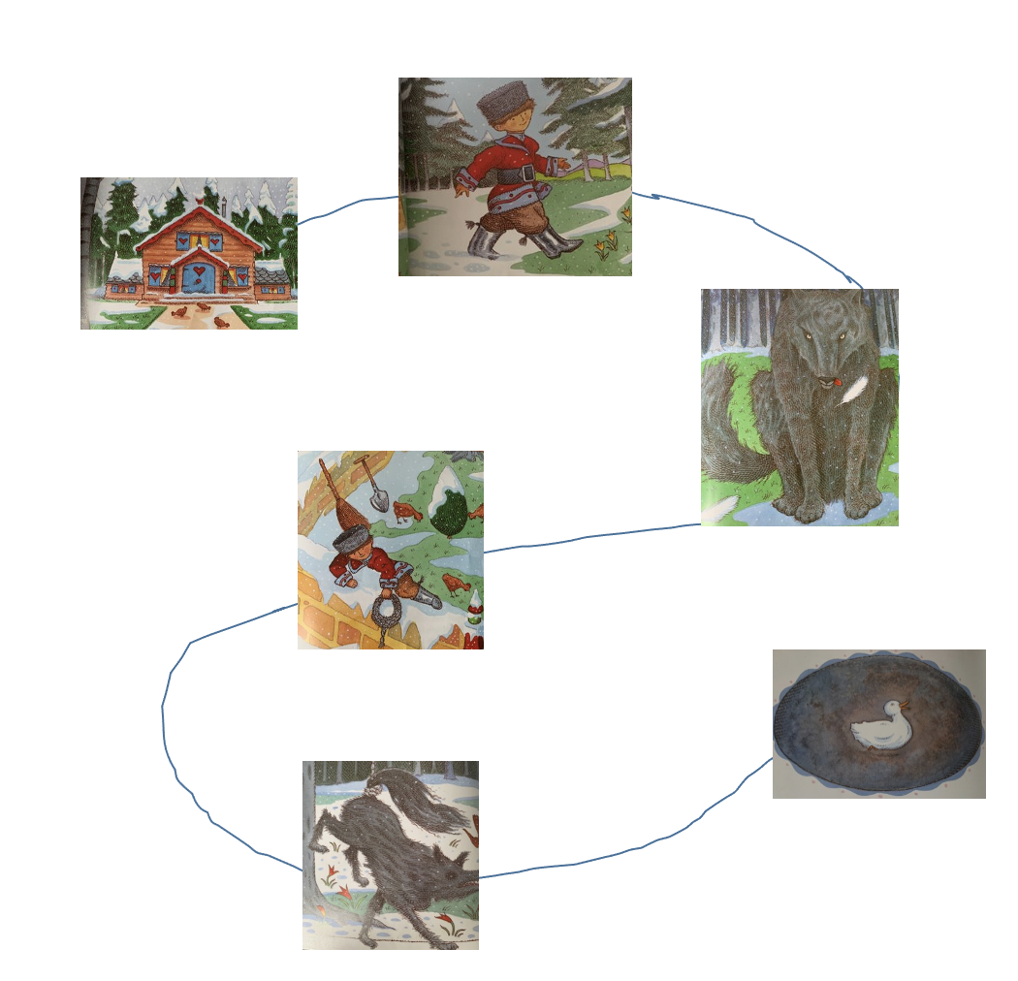
Spot the difference:

Slide 4
Spot the difference:

Slide 5
What is missing?

Slide 6
What is missing?

Slide 7
Use the story map to check your answers!

