Slide 1

Learning Intention:
To find verbs

Slide 2
What is a verb?
A verb is a doing word.
Verbs are actions that you can do.
Today we’re going to think of as many verbs as we can!

Slide 3
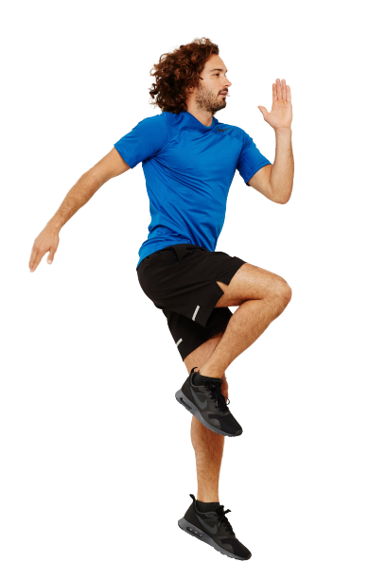
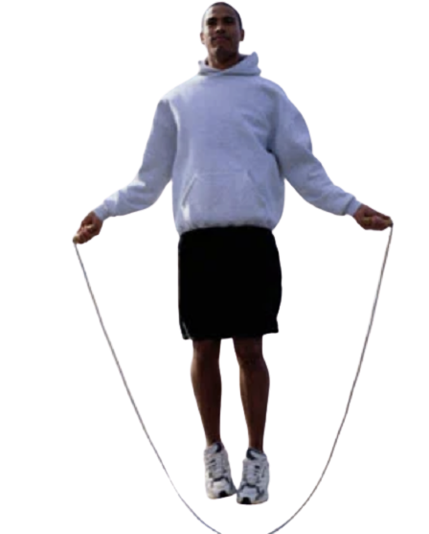
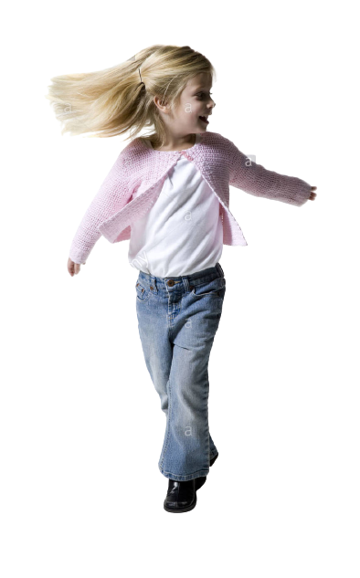
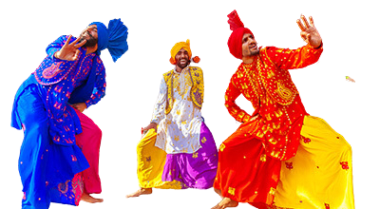
hop
swim
run
dance
skip
spin
Notes:
How can we move? Fred talk the word and then draw each verb when the picture is missing.

Slide 4
Your turn:
Notes:
Now it’s your turn. Can you draw a picture of other ways that we can move our bodies?

Slide 5
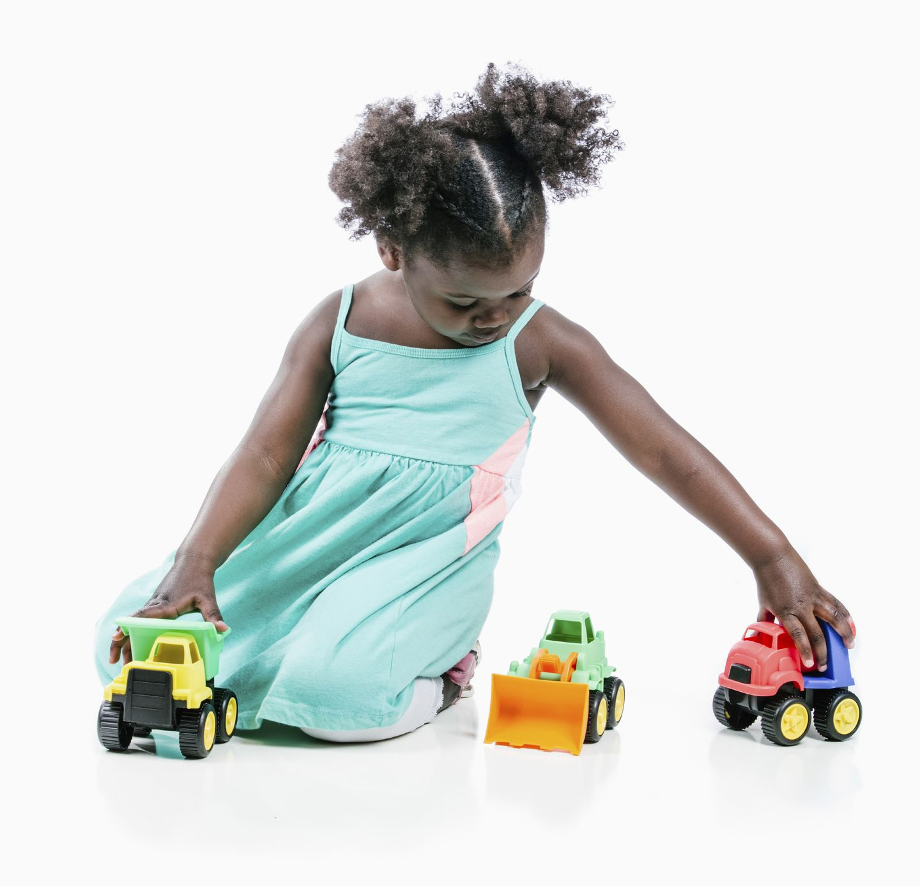
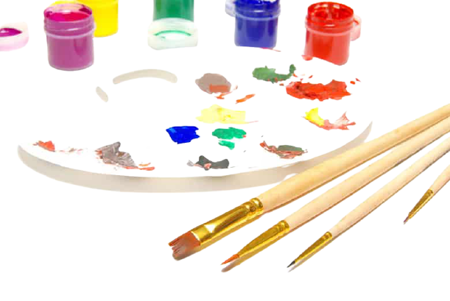
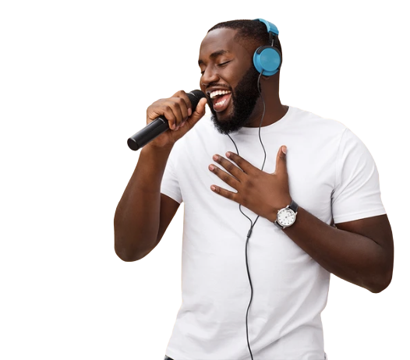

paint
sleep
play
sing
read
cook
Notes:
These are things that we can do, I have written verbs for you, you need to Fred talk them in your head this time and then draw the missing pictures in the boxes.

Slide 6
Your turn:
Notes:
Now it’s your turn. Can you draw pictures of other things that we can do?

Slide 7
Verb Bank:
Add your verbs here:
hop
swim
run
dance
skip
swim
paint
sing
sleep
play
cook
read
Notes:
Wow! You have found so many verbs today. I have put the ones so far into a verb bank. Can you write your verbs under the red title? Use your Fred fingers to help you sound out the word to write it.

Slide 8
Your turn:
Make a poster all about verbs using the verb bank.
Draw different verbs around the circle and word in the middle of the page.

Slide 9
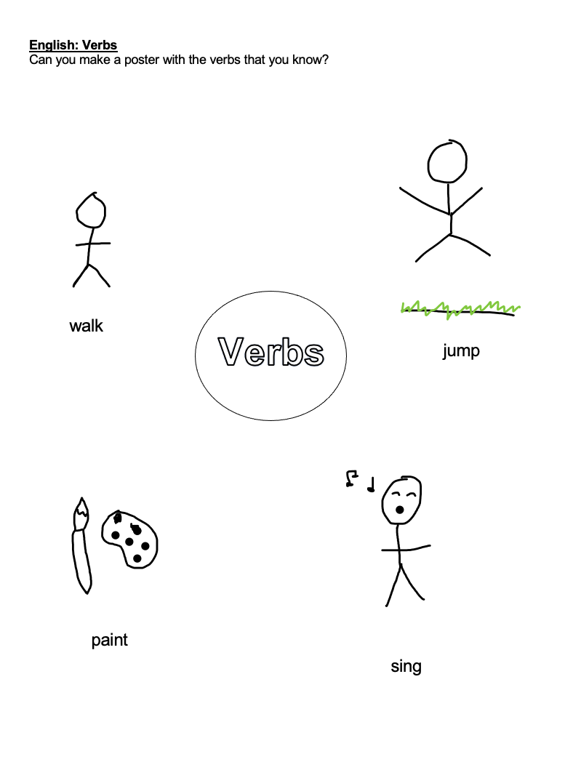
Example:

Slide 10
Commentary:
Slide 3:
How can we move? Fred talk the word and then draw each verb when the picture is missing. Let’s do the first one together. H-o-p, h-o-p… hop! Let’s Fred talk the next one, s-w-i-m, s-w-i-m… swim! Now you need to draw someone swimming.
Slide 4:
Now it’s your turn. Can you draw pictures of other ways that we can move our bodies?
Slide 5:
These are things that we can do, I have written verbs for you, you need to Fred talk them in your head this time and then draw the missing pictures in the boxes.
Slide 6:
It’s your turn to draw a verb, something that we can do. Use the clues to help you if you need them.
Slide 7:
Wow! You have found so many verbs today. I have put the ones so far into a verb bank. Can you write your verbs under the red title? Use your Fred fingers to help you sound out the word to write it.

