Slide 1
Learning intention: To learn about verbs.

Slide 2
I am going to show you some pictures, I want you to decide if it is a verb or not. Remember it is a verb if you can do it.

Slide 3
Jump. Is jump a verb? Can you jump?

Slide 4
Yes. Jump is a verb.

Slide 5
Sit. Is sit a verb? Can you sit?

Slide 6
Yes. Sit is a verb.

Slide 7
Door, is door a verb? Can you door?

Slide 8
No. Door is not a verb.

Slide 9
Read. Is read a verb? Can you read?

Slide 10
Yes. Read is a verb.

Slide 11
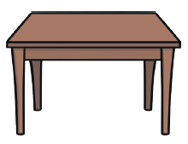
Table. Is table a verb? Can you table?

Slide 12
No. Table is not a verb.

