Slide 1
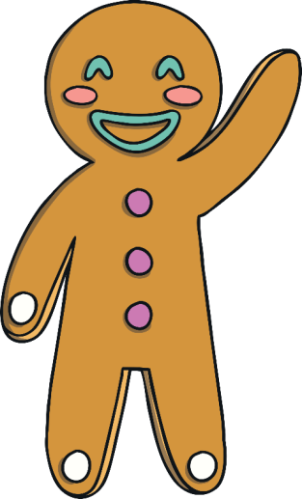
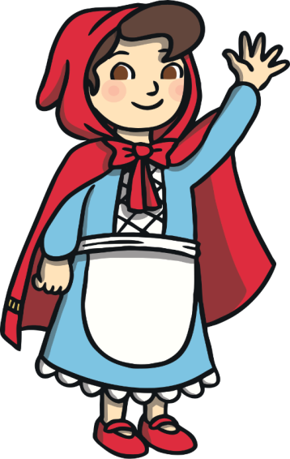
World Book Day Quiz

Slide 2
I am going to give you some clues, can you guess which traditional tale it is?

Slide 3
A biscuit runs away and is chased by lots of people and animals. He tries to cross over a river with the help of a sneaky fox. Which story is it?

Slide 4
That’s right! It’s the Gingerbread Man!

Slide 5
Some hungry goats want some grass to eat and decide to cross over a little bridge. Which story is it?

Slide 6
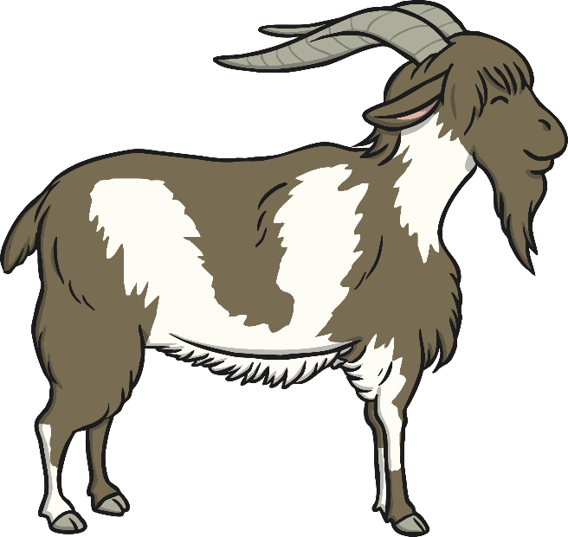
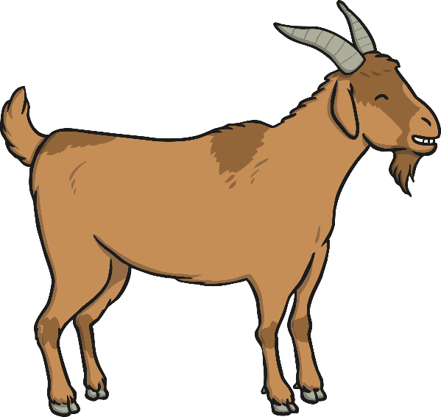
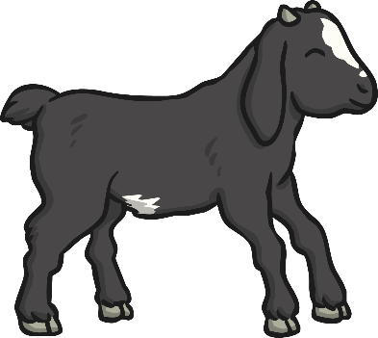
That’s right! It’s the Three Billy Goats Gruff!

Slide 7
A little girl visits her grandma who looks rather different. She seems to have furry ears, big eyes and a long nose! Which story is it?

Slide 8
That’s right! It’s Little Red Riding Hood!

Slide 9
A little girl goes into a cottage she finds in the woods. She eats some food, breaks a chair and goes to sleep in a little bed. Then the homeowners come back! Which story is it?

Slide 10
That’s right! It’s Goldilocks and the Three Bears!

Slide 11
A little boy grows an enormous beanstalk, finds a giant’s castle and a rather special goose. Which story is it?

Slide 12
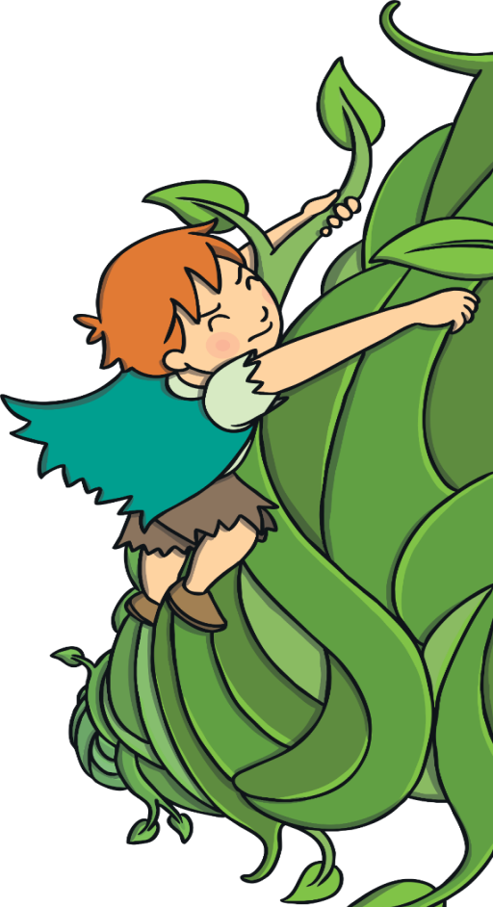
That’s right! It’s Jack and the Beanstalk!

