Slide 1
Today we are reading Rag the rat…

Slide 2
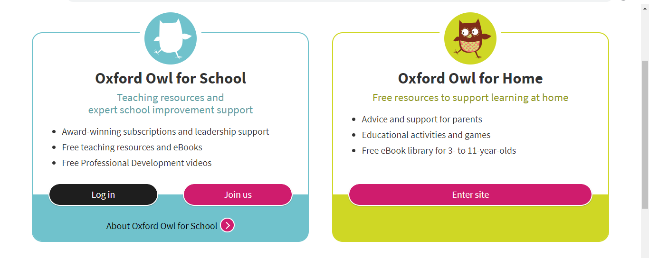
Go on to website www.oxfordowl.co.uk and click Log in.

Slide 3
Click on students and then enter your username and password, then Login.

Slide 4
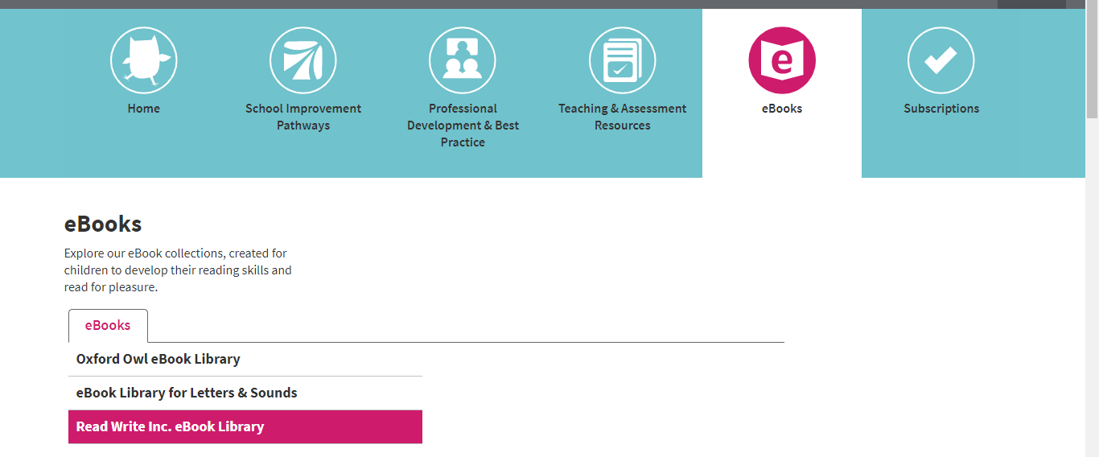
Click on eBooks & Read Write Inc.eBook Library.

Slide 5
Click on … Rag the rat.

Slide 6
Speed Sounds

Slide 7
Story Green Words

Slide 8
Story Red Words

Slide 9
Now it’s time to read the story …

Slide 10
Questions

Slide 11
Star checklist

