Slide 1
Learning Intention
To look at differences and similarities of nocturnal animals

Slide 2
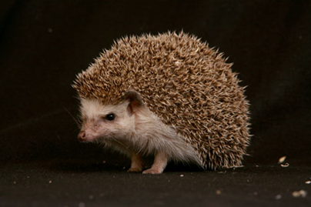
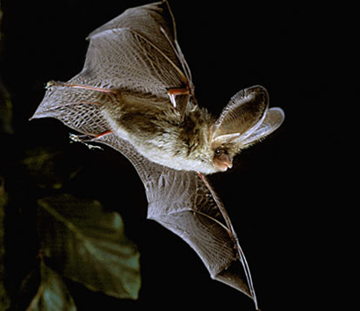
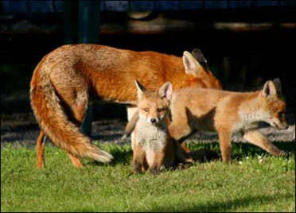
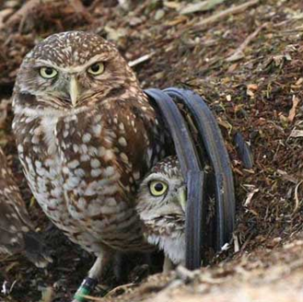
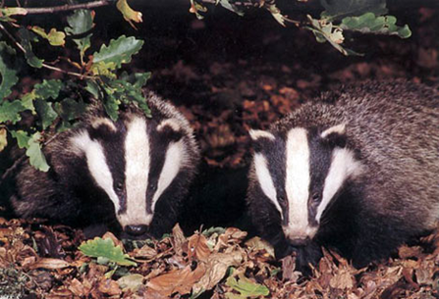
Nocturnal animals are animals that prefer to come out during the night. Some nocturnal animals can be seen during the day, others spend the whole day resting or sleeping.

Slide 3
Badgers

Slide 4
Bats

Slide 5
Foxes

Slide 6
Hedgehogs

Slide 7
Owls

