Slide 1
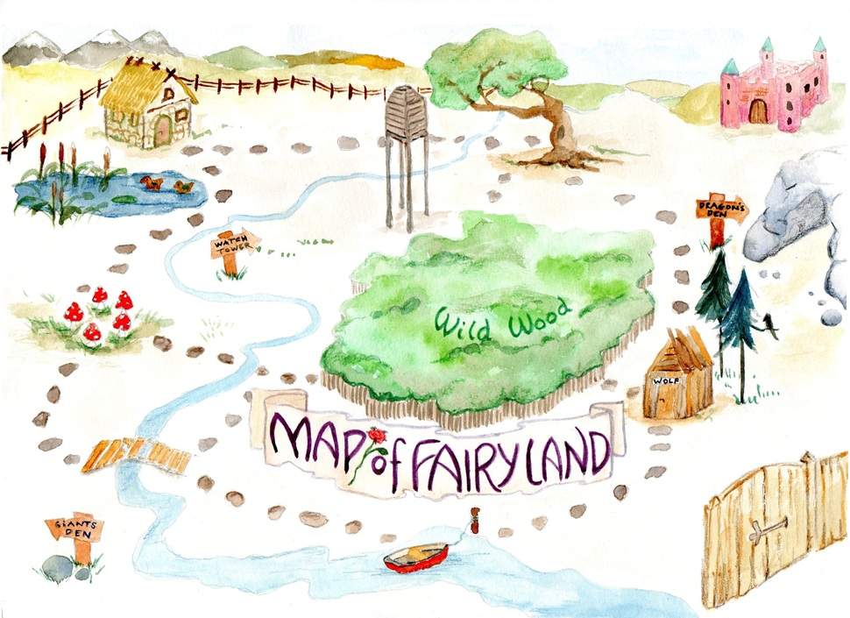
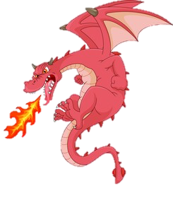
Learning intention: to plan instructions
You are going to be writing instructions for an adventure! Where will we go in Fairyland?

Slide 2
My idea: I want to run up the path.

Slide 3
My instructions map for a Fairyland adventure
path
. .

Slide 4
I want to go to the witch’s hut.

Slide 5
My instructions map for a Fairyland adventure
witch’s
. . .
path
hut
. .
. . .

Slide 6
I want to go in the ship.

Slide 7
My instructions map for a Fairyland adventure
witch’s
. . .
path
hut
. .
. . .
ship
. .

Slide 8
I want to go home.

Slide 9
My instructions map for a Fairyland adventure
witch’s
. . .
path
hut
. .
. . .
ship
. .

Slide 10
Complete the story map on the worksheet using the ideas we have talked about. There are more ideas on the sheet.

