Slide 1
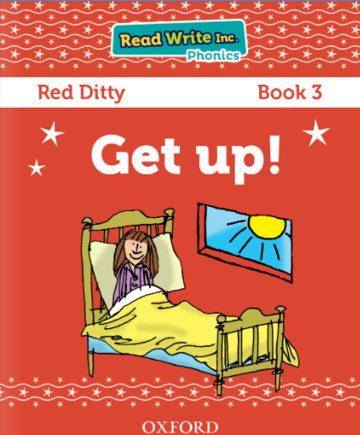

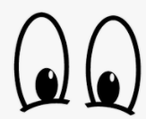
You are going to read the story ‘Get up!’.
Look at the picture
.
What can you see?
Why is the girl in bed?

Slide 2
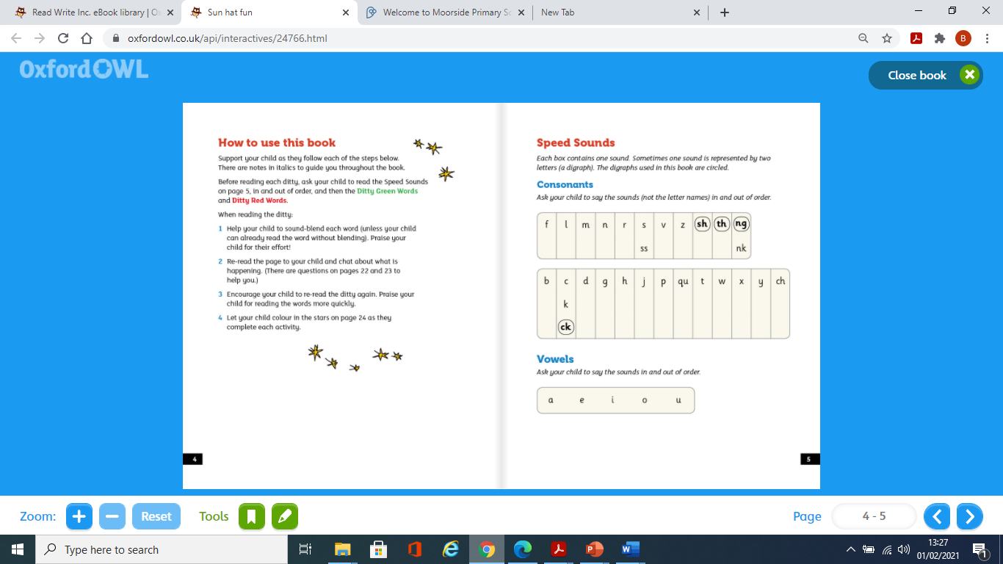

Slide 3
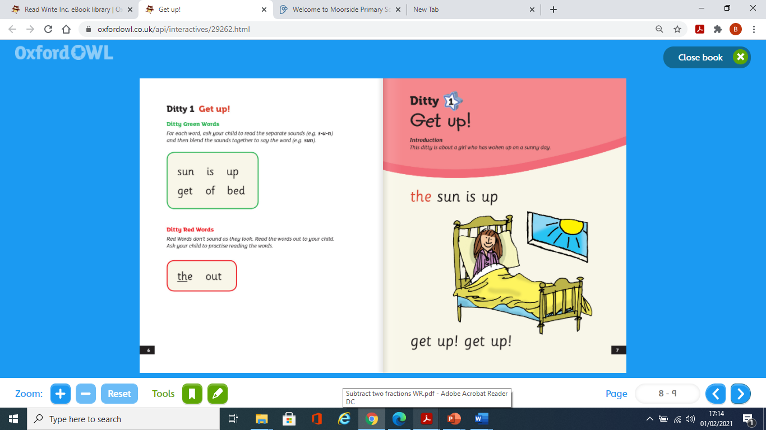

Slide 4
.
What can you see?
What is the weather like?
Why is the girl in bed?

Slide 5
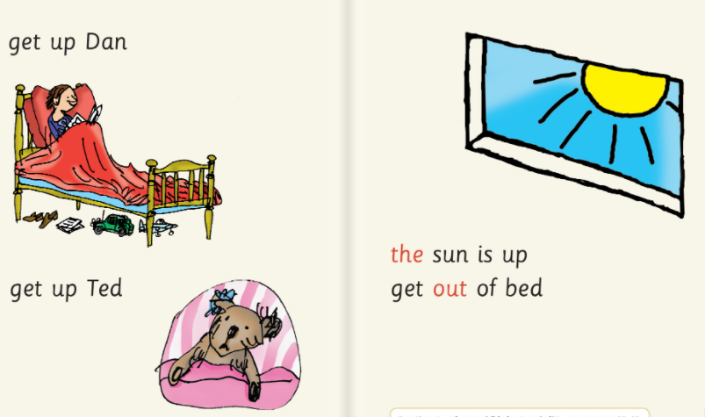
What three things did the girl do in the sun?

Slide 6
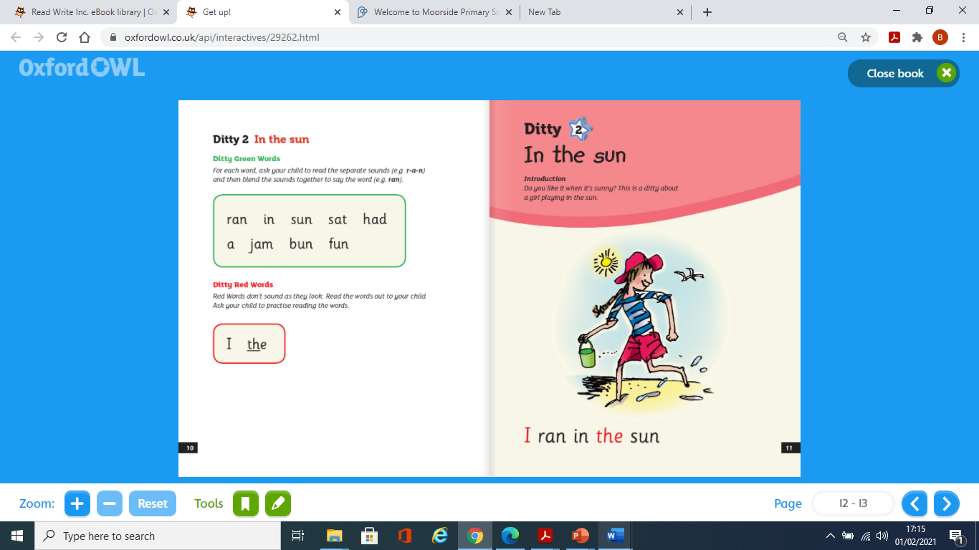

Slide 7
Where did the girl spend the day?

Slide 8
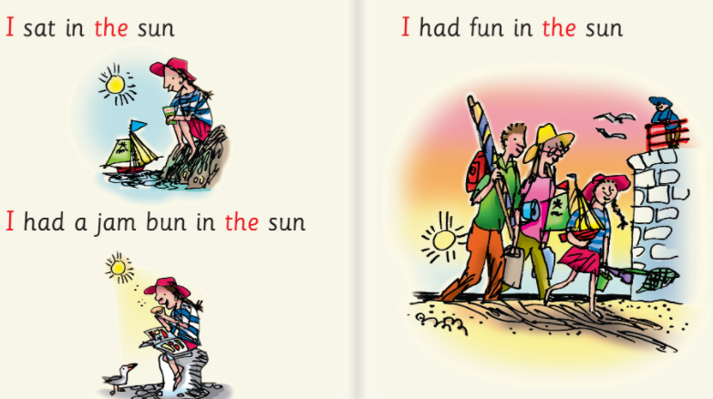
What three things did the girl do in the sun?

Slide 9
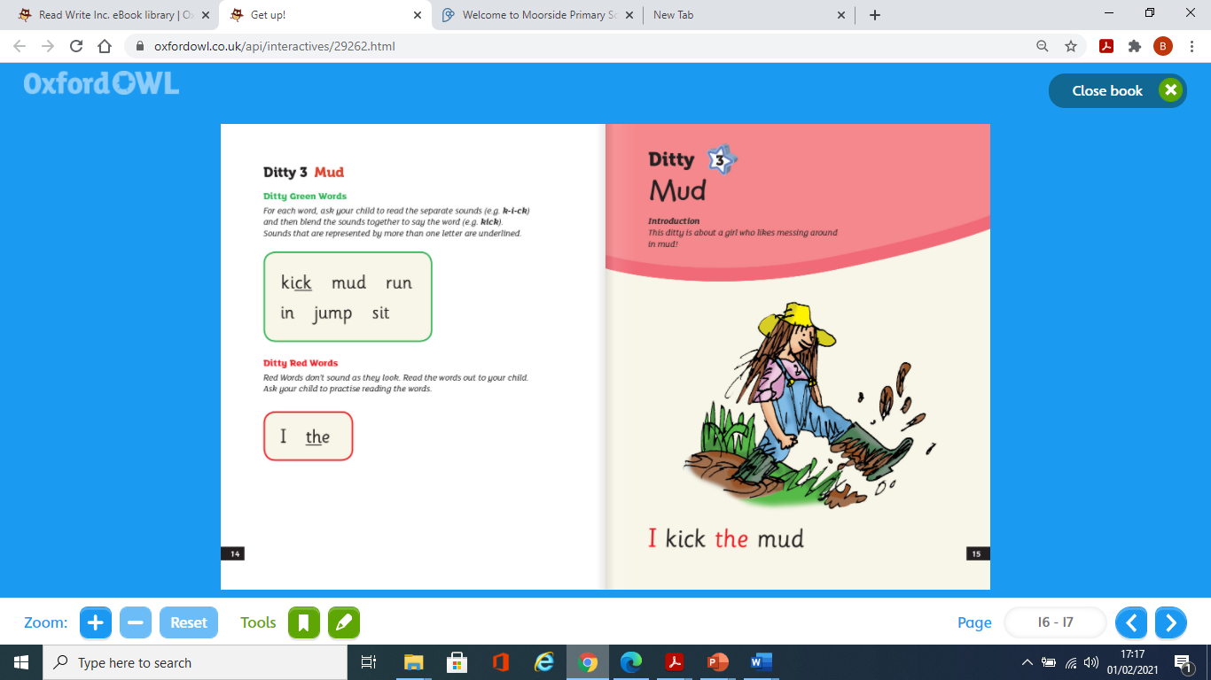

Slide 10
Where is the girl?
What is she doing?

Slide 11
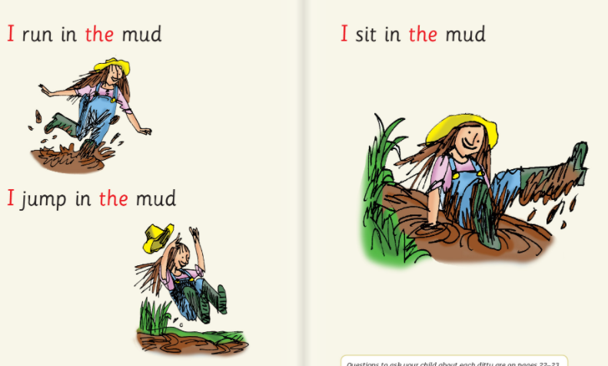
What four things does the girl do in the mud?
How does she feel? How do you know?

Slide 12
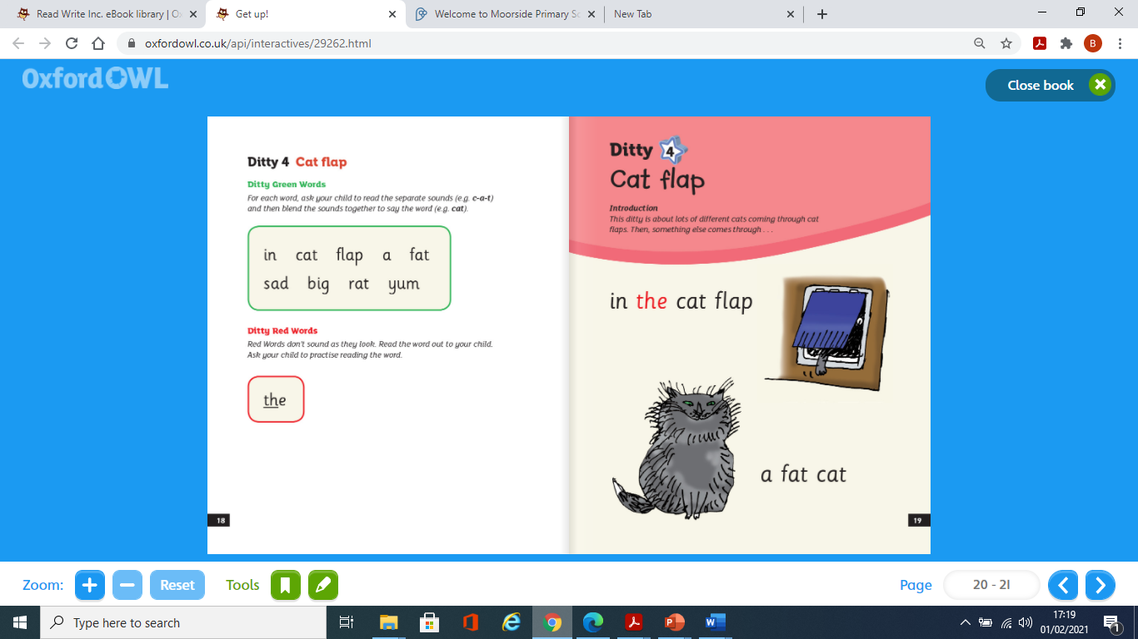

Slide 13
What is the first thing that comes through the cat flap?

Slide 14
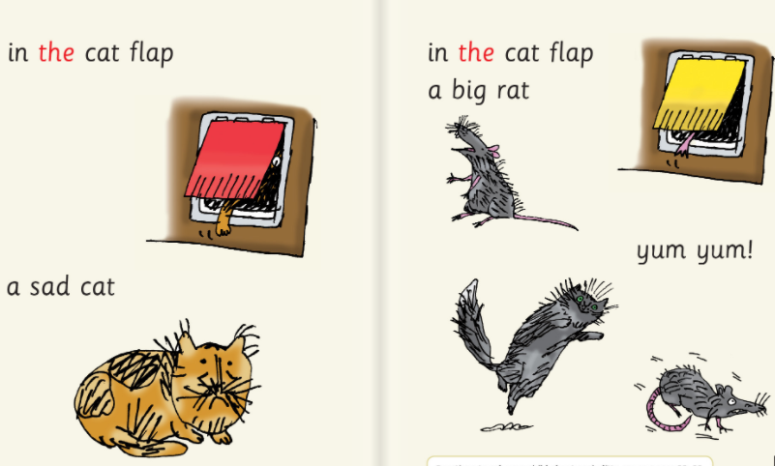
What is the last thing that comes through the cat flap?
What happens at the end do you think?

