Slide 1
To learn about the colours in Aboriginal art.

Slide 2

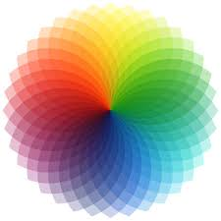
Where did they first get the colours from?
Aboriginal art is thousands of years old so when the original artists began painting, they couldn’t just go to shops to buy paint like we might do now.
How do you think they made the colours?

Slide 3
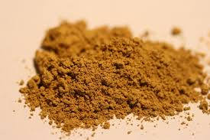
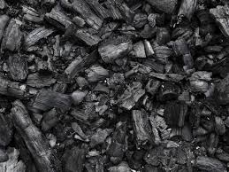

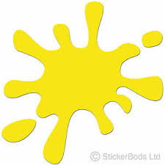
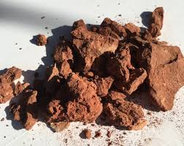


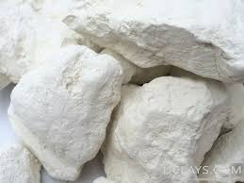
Colours from natural materials
The ancient Aboriginal artists would have made colours from the natural materials of the land around them.
Black would have been made from charcoal after burning wood.
Yellow would have been made from ochre powder (a sandy rock).
Red would have been made from red clay powder.
White would have been made from ochre powder and white clay powder.

Slide 4
What do the colours mean?
Colours had very special meanings to the ancient Aboriginals in their art work.
Black represented night and the peoples skin colour.
Yellow represented the sun and was a sacred colour.
Red represented the land or blood.
White represented the spirits or their ancestors or animals who had died.

Slide 5


Your task.
I want you to think carefully about the
colours you might want to use in your
Aboriginal artwork.
Think about what natural materials you could use to make the colour and what it represents.
Example: Green could be made using grass and would represent growing new things.

