Slide 1

Learning intention: To understand the role of a monarch

Slide 2
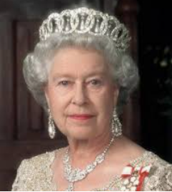
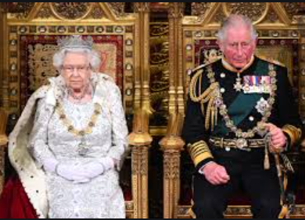
Recap…
Monarch- Is a King or Queen of a country. They are in charge of a country.
But what does the role entail?

Slide 3
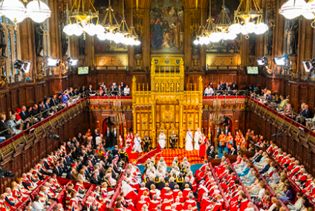
The Queen of England role
The Queen must remain strictly neutral with respect to political matters.
This means that she is not allowed to share her opinion, thought or feelings about the United Kingdom
government.

Slide 4
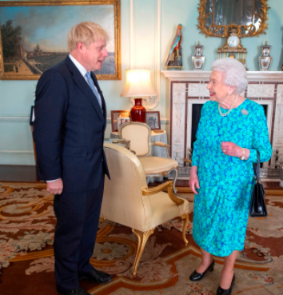
The Queen does not vote or stand for election. However The Queen does have ceremonial and formal roles with the Government.
This means the Queen is not
allowed to vote for a Prime
Minister but she does have to meet with
them and sign laws for the country
to follow.

Slide 5
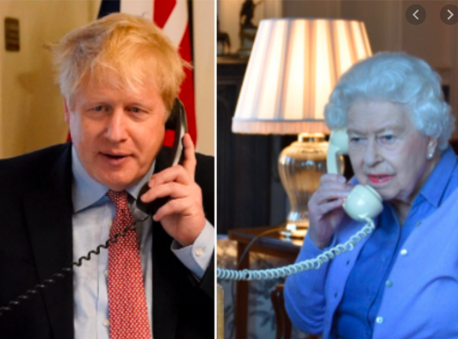
The Queen is in regular contact with the Prime Minister so she can understand what is being decided in the Houses of Parliament.

Slide 6
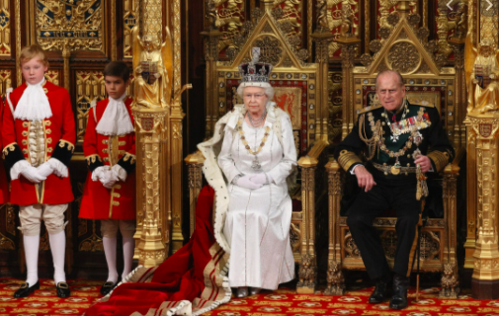
The Queen has to open new sessions at Parliament, even though she is not allowed to have an opinion on anything being discussed.

Slide 7
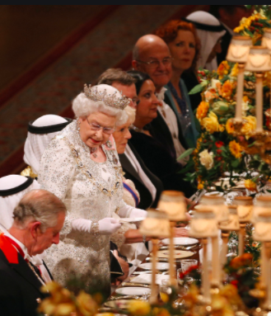
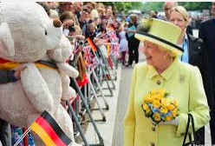
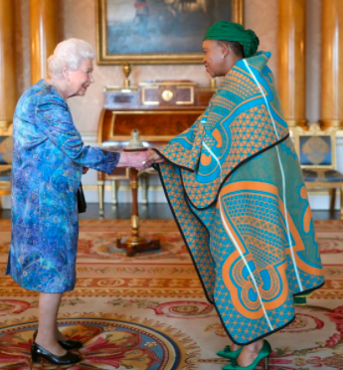
Because the Queen is Head of State (England), she has to go on visits abroad. There The Queen carries out Royal duties in other countries to make sure the countries and the United Kingdom form good friendships. She meets lots of different people.

Slide 8
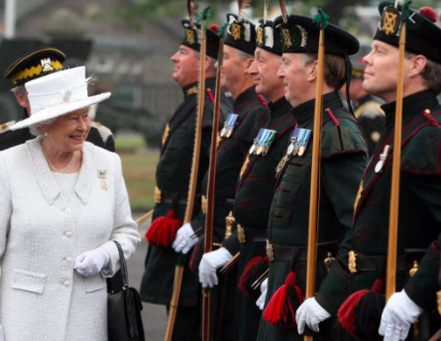
Head of the armed forces.
The Queen is also the Head of the Armed Forces. She is the only person who can declare when the country is at war and when war is over, although she must take the advice from her own government first.

Slide 9
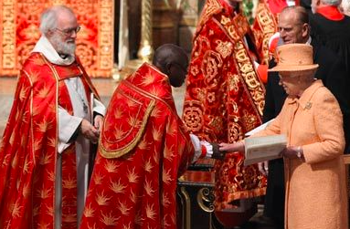
Head of the Church of England
The Queen is the Head of the Church of England- a position that all British monarchs have held since Henry the eighth was King.
The Queen appoints the archbishops on the advice from the Government.

Slide 10
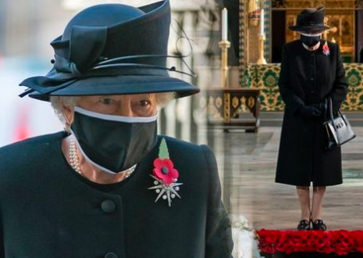
Representing the nation.
The Queen represents the nation at times of great sorrow or great celebration. One example of this is Remembrance day ceremony. The Queen lays a wreath every year to honour the member of the armed forces who have died fighting for the country.

Slide 11
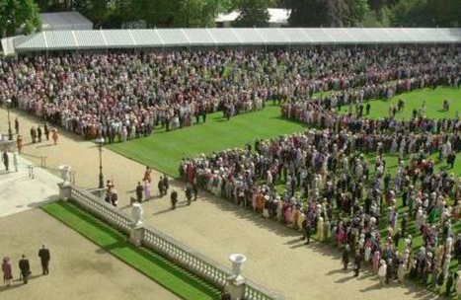
Royal garden parties
At least three garden parties are held each year at Buckingham palace with over 8000 people attending. She has to attend each one and meet all the guests.

Slide 12
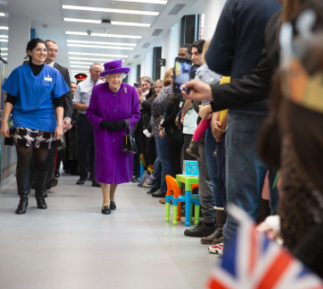
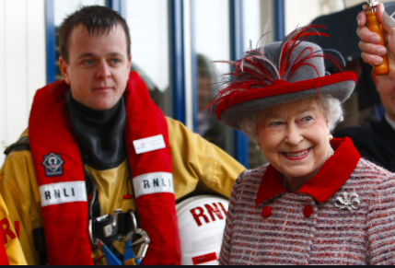
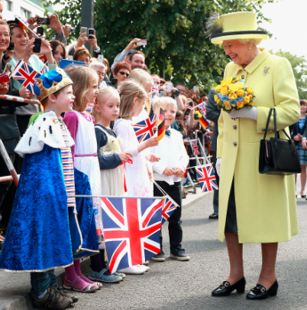
Visits
Alongside her other duties the Queen spends a huge amount of time travelling around the country visiting hospitals, schools, factories and other places and organisations.

