Slide 1
Learning intention History of transport.

Slide 2
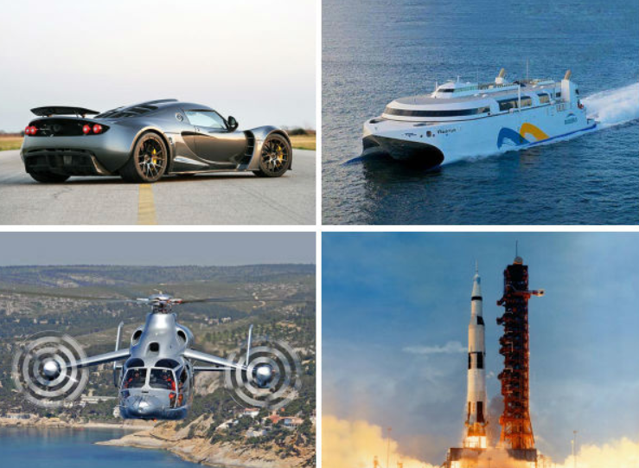
There are four main types of transport.
Water Air Land Space

Slide 3
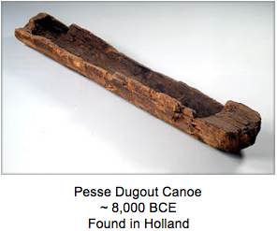
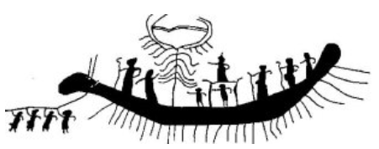
8,000BC
The oldest boat ever found

Slide 4
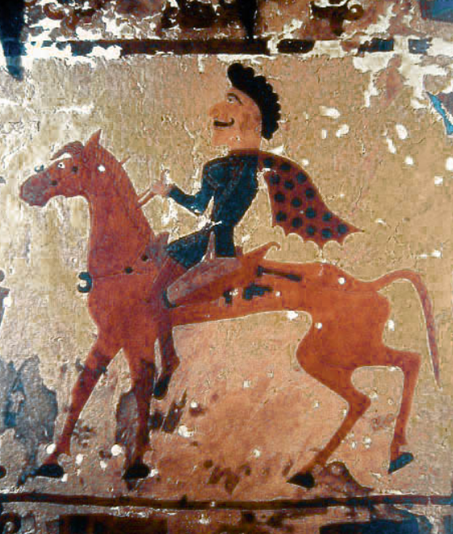
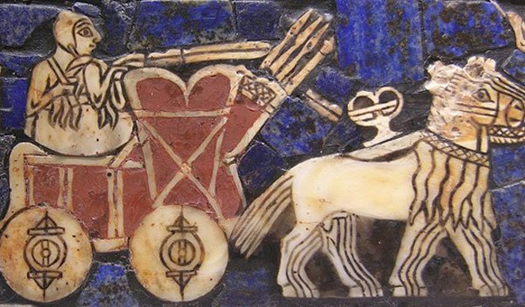
3,500BC
The wheel was invented
Horses were first used

Slide 5
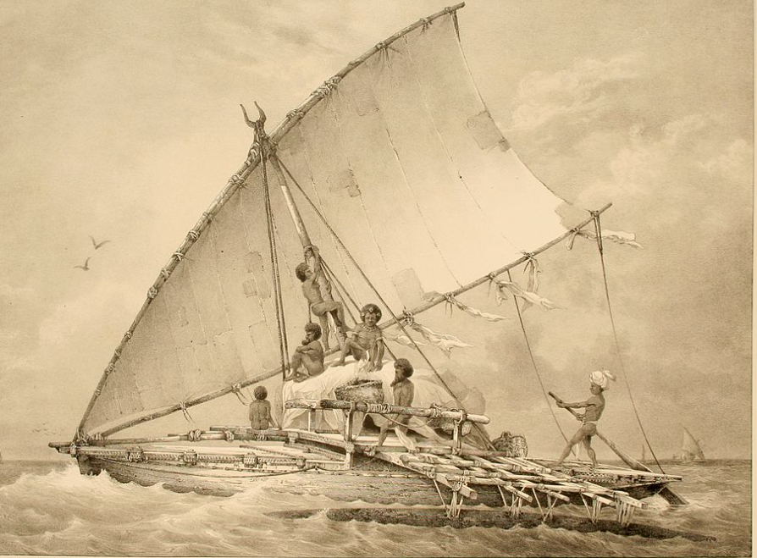
3,000BC
Sails were first used on boats

Slide 6
1,100AD
Horse draw carriages used.

Slide 7
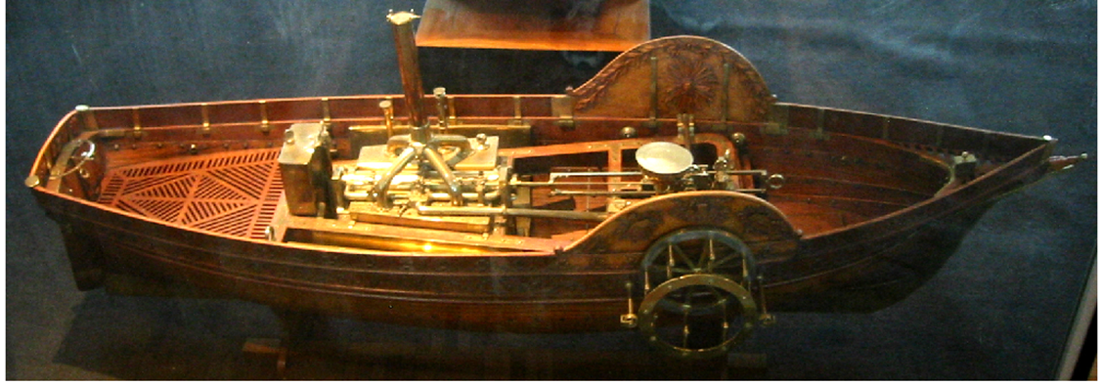
1772
The first steam powered boats.

Slide 8
1783
First flying machine the hot air balloon.

Slide 9
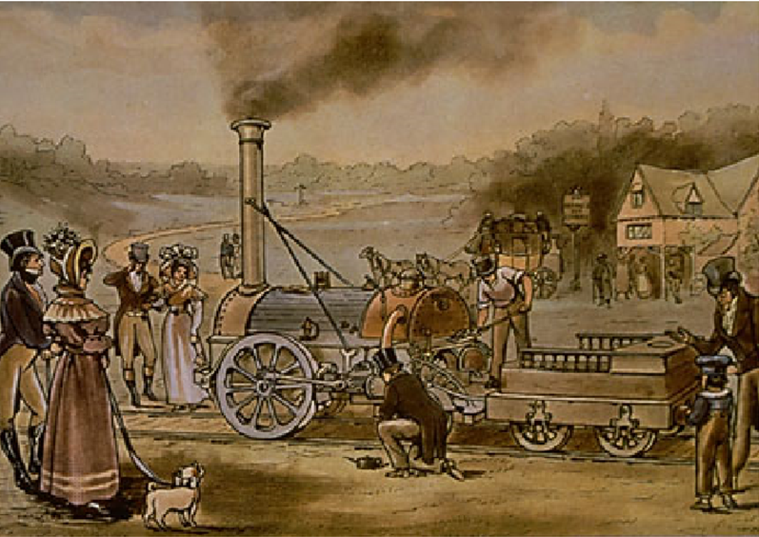
1814
The first steam engine built.

Slide 10
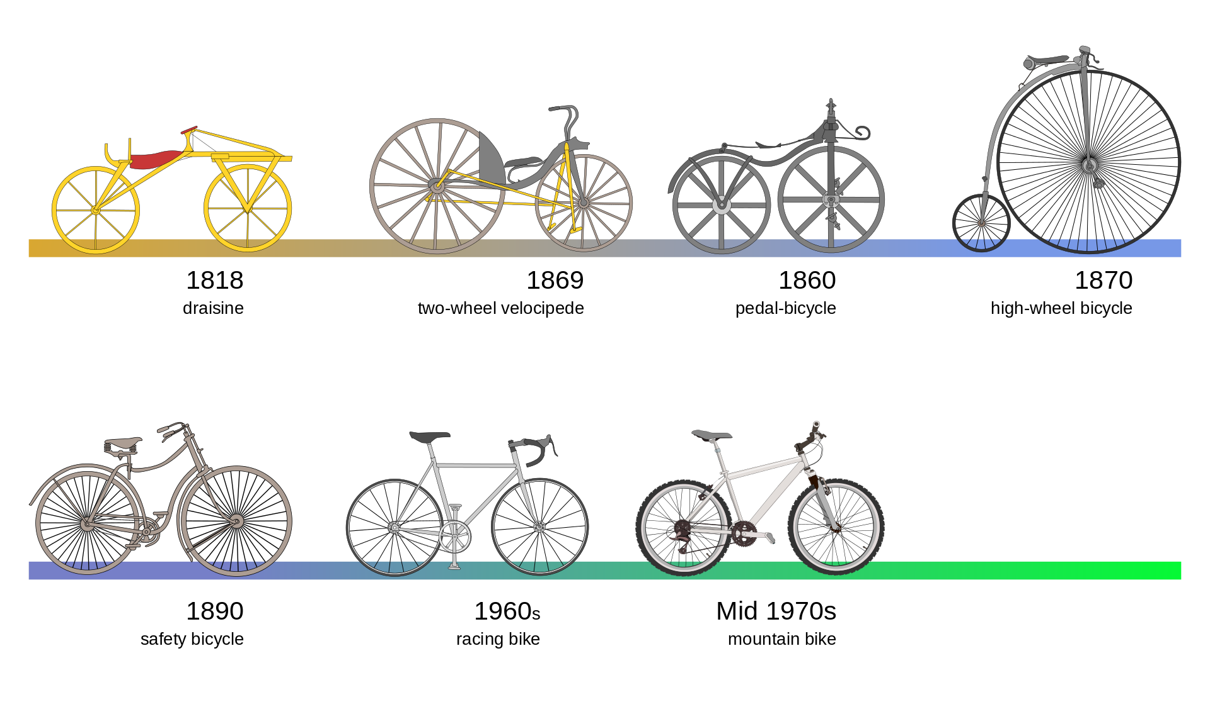
1818
Bikes invented.

Slide 11
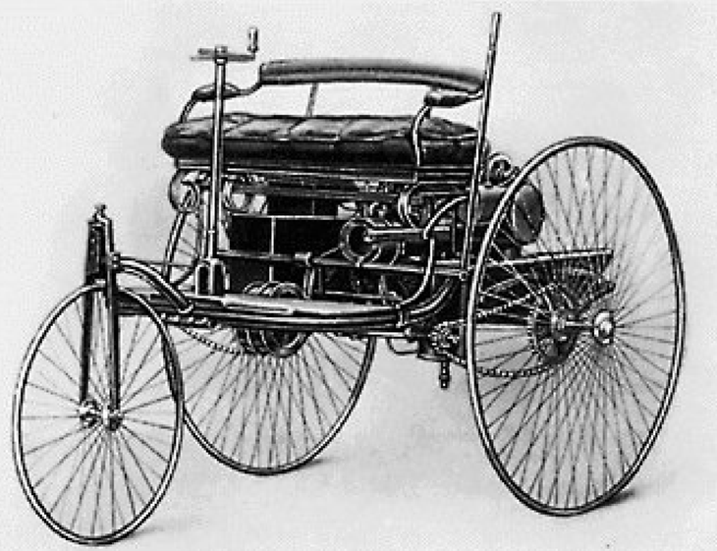
1885
The first car invented by Benz.

Slide 12
1903
First powered flight.

Slide 13
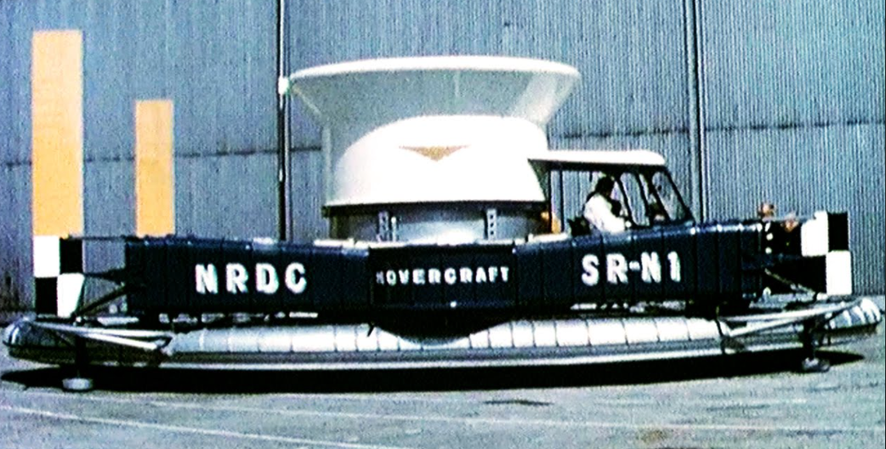
1956
The Hovercraft was invented.

Slide 14
1957
Boeing 707 - the first successful passenger carrying aircraft.

Slide 15
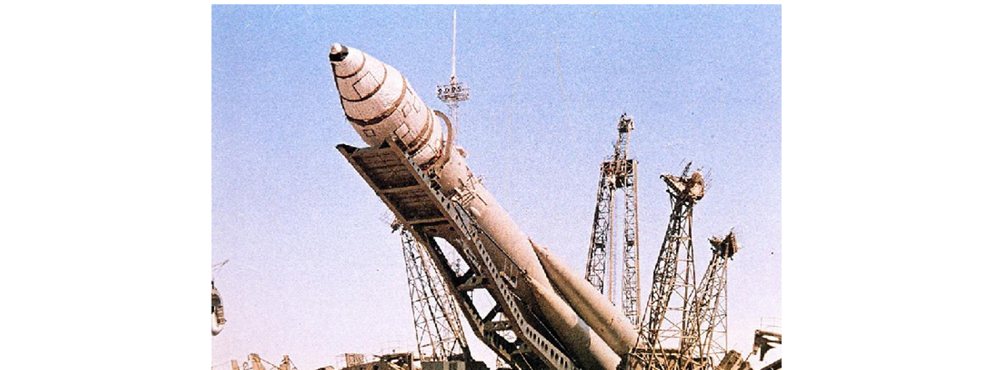
1961
The first space rocket.

Slide 16
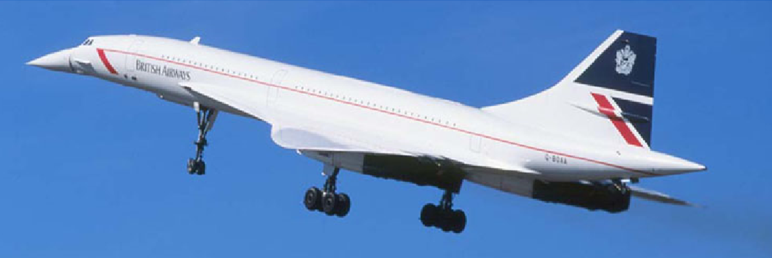
1976
Concord the fastest passenger aircraft flew at 1,354 miles per hour.

Slide 17
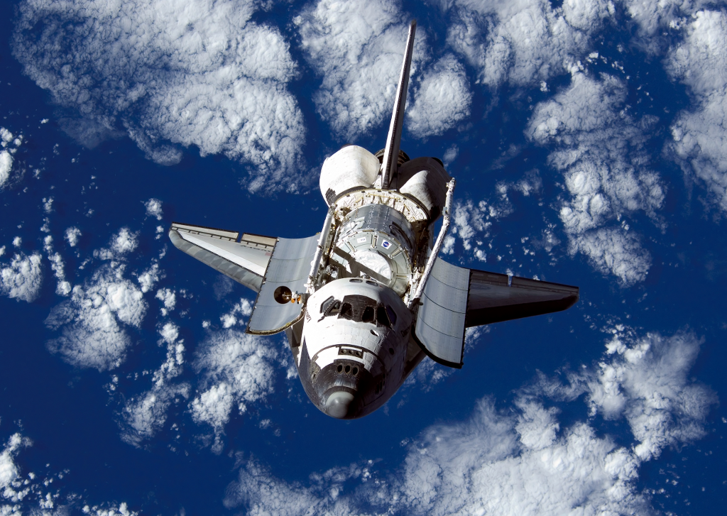
1981
The Space Shuttle first flew.

Slide 18
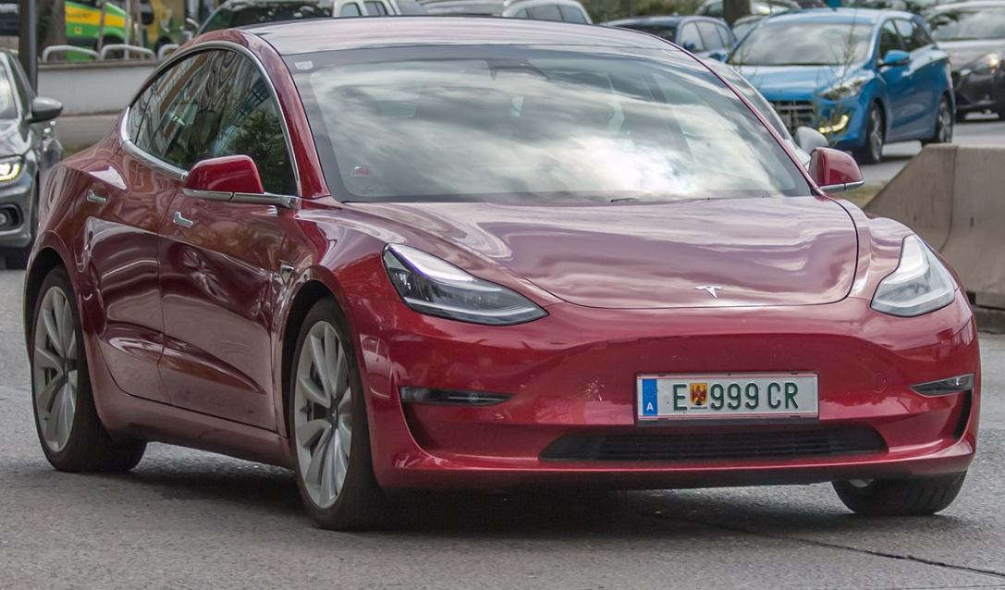
2020
Tesla had built 1 million electric cars.

Slide 19
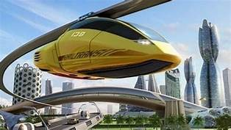
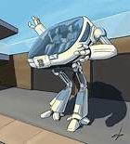
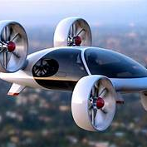
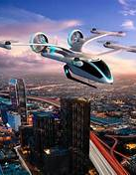
20??
What could happen next?

Slide 20
Task
Choose 6 slides.
Draw a picture of each and label with the date in order.
8000BC

Slide 21
8000BC
The first kind of transport was water transport. The oldest canoe ever discovered was 10000 year old.

