Slide 1
Maths Learning Intention - Finding the highest common factor to simplify fractions

Slide 2
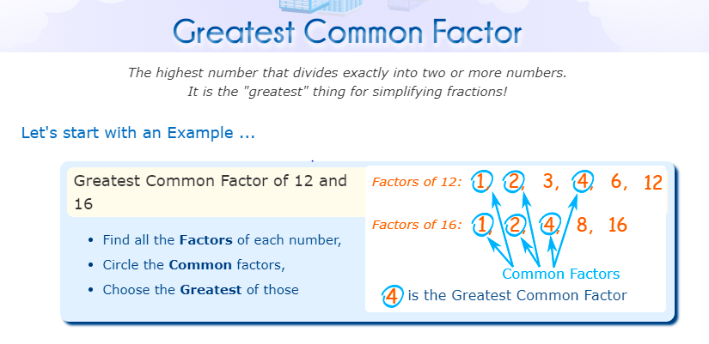

Slide 3
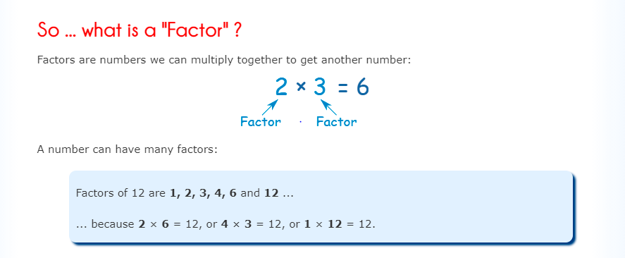

Slide 4
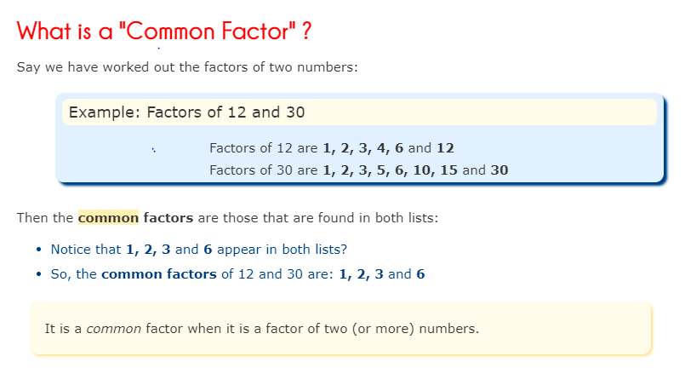

Slide 5
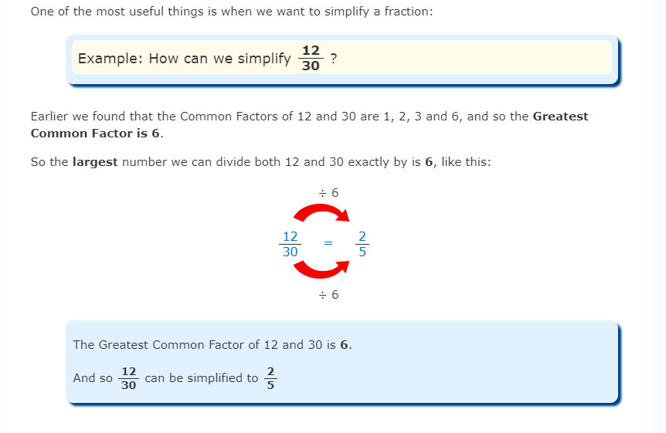

Slide 6
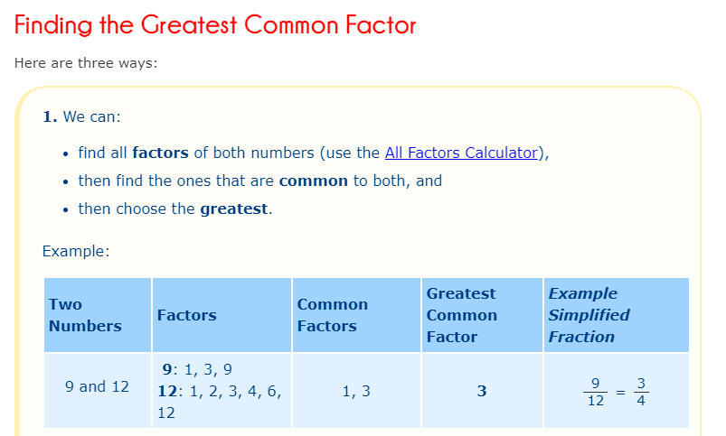

Slide 7

Let’s look at:
Common factors of 8 are 1, 2, 4, 8.
Common factors of 12 are 1, 2, 3, 4 , 6 and 12.
The highest common factor is 4.
8 divided by 4 = 2.
12 divided by 4 = 3.
The simplified factor would be

Slide 8
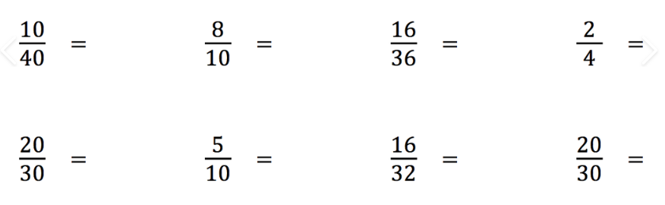
Find the highest common factors of the numbers in these fractions to simplify them to their lowest form.

