Slide 1

Learning intention: To identify and describe the properties of 3D shapes, including the number of edges, vertices and faces.
Today we will focus on vertices.

Slide 2
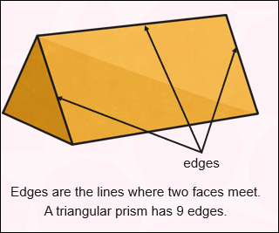
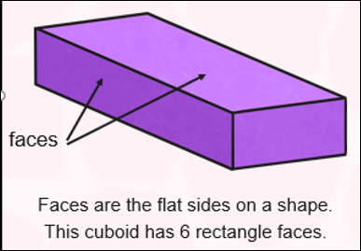
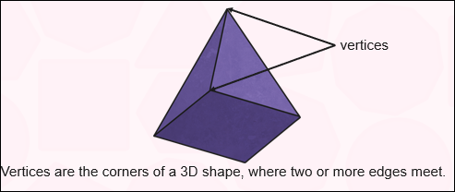
Faces, edges, and vertices

Slide 3
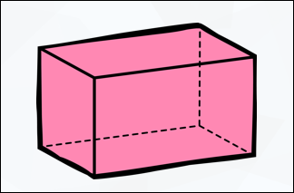
How many vertices does this cuboid have?
Don’t forget the vertice at the back.
It has 8 vertices

Slide 4
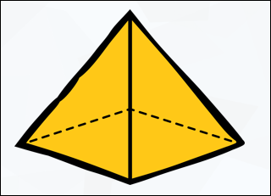
How many vertices does this square based pyramid have?
Don’t forget the vertice at the back.
It has 5 vertices

Slide 5
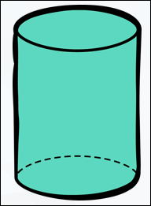
How many vertices does this cylinder have?
It has 0 vertices.

Slide 6
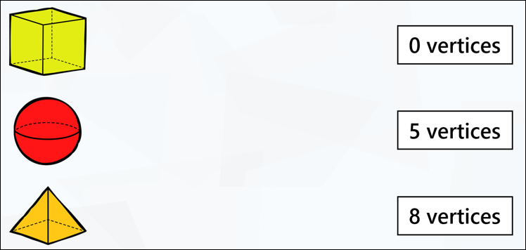
Match the 3D shape to the number of vertices.

Slide 7
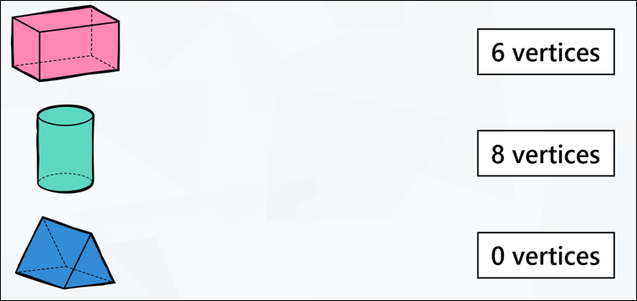
Match the 3D shape to the number of vertices.

