Slide 1

Learning intention: To learn to represent numbers in different ways.

Slide 2
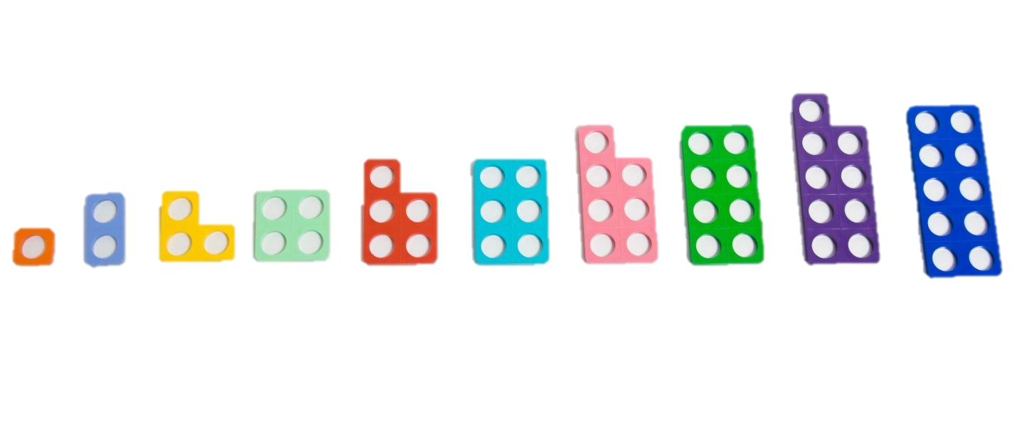
What do these numbers have?
10 11 12 13 14 15
16 17 18 19

Slide 3
They all have a ten.
10 11 12 13 14 15
16 17 18 19

Slide 4
They all have 1 ten when we write them.
10 11 12 13 14 15
16 17 18 19

Slide 5
Lets have a look at some bigger numbers.
To represent 20 we use 2 tens and to represent 30 we use 3 tens.
10
20
30

Slide 6
Which number do you think this is?

Slide 7
That’s right! This is 60.

Slide 8
Which number do you think this is?

Slide 9
That’s right!
33

Slide 10
Which number do you think this is?

Slide 11
That’s right!
56

Slide 12
Which number do you think this is?

Slide 13
That’s right!
74

Slide 14
Which number do you think this is?

Slide 15
That’s right!
41

