Slide 1
Learning Intention – To plan my own poem

Slide 2
Listen to the poem again, think about the three main characters.

Slide 3
Today’s task
Today you are going to plan your own version of the poem.
Think about an argument you have had with a friend, a brother or a sister. Think about which adult stopped the argument.
You are going to make a story map to show what will happen in your narrative poem, have a look at my example on the next page to get some ideas.

Slide 4
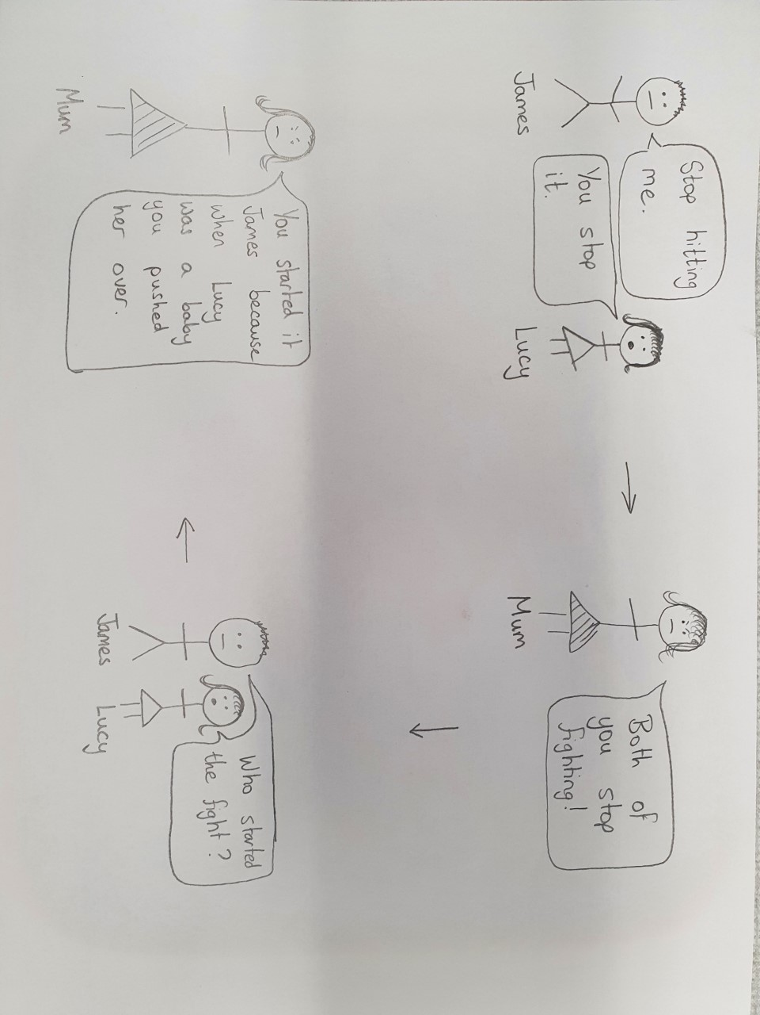
My story map

