Slide 1
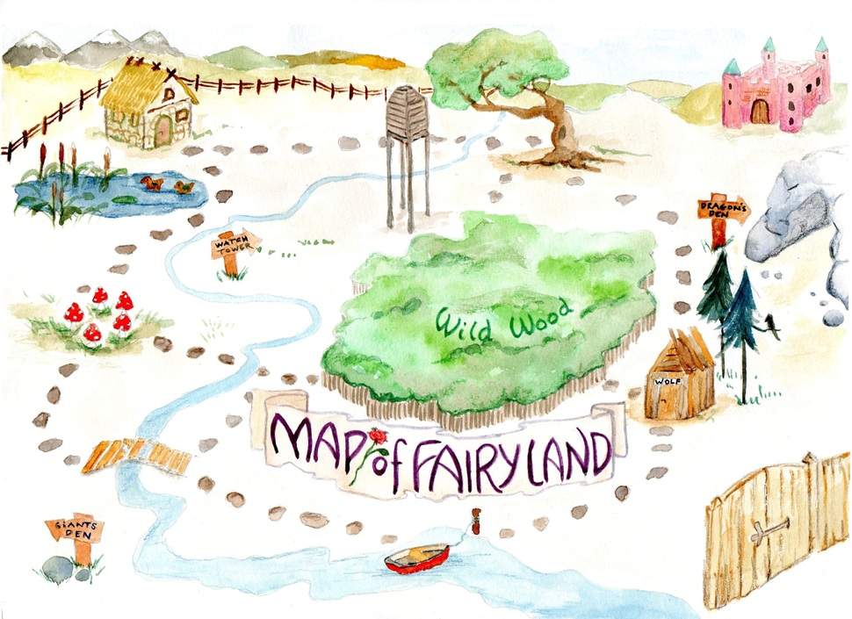
Learning intention: to plan instructions
You are going to be writing instructions for an adventure! You can tell the reader where to go in Fairyland - what might happen to them along the way? Who might they meet?

Slide 2
Where do you want to go? You can also use your imagination to think of places that aren’t on this map.

Slide 3
My first idea: I want to go through the gate. Maybe there will be a magical creature guarding it! I’m going to add this idea to a story map.

Slide 4
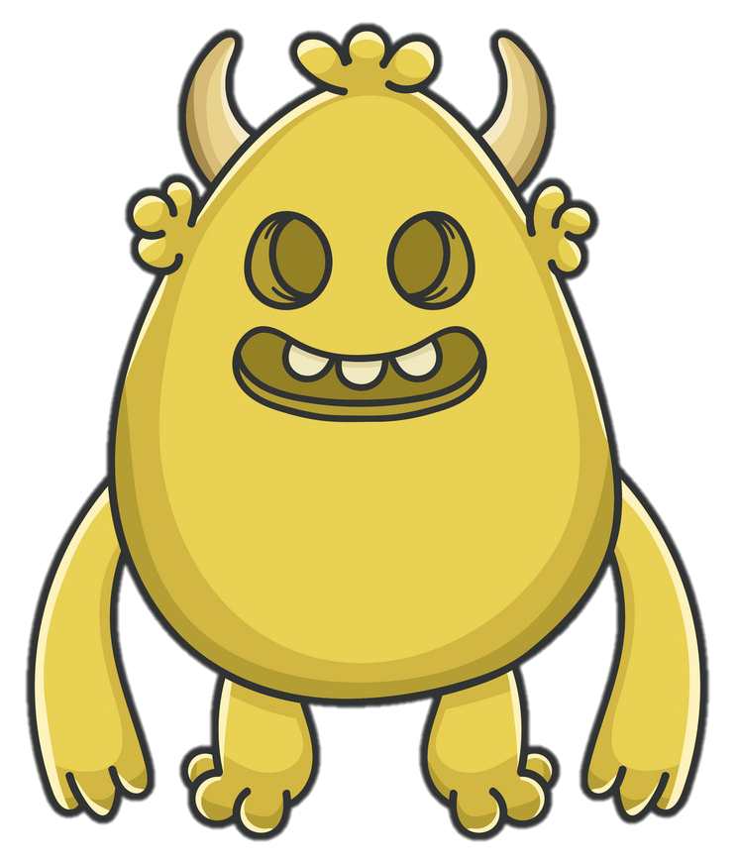
My instructions map for a Fairyland adventure
slimy, green goblin

Slide 5
My next idea: I want to go in the boat. It will take me past the rainbow shark’s lair! (I have used my own idea instead of the map for that part.)

Slide 6
My instructions map for a Fairyland adventure
Now it’s your turn…
slimy, green goblin
rainbow shark’s dangerous den

Slide 7
Draw a story map in your book with pictures of where you are going to tell the reader to go in Fairyland. What adventures will they have? Keep going until they are safely back home.
Your map will look something like this:
home

Slide 8
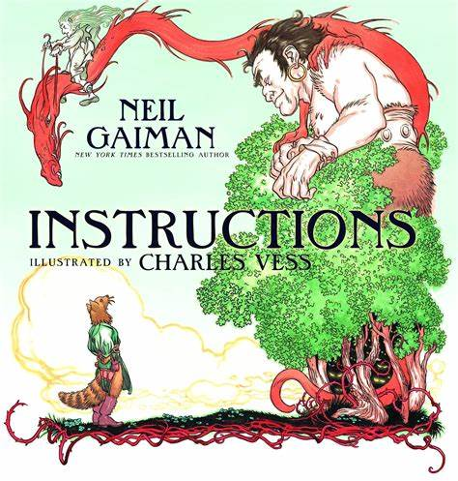
Use ideas from the ‘Instructions’ story or from the map of Fairyland to help you. You can read the story again (from Wednesday 24.2.21 and Thursday 25.2.21) if you need more help!

