Slide 1
Learning intention
Identifying a text style

Slide 2

Look at the text examples on each slide.
Ask these questions about each one.
-What is the subject of the text?
-Who do you think has written it?
-Would you like to read more?
?

Slide 3
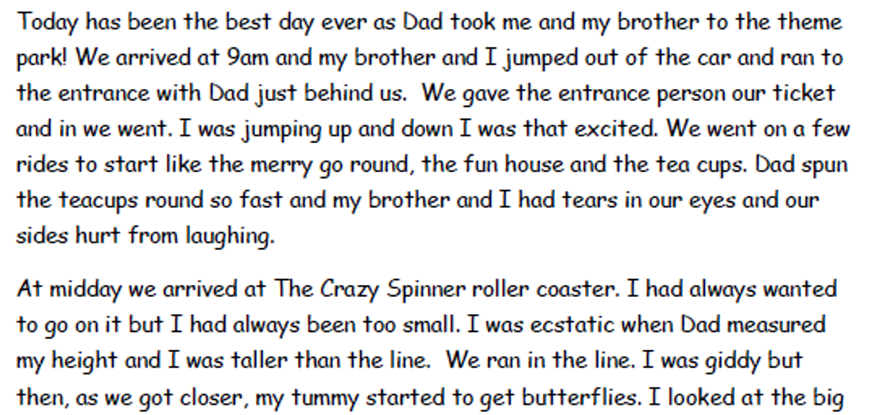

Saturday 7th June 2016

Slide 4
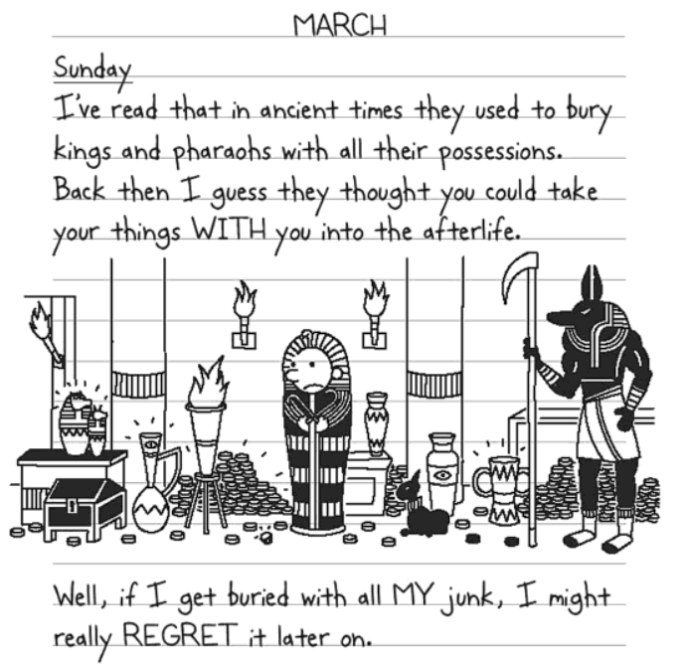
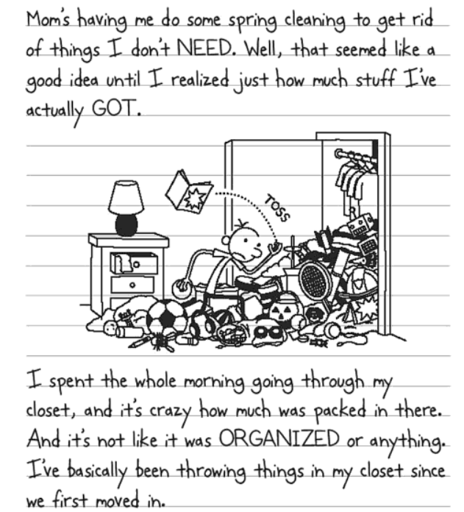

Slide 5
What do you think these are?
Why? What clues do you have?
What do they have in common?
What is different about them?
When do you think they were written?

Slide 6




Have you ever read or written in a Diary?

Slide 7
Features of a Diary
Written in past tense- because the story has already happened.
Written in the first person- words like ‘I, me, us, ours’ are used.
Describes the writers points of view, thoughts and feelings.
Is written in an informal style – as if you are talking to a friend.

