Slide 1
Today we will read ‘A bad mood’.
You can find this on OxfordOwl. Elibrary > read write inc > orange level
https://www.oxfordowl.co.uk/api/interactives/29279.html

Slide 2
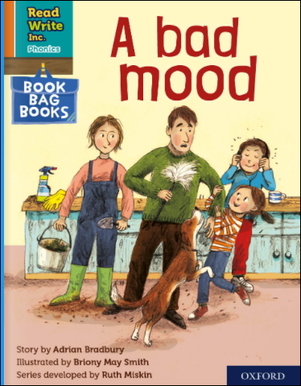

Slide 3
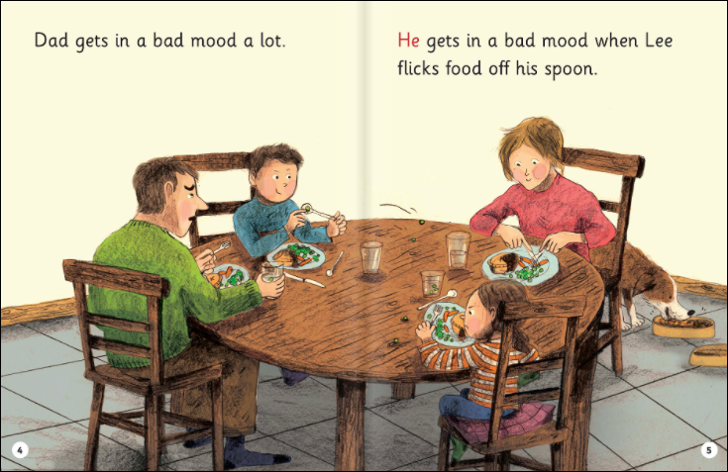

Slide 4
