Slide 1
Maths
Learning Intention: To translate shapes on a grid

Slide 2
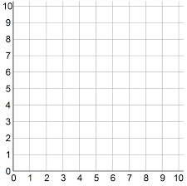

Slide 3
Translate this triangle 2 squares right.

Slide 4
Translate this square 3 squares up.

