Slide 1
Set 2 Sounds
‘ee’

Slide 2
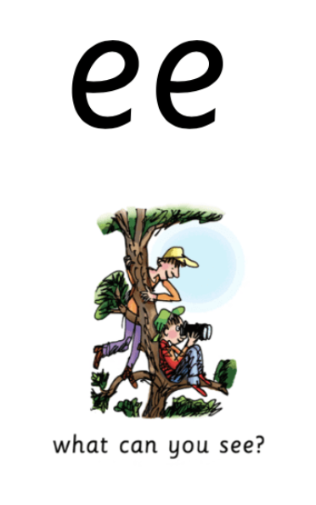
Notes:
What can you see?

Slide 3
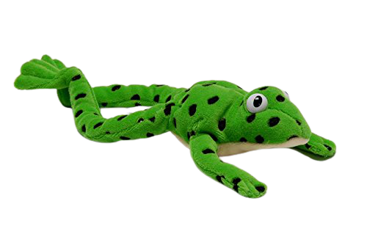
Notes:
Fred talk time! S-ee th-r-ee k-ee-p f-ee-l

Slide 4
Notes:
ee, two letters, one sound, special friends, ee

Slide 5
Notes:
My turn – ee. Your turn. My turn – What can you see? Your turn.

Slide 6
Notes:
Now let’s play our game – can you remember? When it wriggles tell me if it’s ee, or what can you see? If you don’t have the wiggle don’t worry, ask someone to point and if you don’t have someone there, that’s ok too, have a practice at being super speedy and point when you say it. ee or what can you see?

Slide 7
Notes:
It’s time for some green words – let’s use Fred talk to help us sound them out. b-ee-n, s-ee. Th-r-ee

Slide 8
Notes:
Let’s practice writing our sound - ee

Slide 9
Notes:
Can you write some words with today’s sound? See, green, sleep. Tick and fix on the next slide

Slide 10
Notes:
Let’s use our Fred fingers, d-ay 2 sounds. P-l-ay 3 sounds and m-ay 2 sounds.

Slide 11
Commentary:
2: What can you see?
3: Fred talk time! S-ee th-r-ee k-ee-p f-ee-l
4: ee, two letters, one sound, special friends, ee
5: My turn – ee. Your turn. My turn – What can you see? Your turn.
6: Now let’s play our game. When it wiggles tell me if it’s ee, or what can you see? If you don’t have the wiggle don’t worry, ask someone to point and if you don’t have someone there, that’s ok too, have a practice at being super speedy and point when you say it. ‘ee’ or what can you see?
7: It’s time for some green words – let’s use Fred talk to help us sound them out. B-ee-n, s-ee, th-r-ee.
8: Let’s practice writing our sound - ee
9: Can you write some words with today’s sound? See, green, sleep. Tick and fix on the next slide
10: Let’s use our Fred fingers, s-ee 2 sounds. G-r-ee-n 4 sounds and s-l-ee-p 4 sounds.

