Slide 1
Maths
Learning intention: To identify halves and quarters

Slide 2
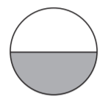
$$\frac{1}{2}$$
one half

Slide 3
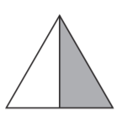
$$\frac{1}{2}$$
half

Slide 4
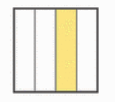
$$\frac{1}{4}$$
one quarter

Slide 5
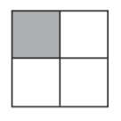
$$\frac{1}{4}$$
one quarter

