Slide 1
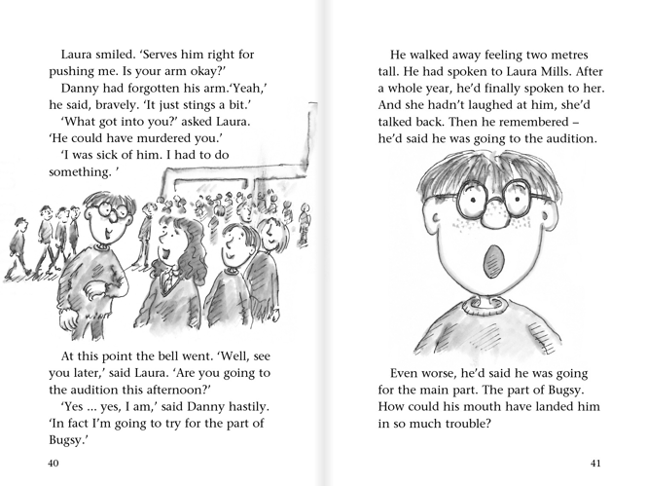

Slide 2
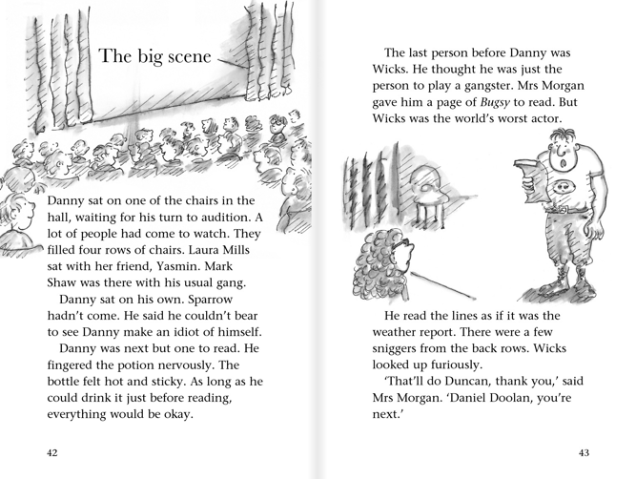

Slide 3
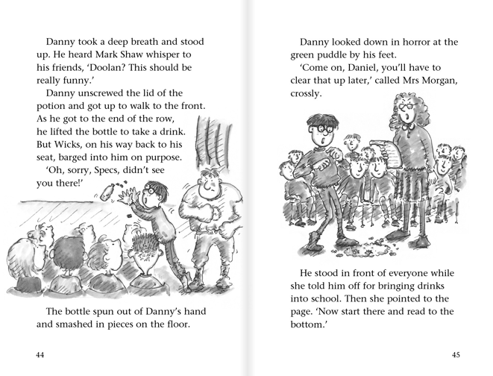

Slide 4
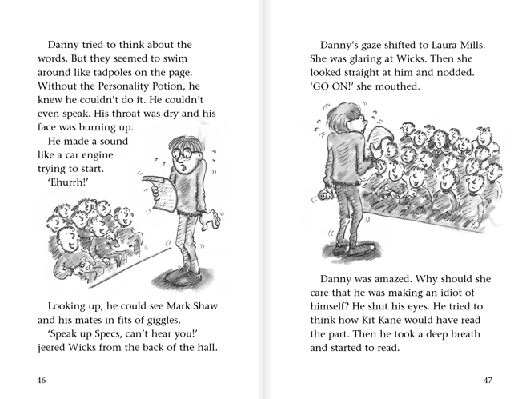

Slide 5
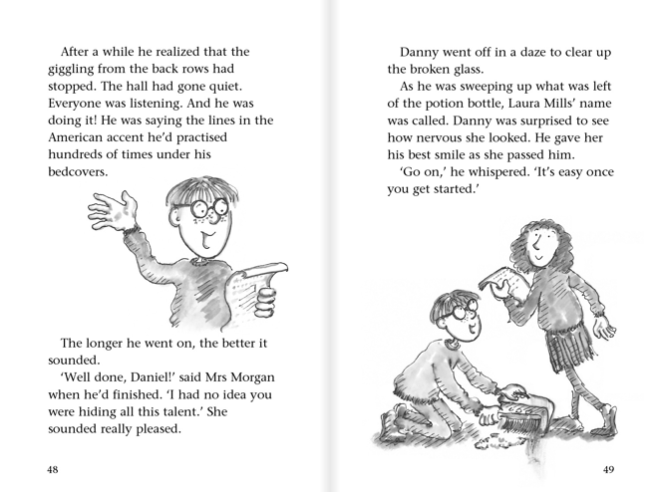

Slide 6
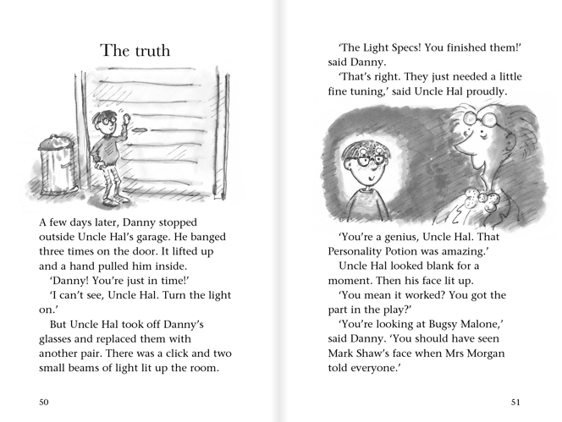

Slide 7
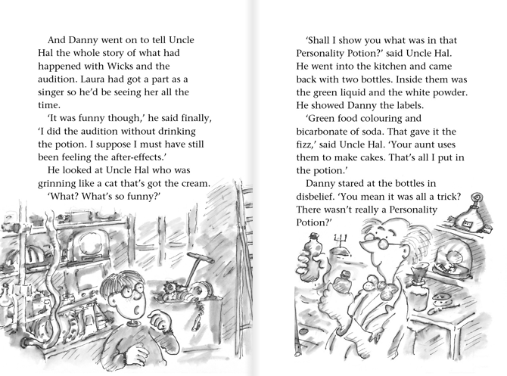

Slide 8
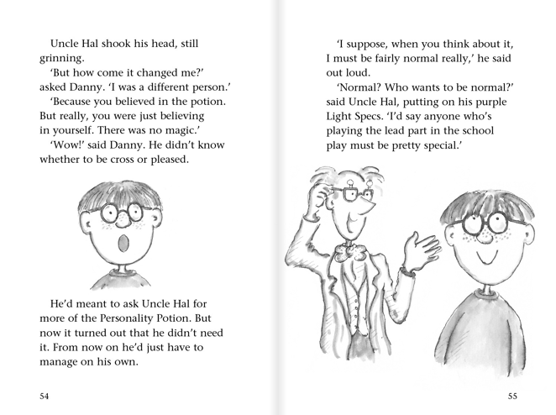

Slide 9
Danny’s Uncle gives him a special personality potion, which is meant to bring out hidden talents.
Danny’s mum tells him off for spending his life hiding in his room instead of going to the park with friends.
Uncle Hal explains that the personality potion was just a trick to make Danny believe in himself.
Danny is given the main part in the play even though he dropped the potion.
At breaktime, Danny is brave enough to stand up to Wicks and refuses to give him his fudge bar.
Unfortunately, Danny is forced to sit next to Wicks, the bully, on the school bus and he steals his lunch.
Mrs Morgan announces that the school play was going to be ‘Bugsy Malone’ and Danny is desperate to be in it but he doesn’t feel very confident.

