Slide 1
Learning Intention
To use descriptive language to modify sentences

Slide 2
Today we will be recapping using adverbs and adverbials to modify our sentences.
What is an adverb?
Adverbs give us more information about:
Verbs (action or doing words/to show states of being)
Adjectives (describing words)
Other adverbs
Whole clauses

Slide 3
Here is an example
Adverbs can give us more information about verbs (an action, doing or state word).
The smooth, sleek snake slithered silently along the branches of the great tree.
What other adverbs could you use to say how the snake moved?
The smooth, sleek snake slithered ________.

Slide 4
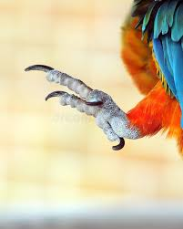
Remember adverbs can give more information. Look at this example.
Adverbs can give us more information about adjectives
(describing words).
His long, yellow talons were extremely sharp.
What other adverbs could you use to describe how sharp the talons were?
His long, yellow talons were ________ sharp.
Photo courtesy of gr33n3gg (@flickr.com) - granted under creative commons licence - attribution

Slide 5
Adverbial Phrases
We can also use phrases rather than single adverbs to modify clauses. These are called adverbial phrases. Adverbial phrases do not usually contain a verb.
For example:
The smooth, sleek snake hissed at the man with anger.
The multicoloured, squawking bird flew down the trunk of the tree
Can you make your own adverbial phrase to modify this clause?
The man chopped ________________________ .’

Slide 6
Fronted adverbials
Sometimes an adverb or adverbial phrase can come before the verb instead of after.
Let’s look at one for the man in the story
Rapidly, the man chopped at the hard, brown truck with his razor sharp axe.
A comma always comes after a fronted adverbial.

Slide 7
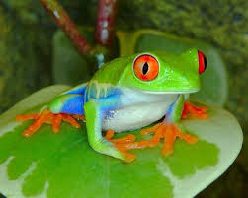
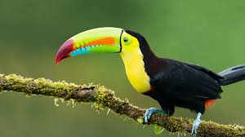
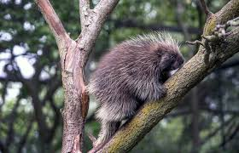
Now it’s your turn
Toucan
Porcupine
Tree frog
For each of these animals create three sentences
With an adverb
With an adverbial phrase
With fronted adverbial

