Slide 1
Year 1 Maths Alternative 1 Learning intention: To begin to learn about time

Slide 2
Day and night

Slide 3
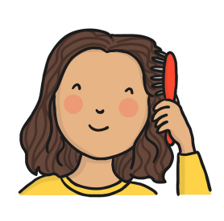
I am going to show you some pictures and I want you to decide if you do these things in the day or at night. Let’s do the first one together.
Day
Night
Brush your hair.

Slide 4
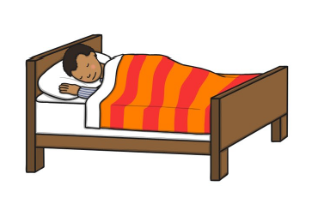
Day
Night
Go to sleep.

Slide 5
Day
Night
Go to school.

Slide 6
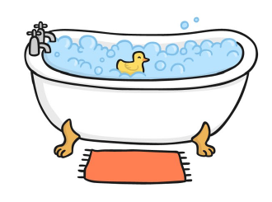
Day
Night
Have a bath.

Slide 7
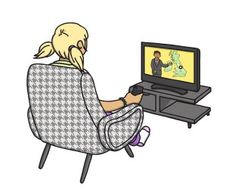
Day
Night
Watch tv.

Slide 8
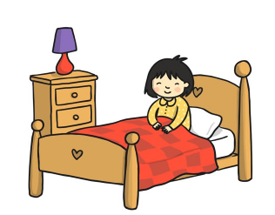
Day
Night
Wake up.

Slide 9
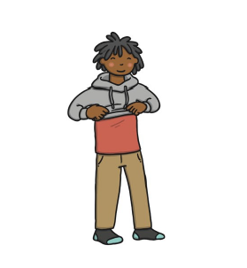
Day
Night
Get dressed.

Slide 10
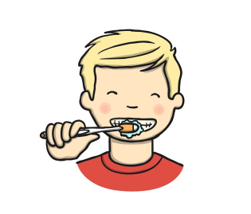
Day
Night
Brush my teeth.

Slide 11
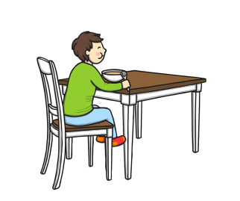
Day
Night
Eat breakfast.

