Slide 1
Today we are reading a book from Oxford Reading Tree.

Slide 2
The colour of the book that we are reading today is Lilac.

Slide 3
The title of the book is called The Haircut

Slide 4
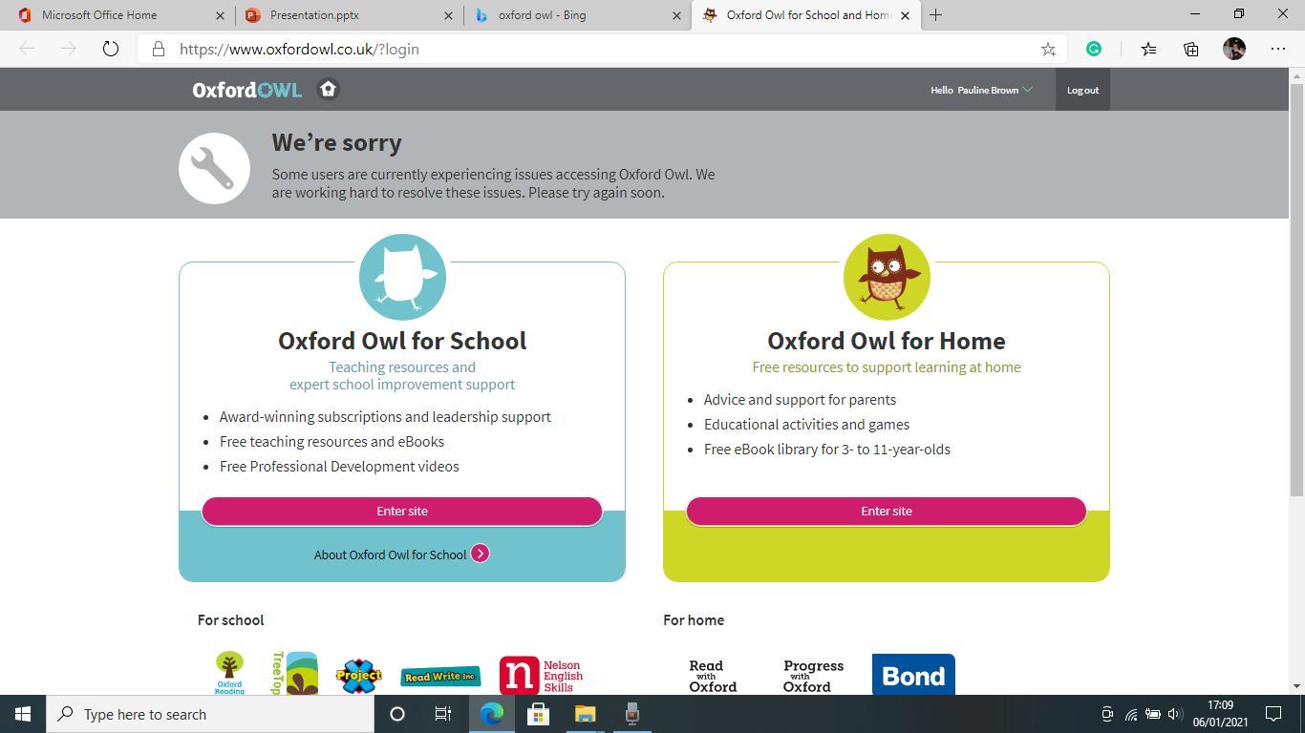
Oxford Owl for School and Home

