Slide 1
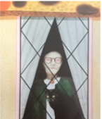
Learning intention: to write a witch story
Today we are writing the middle of the story.
Remember to use your setting description and story map from last week to help you to write your story.
Look at the next slide to see how I used my story map to help me to write the middle of the story.

Slide 2
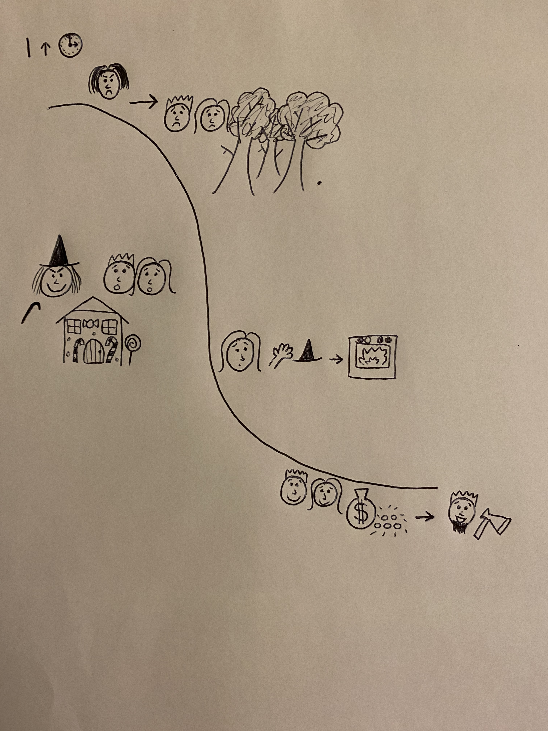
peaceful
freezing
suspicious
towering mountains
My story middle
Introduce new character of the witch
Introduce new setting of the witch’s house

Slide 3
Hansel and Gretel were lost on the tall, snowy mountain again. They found a house made of sweets but …
Use your own story map to write your version of the story. Remember to change and describe the setting!

Slide 4
Can you write the middle of the story using your story map?
Remember:
Capital letters
Full stops
Conjunctions to extend your sentences (and, or, but)

