Slide 1
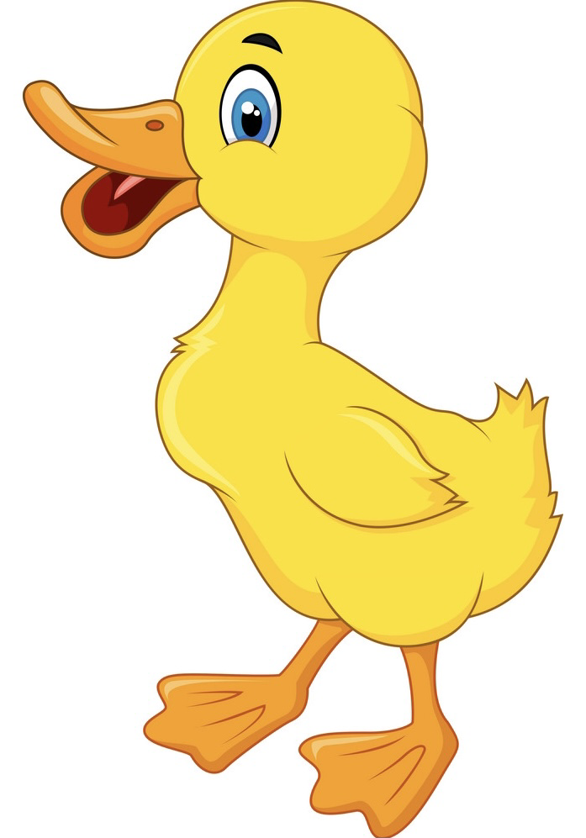
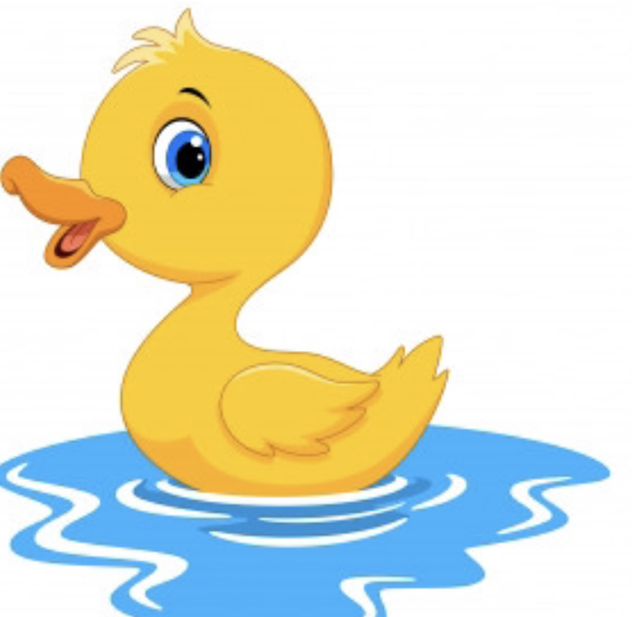
Five little ducks

Slide 2
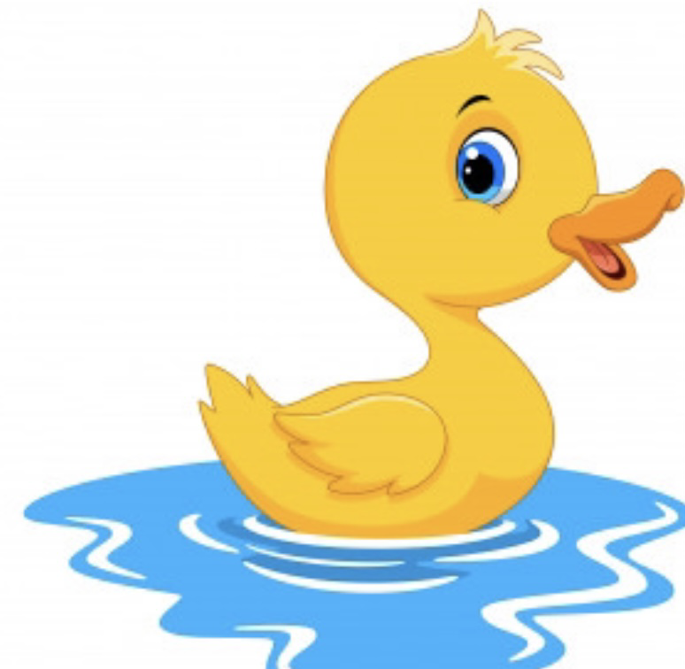
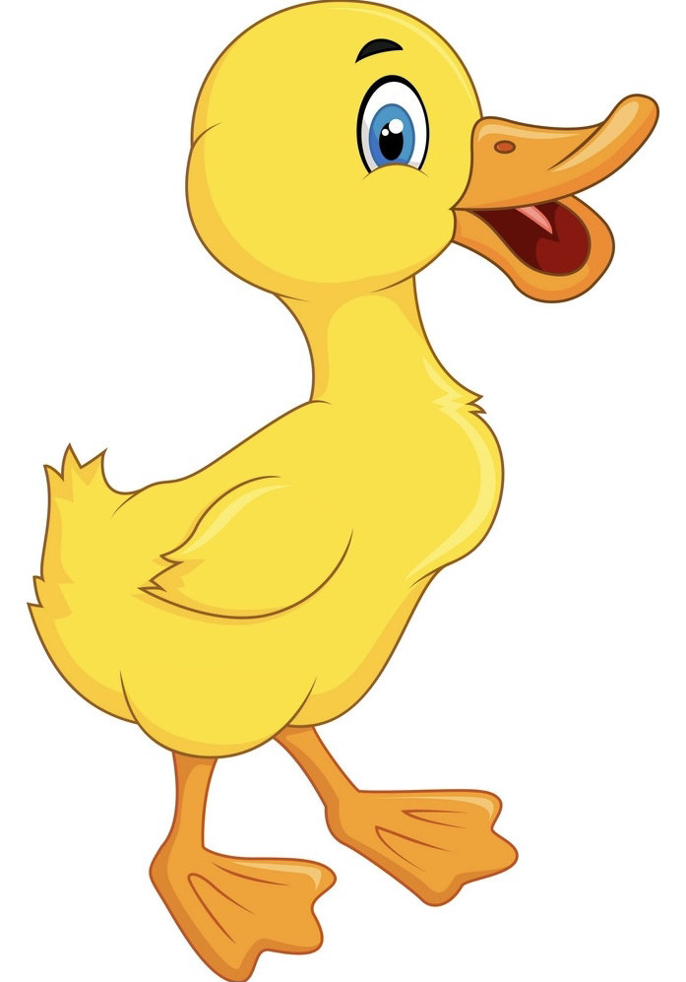
Five little ducks went swimming one day.
Over the hills and far away.

Slide 3
Mummy duck said “Quack quack quack quack.”
But only four little ducks came back.

Slide 4
Four little ducks went swimming one day.
Over the hills and far away.

Slide 5
Mummy duck said “Quack quack quack quack.”
But only three little ducks came back.

Slide 6
Three little ducks went swimming one day.
Over the hills and far away.

Slide 7
Mummy duck said “Quack quack quack quack.”
But only two little ducks came back.

Slide 8
Two little ducks went swimming one day.
Over the hills and far away.

Slide 9
Mummy duck said “Quack quack quack quack.”
But only one little duck came back.

Slide 10
One little duck went swimming one day.
Over the hills and far away.

Slide 11
Mummy duck said “Quack quack quack quack.”
And all her five little ducks came back

