Slide 1
Learning intention: To create a pictogram.

Slide 3
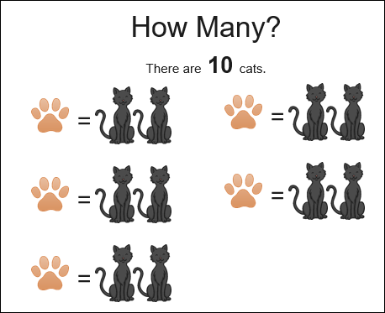

Slide 4
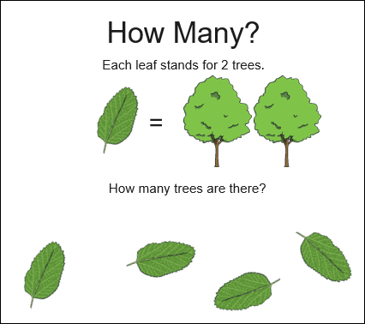

Slide 5
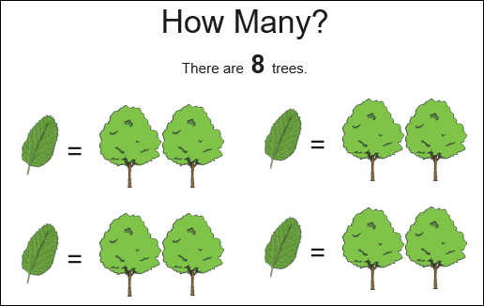

Slide 6
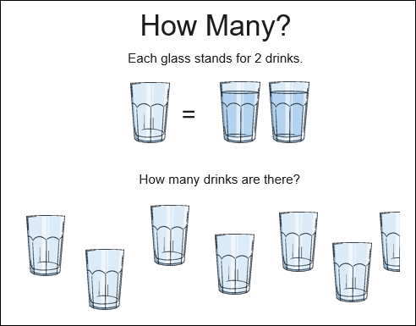

Slide 7
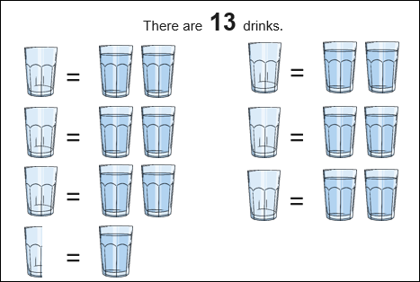

Slide 8
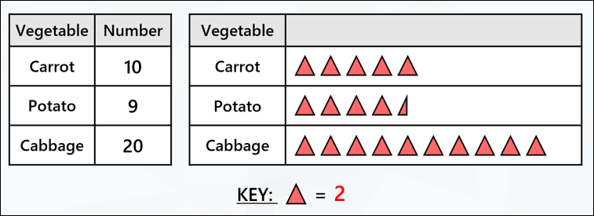
Each triangle represents 2.
Half a triangle represents 1.
Your knowledge of counting in twos will help you with this.

Slide 10
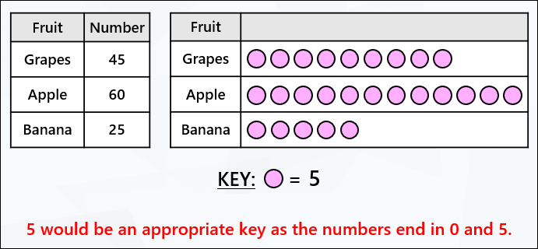

Slide 11
You don’t need to use the correct colours, just draw the triangles using your pencil.

