Slide 1
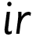

Focus: ir
i - start at the top, come down and flick. Lift and dot
r – start at the top, come down, bounce back up and over

Slide 2
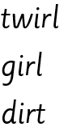
Your turn! Write ir in your book using the lines.
Then try:

