Slide 1
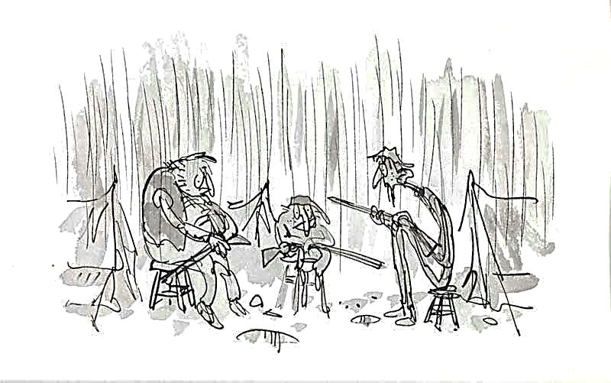

Learning intention
Reading for understanding

Slide 2
Listen and read this chapter.
There will be some questions to answer on sheet ‘English Chapter 8 comprehension’

Slide 3
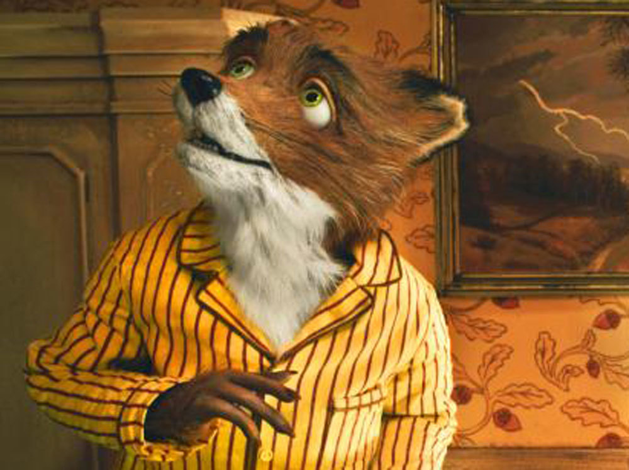
Fantastic Mr Fox
Chapter 8
The Foxes begin to starve

Slide 4
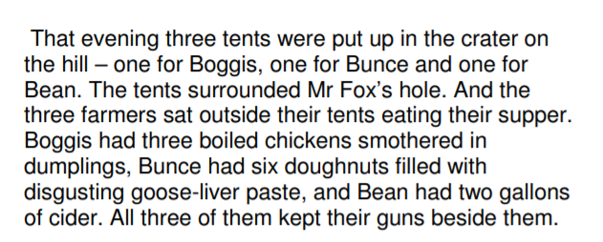

Slide 5
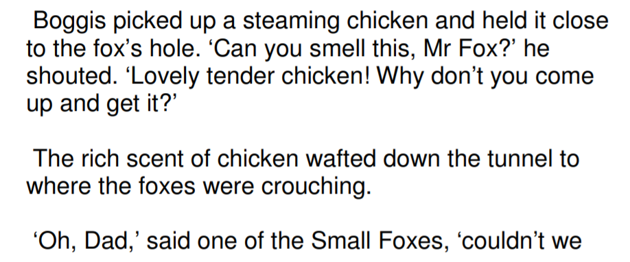
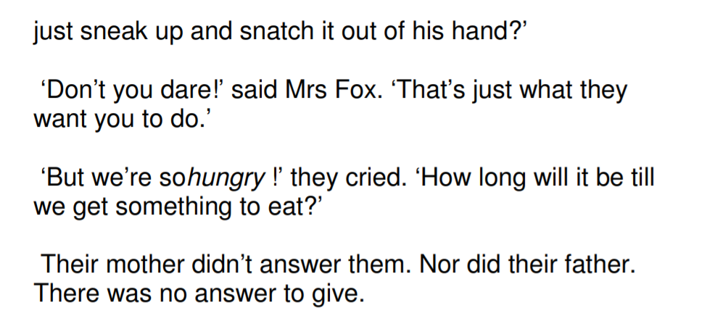

Slide 7
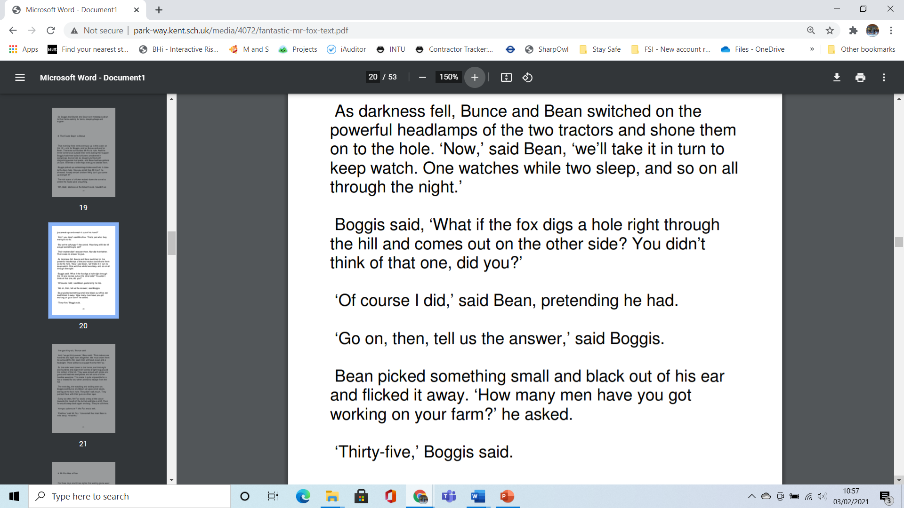

Slide 9
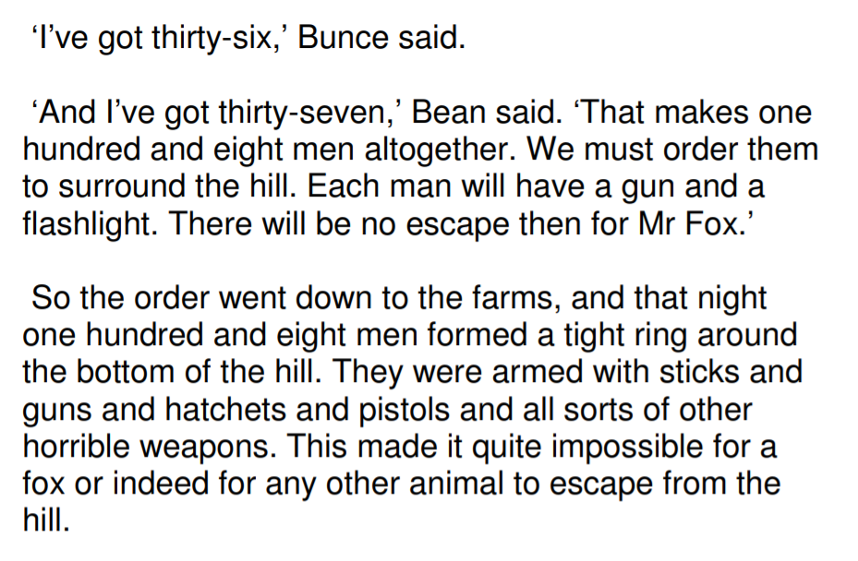

Slide 10
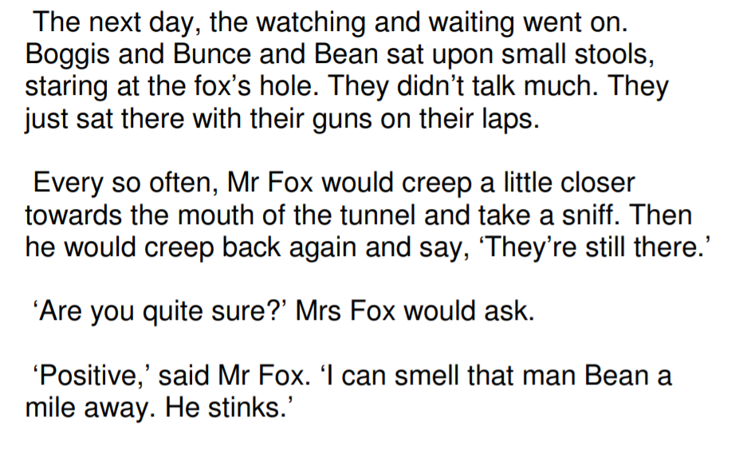

Slide 11
Now find the sheet English Chapter 8 comprehension and answer the questions. Complete the challenge.
Go through the chapter slide by slide.

