Slide 1
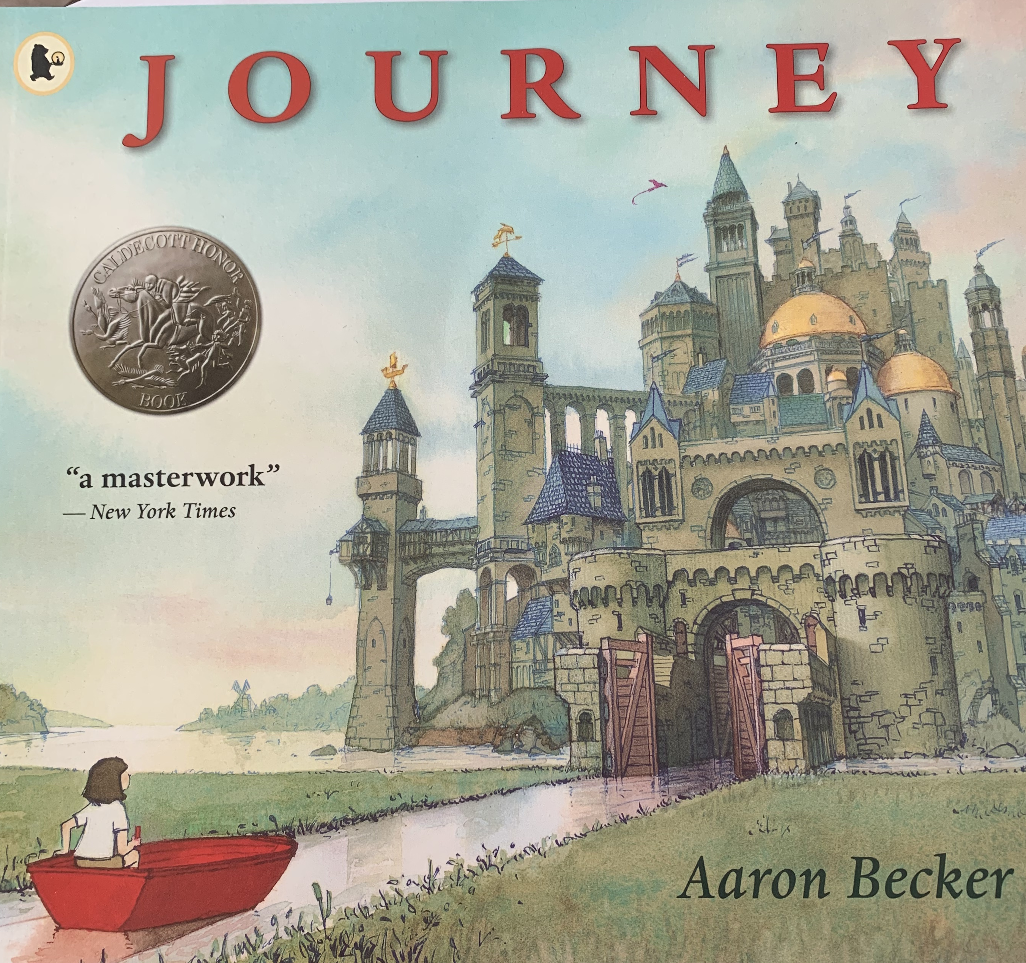

Slide 2
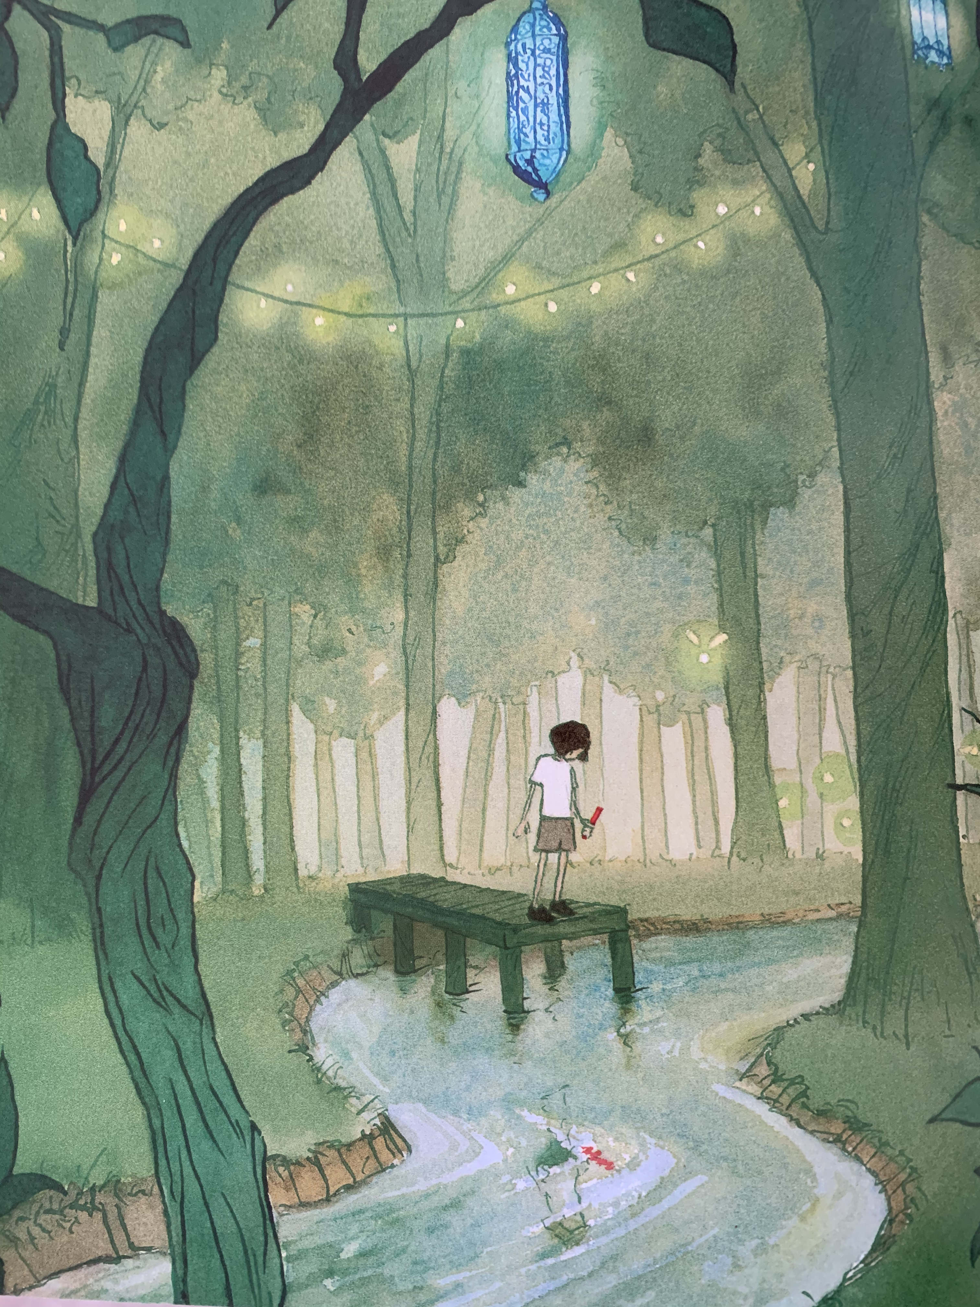
7

Slide 3
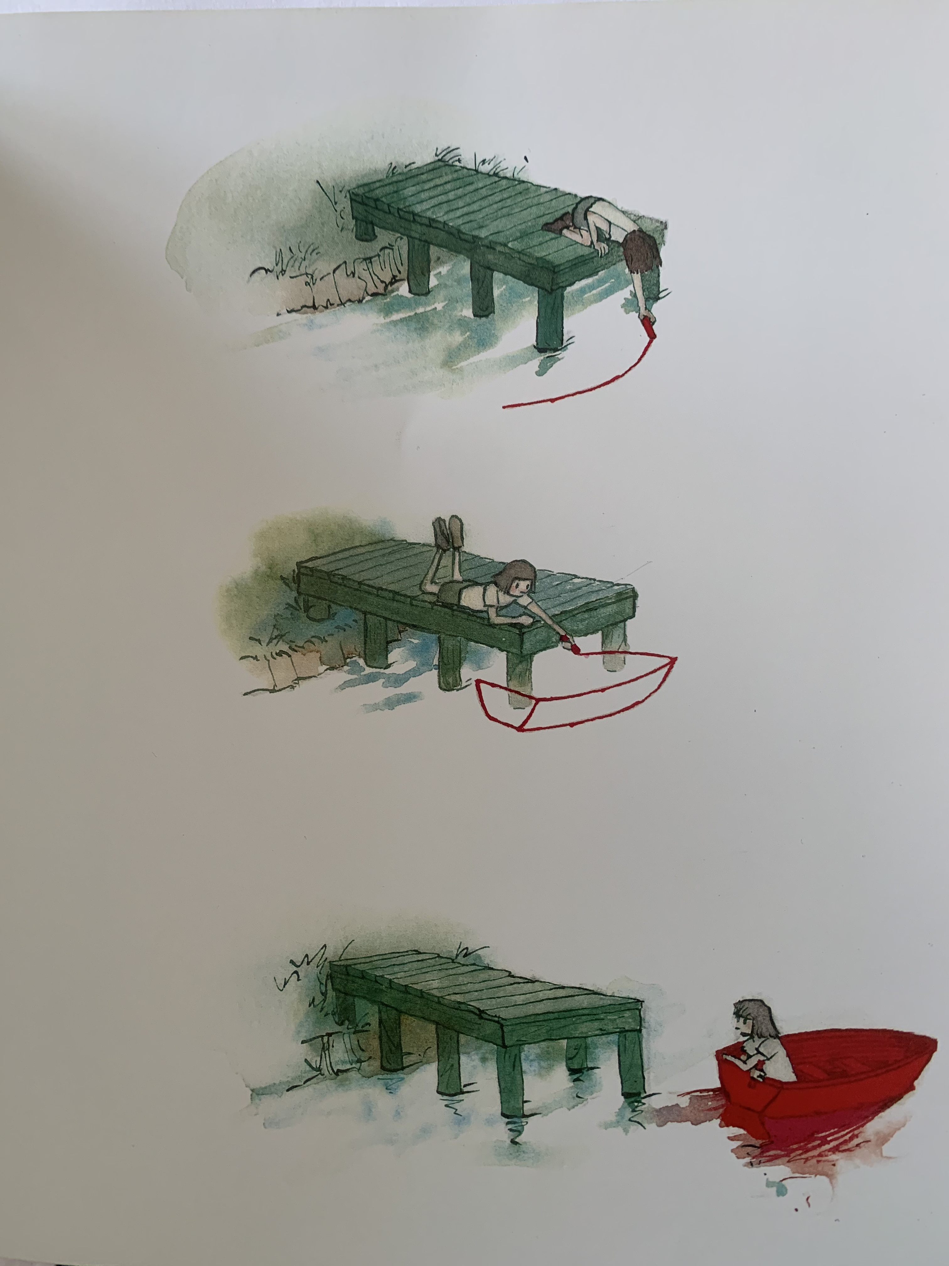
8

Slide 4
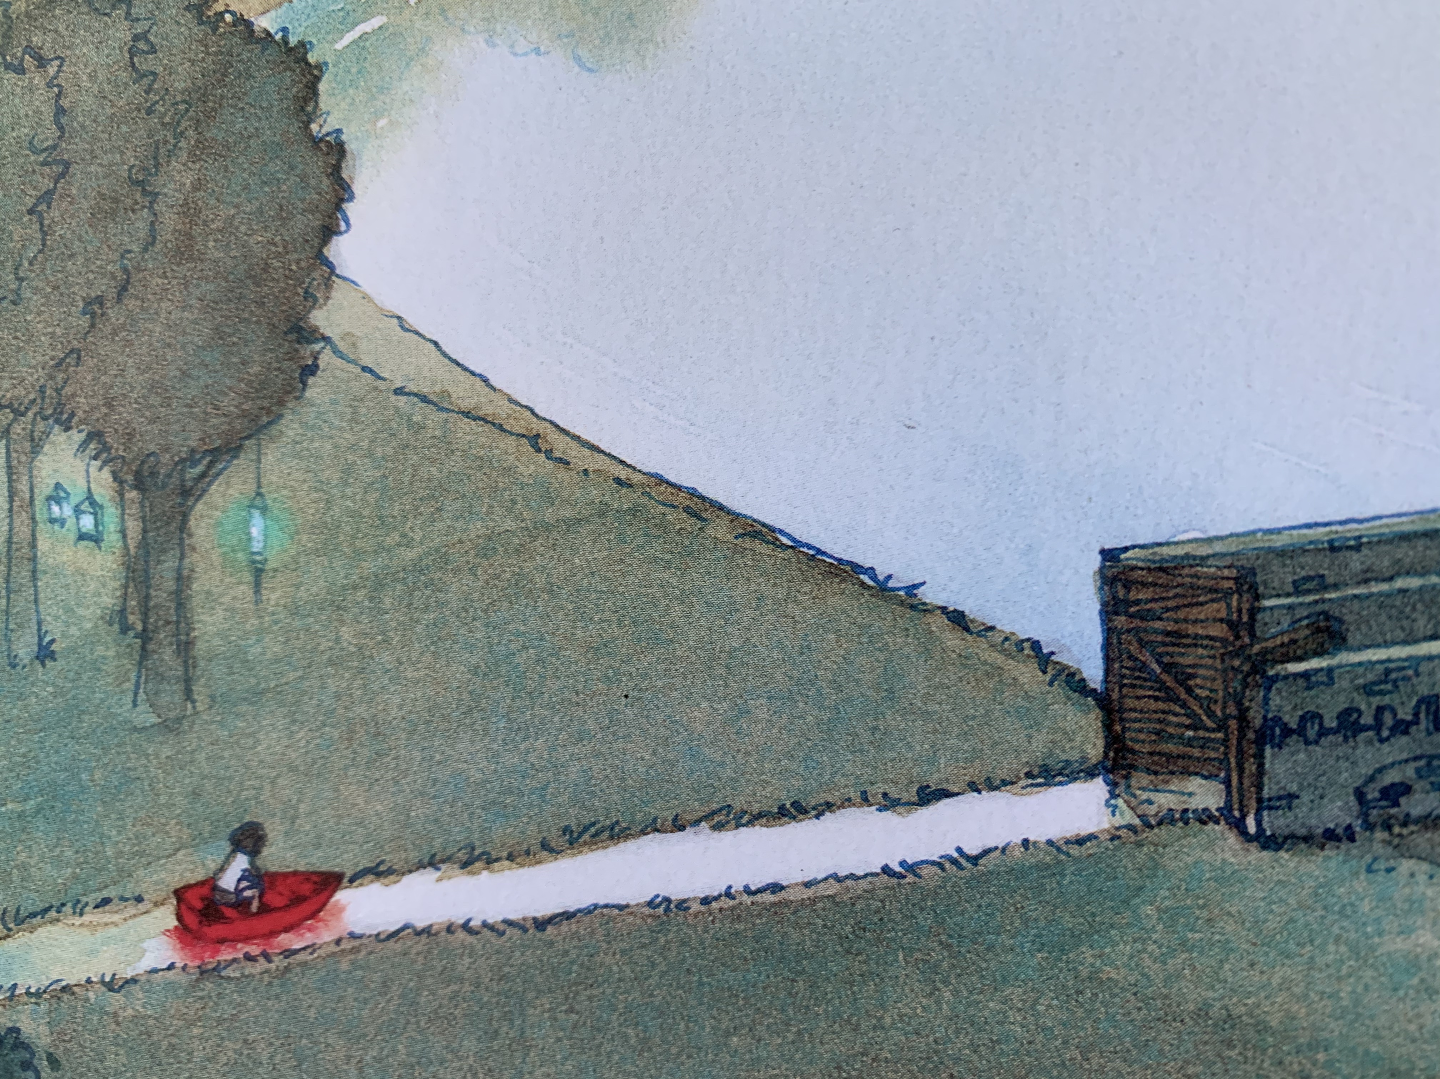
9

Slide 5
10

Slide 6
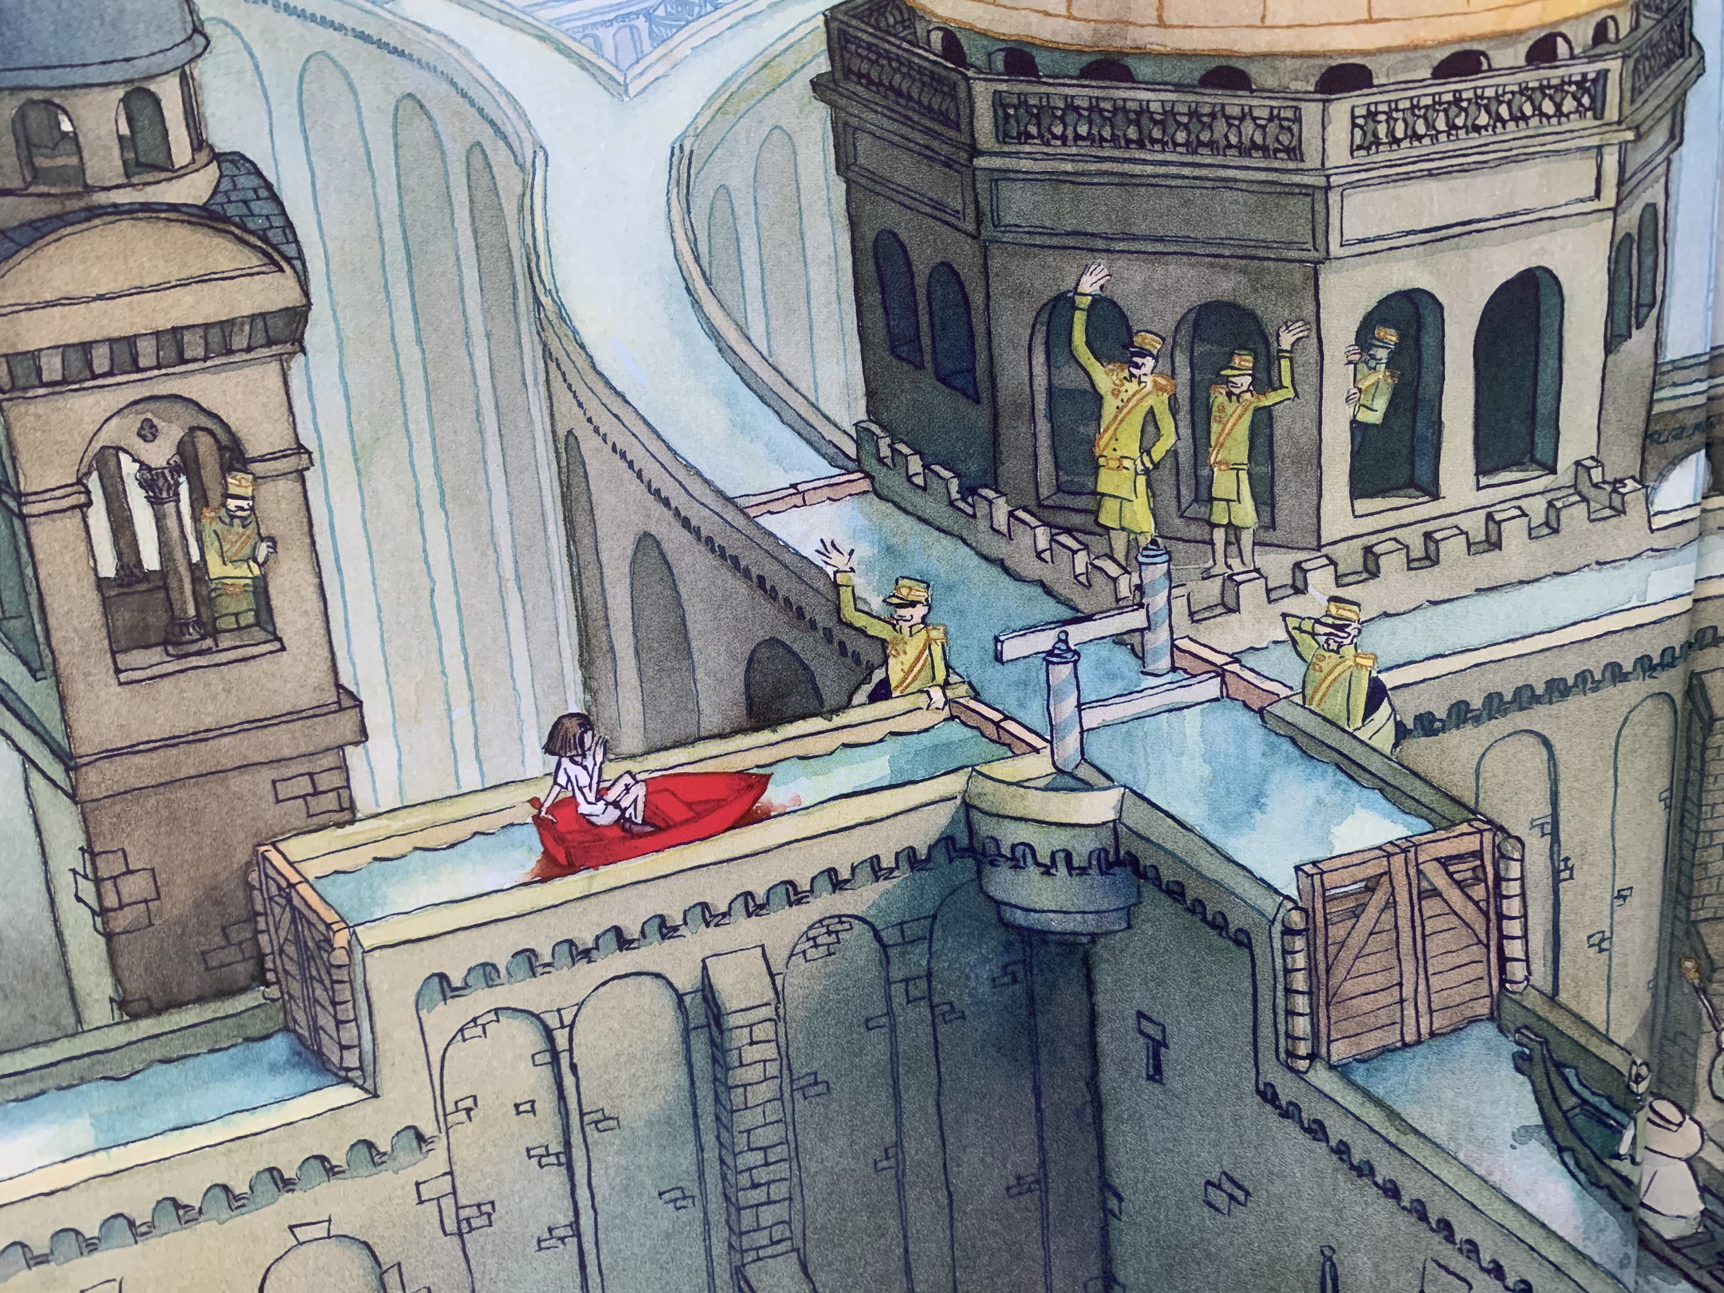
11

Slide 7
Questions:
Page numbers are at the bottom of the slide
p. 7 What can the girl see in the water?
p. 8 How did she make the boat? What did she use?
p. 9 Where is she going to go?
p. 10 What can the little girl see? How is she feeling?
p.11 Who are the people in yellow clothes? Do they seem kind? Why/why not?

