Slide 1

Understanding vocbulary in context

Slide 2
Who is the author?
Where is the story set?
What did we predict this book would be about?

Slide 3
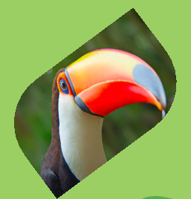
THINK
What do you know about the
rainforest?
Where are rainforests located
on Earth?
3. What animals live there?

Slide 4
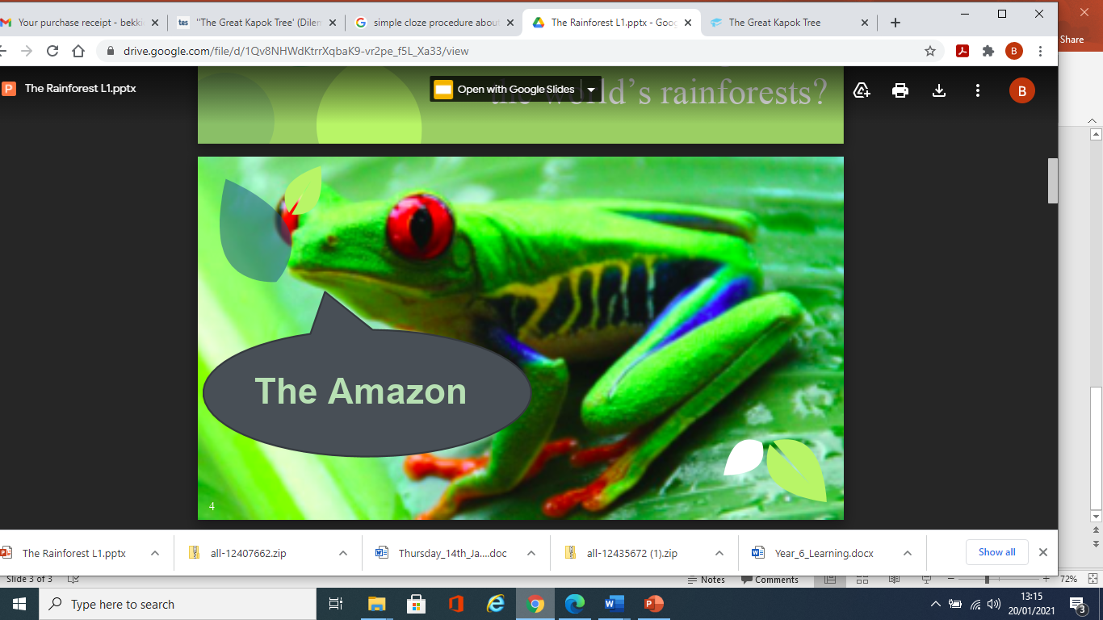
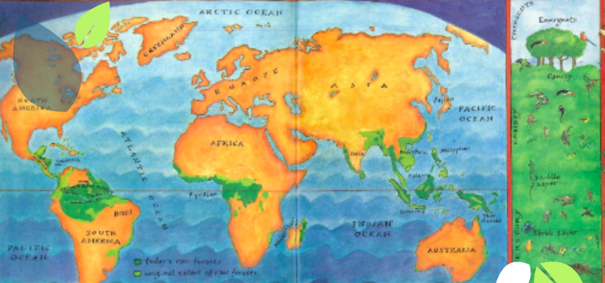
Which is the largest rainforest in the world?

Slide 6
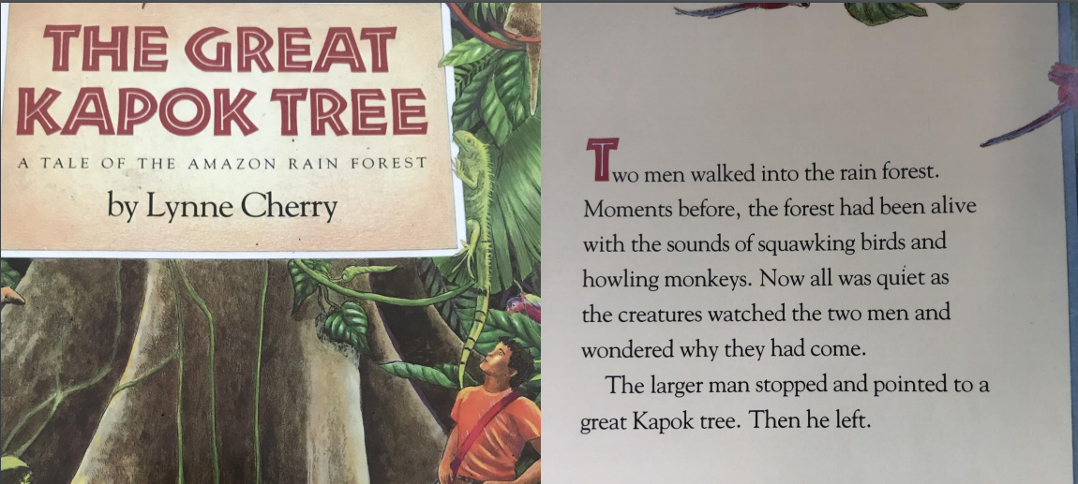
Sounds of the rainforest

Slide 7
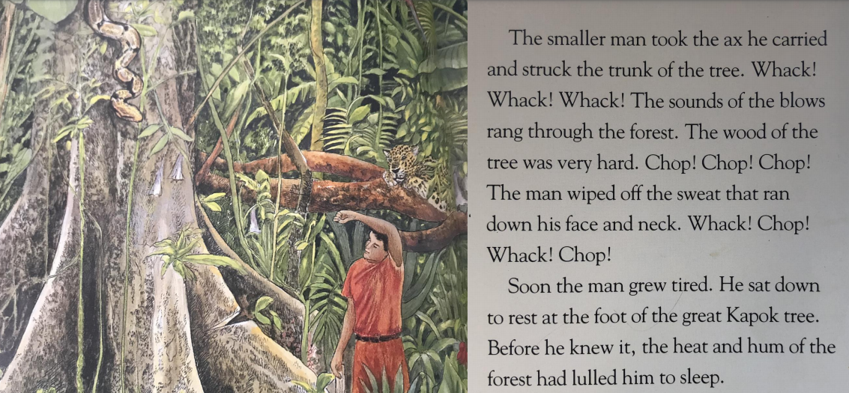

Slide 8
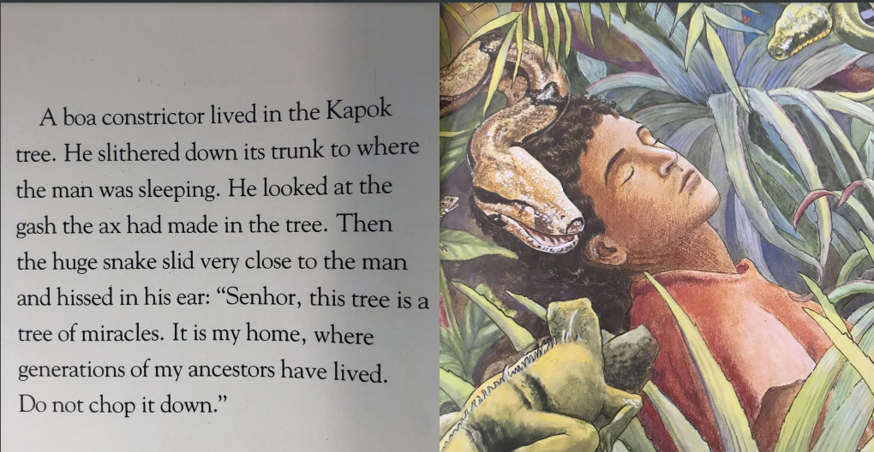

Slide 9
Now it’s your turn Today we are going to be understanding words in context.
First read the text carefully again.
Next think about the meaning of each of the words.
Remember to read around the words because they give you clues their meaning.
canopy
understory
environment
community
squawking
lulled
gash
ancestors

