Slide 1
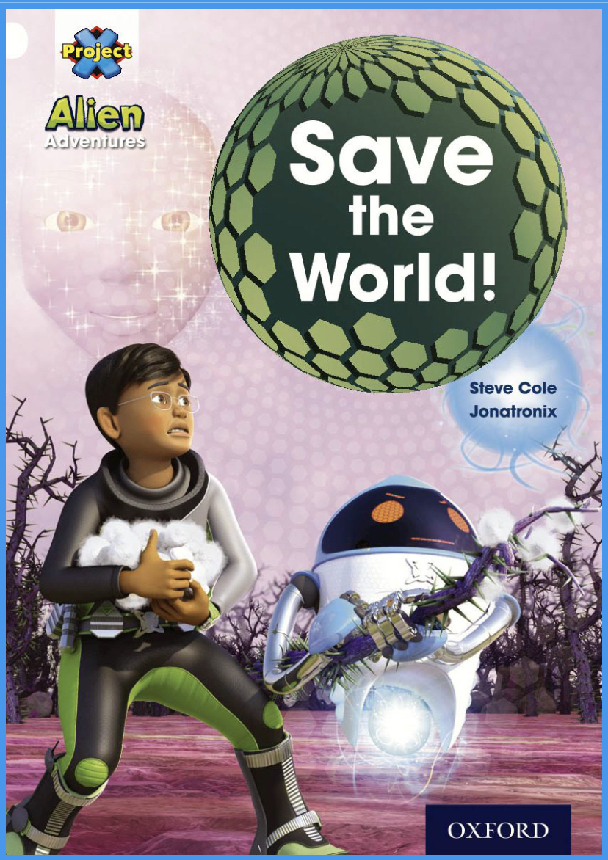
Today we are reading… Save the World! (White)

Slide 2
How to get to the book: 1. Log in to Oxford Owl 2. Click on Read Oxford Owl eBook library 3. Click on Levels and select “white” 4. Click on “Save the World!”

Slide 3
Page 2-3
Questions:
What is Max’s mission?
How do you think Max feels about his mission?
What happened in Max’s last adventure?
What does “fragment” mean?

Slide 4
Page 4-5
Questions:
What did Seven use to scare off the Meebs?
How did the Meebs react to this?

Slide 5
Page 6-7
Questions:
What was their new plan?
What does “wrecked” mean?
What do you think will happen next?

Slide 6
Page 8-9
Questions:
What is a “fragment”?
What did Nok try to do?
What happened to the cave?

Slide 7
Page 10-11
Questions:
What does “peered” mean?
How many metal spheres were there?
What are the krools doing?
How do you think Max and his friends feel at this point?

Slide 8
Page 12-13
Questions:
What happened to Tiger?
What is Max’s plan?
What are “vibrations”?

Slide 9
Page 14-15
Questions:
What did Nok do?
What does “flickered” mean?
What do you think will happen next?

Slide 10
Page 16-17
Questions:
Why were they panting for breath?
What does “recovering” mean?

Slide 11
Page 18-19
Questions:
What did Cat, Ant and Seven do?
How did they find Max and his friends?

Slide 12
Page 20-21
Questions:
What does “appeared faintly” mean?
What did they do with the water?
What does “sinister” mean?

Slide 13
Page 22-23
Questions:
What did Kree-Ator tell them?

Slide 14
Page 24-25
Questions:
Which adjectives are used to describe the blossom?
What were the krools doing?

Slide 15
Page 26-27
Questions:
What happened to the Mega-Meeb?
How do you think Max and his friends are feeling at this point?

Slide 16
Page 28-29
Questions:
What did Seven do?
What does “snatched” mean?

Slide 17
Page 30-31
Questions:
What does Max tell the Meebs to do?
How do you think Nok is feeling and why?

Slide 18
Page 32
Questions:
What are the white flowers called?
How do you think Max and his friends are feeling now?

Slide 19
Did you like the story? Why/ why not?

