Slide 1
Year 1 English Peter and the Wolf Quiz

Slide 2
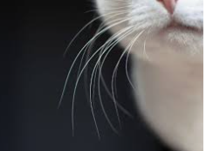
Today we are going to answer some questions about the story by looking at clues. First, can you guess who this character is?
I have a long tail.
I have whiskers.
I have 4 legs.
Who am I?

Slide 3
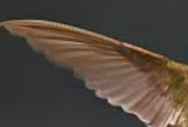
Can you guess who this character is?
I have two wings.
I have a beak.
I can fly.
Who am I?

Slide 4
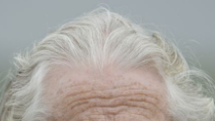
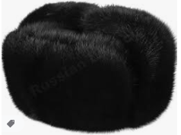
Can you guess who this character is?
I have a walking stick.
I have grey hair.
I wear a black hat.
Who am I?

Slide 5
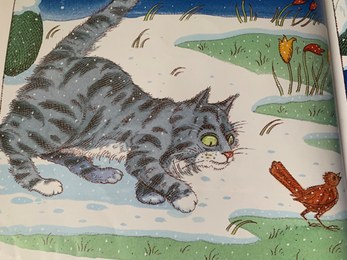
Now lets try and work out what happens next in the story.
What happened next?

Slide 6
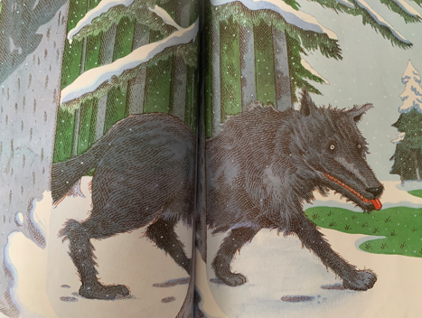
Now lets try and work out what happens next in the story.
What happened next?

Slide 7
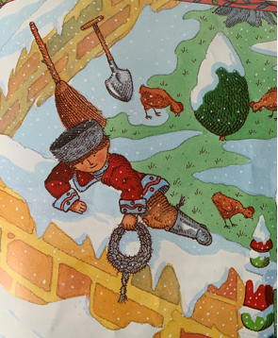
Now lets try and guess what happens next in the story.
What happened next?

Slide 8
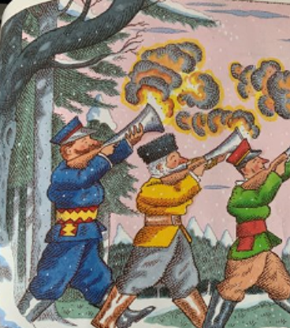
Now lets try and guess what happens next in the story.
What happened next?

Slide 9
Answers
Slide 2 – The cat.
Slide 3 – The bird.
Slide 4 – Grandfather.
Slide 5 – The bird flies up into the tree.
Slide 6 – The wolf eats the duck.
Slide 7 – Peter climbs the tree with the rope.
Slide 8 – The hunters cheer and take the wolf to the zoo.

