Slide 1
Year 1 Art

Slide 2
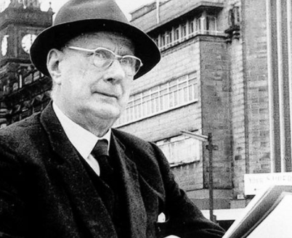
This week we are going to be learning about a new artist.
This is Laurence Stephen Lowry.
Lowry was an artist who drew things that he could see.
This is called observational drawing.

Slide 3
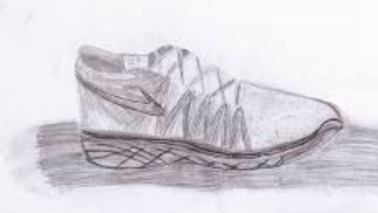
Observational drawing Observational drawing is when we look at something and draw what we can see.

Slide 4
Lets have a look at some of Lowry’s art work.

Slide 5
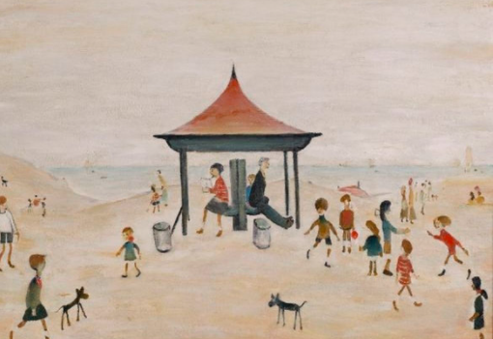

Slide 6
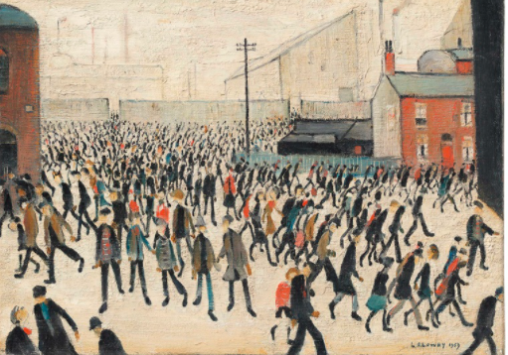

Slide 7
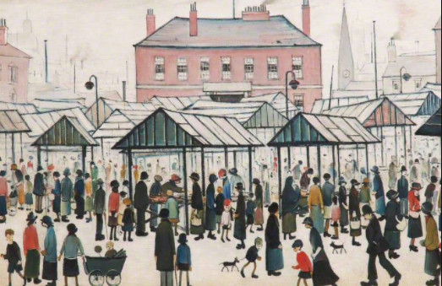

Slide 8
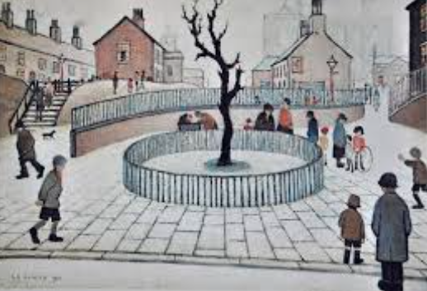

Slide 9
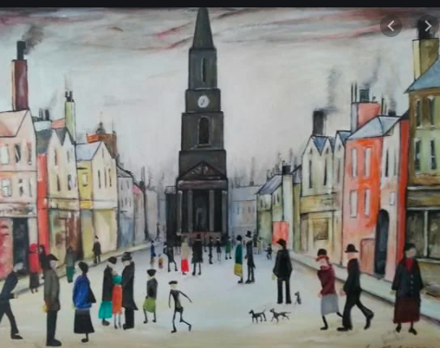

Slide 10
Now have a go at doing your own observational drawing. Can you choose something in your house and have a go at drawing it?

Slide 11
Slide 2 – This week we are going to be learning about a new artist Lowry.
Slide 3 – Observational drawing
Slide 4 – Lets have a look at some of Lowry’s art work.
Slide 10 – Now have a go at your own observational drawing.

