Slide 1



Slide 2
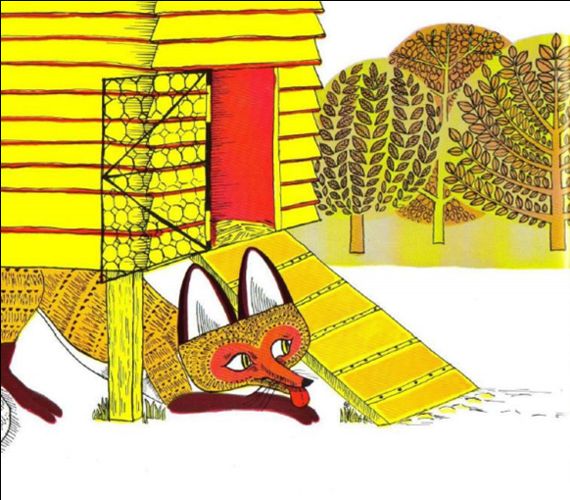

Slide 3
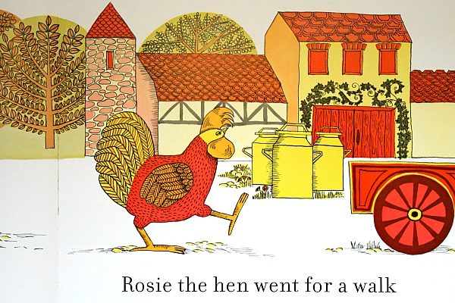
Rosie the hen went for a walk

Slide 4
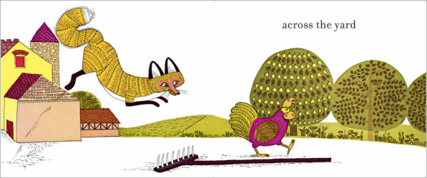
across the yard

Slide 5
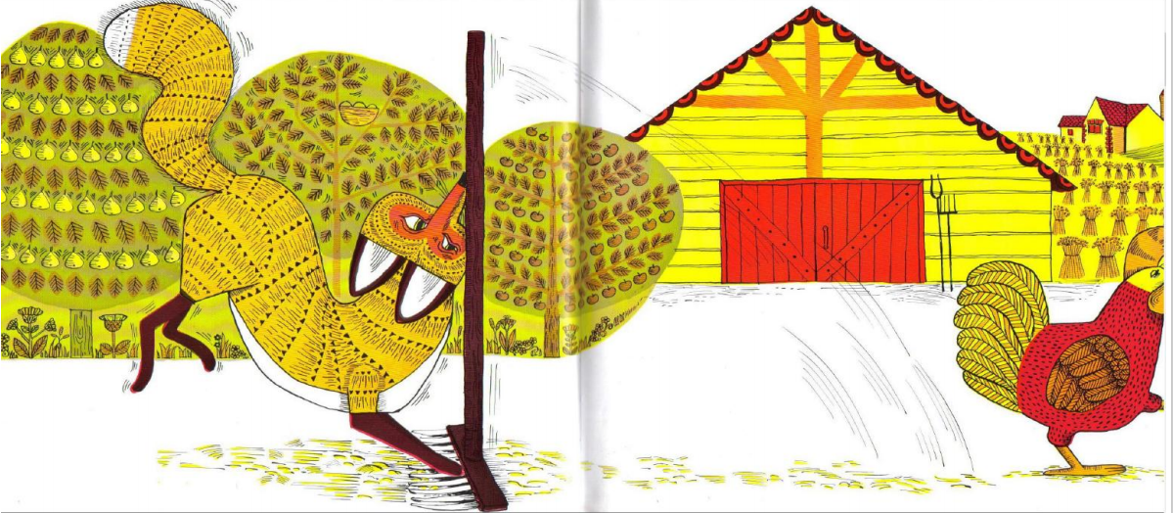
Bang

Slide 6
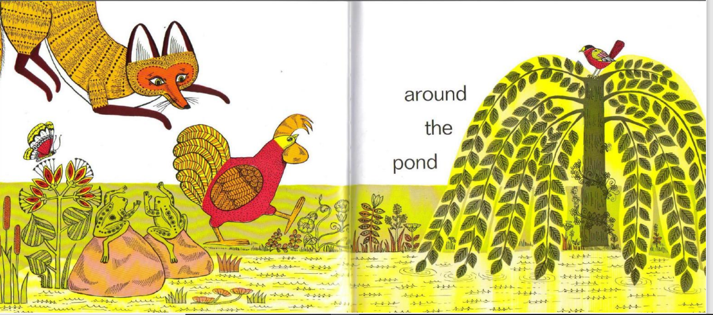
around the pond

Slide 7
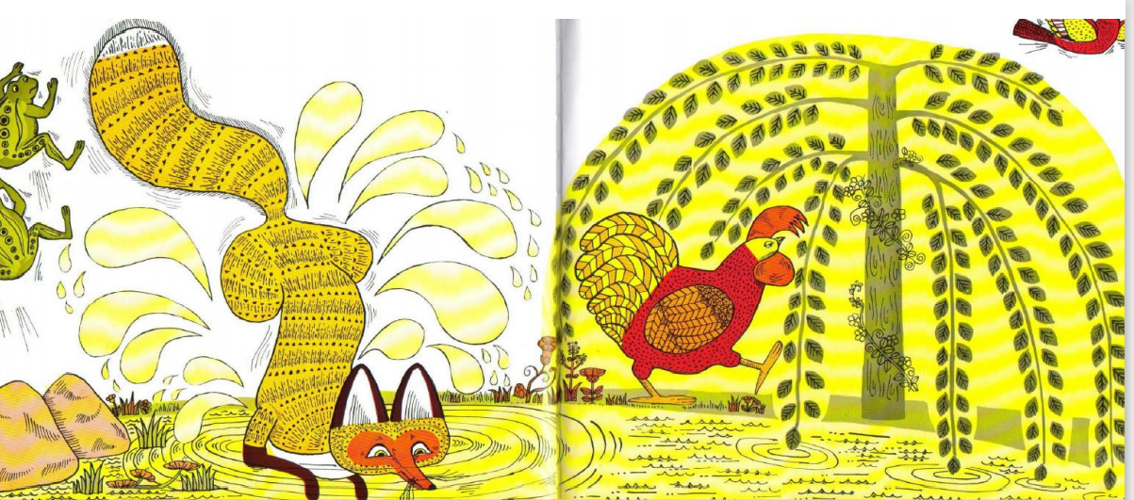
Splash

Slide 8
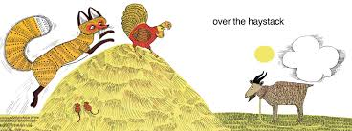
over the haystacks

Slide 9
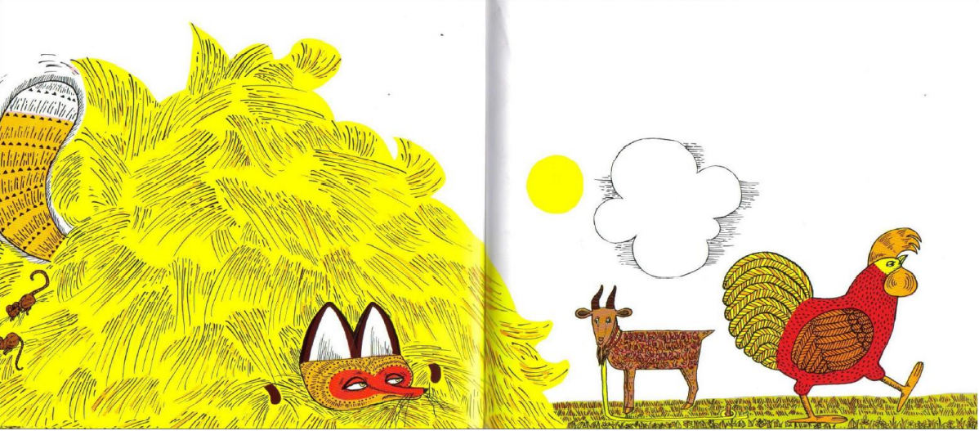

Slide 10
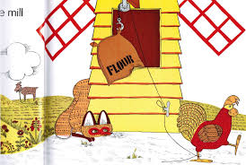
past the mill

Slide 11
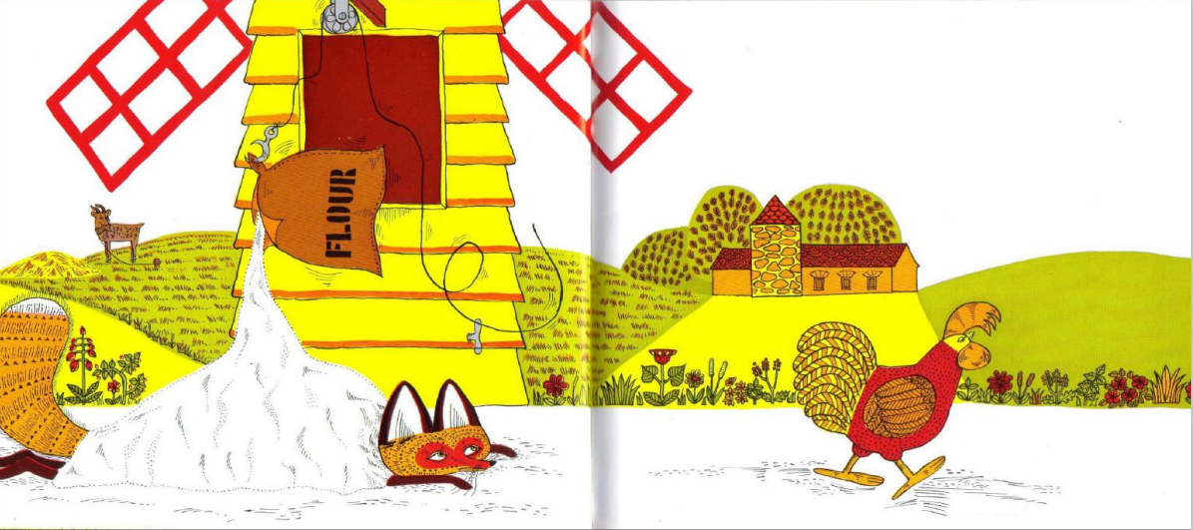

Slide 12
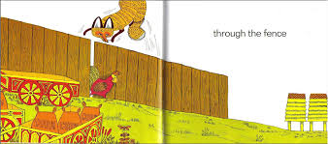
through the fence

Slide 13
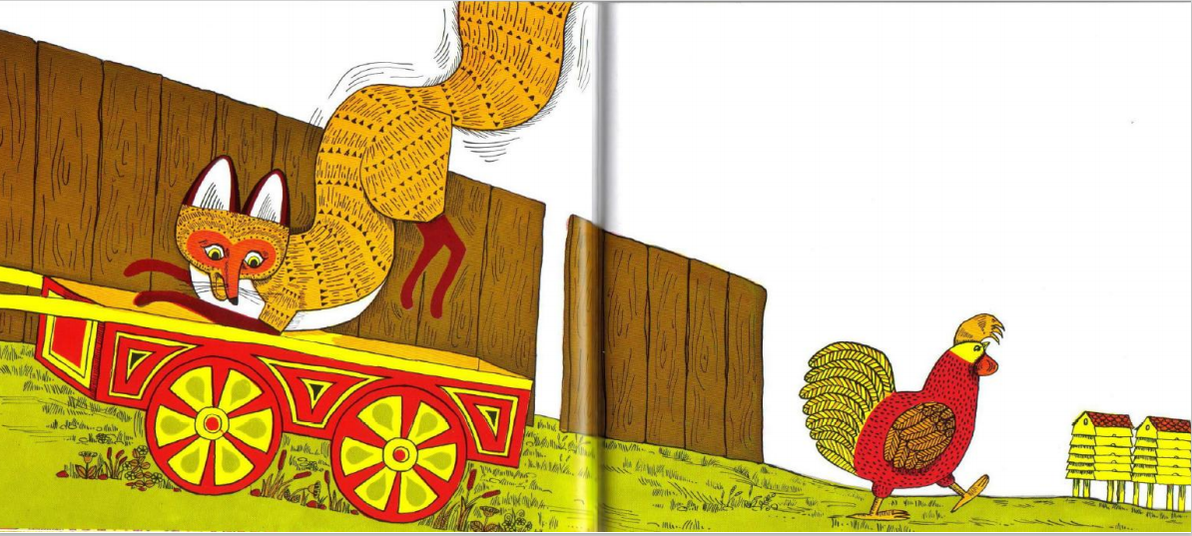

Slide 14

under the beehives

Slide 15
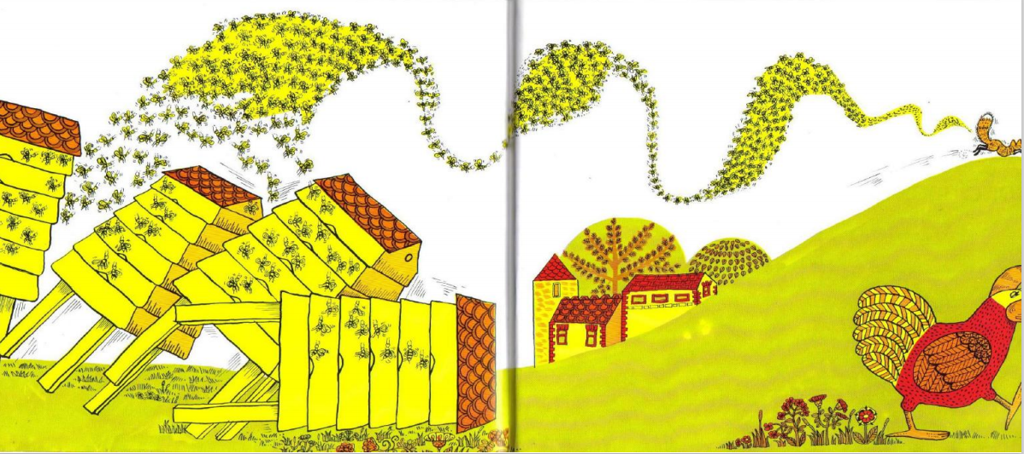

Slide 16
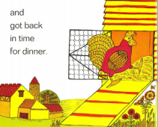
and she got back in time for dinner.

Slide 17
I hope you enjoyed your journey with Rosie. She has been very busy today.

Slide 18
I wonder if you could get a toy
Put it under a chair
On top of the table
Behind your back
In front of the television
On your knee.
Well done you have worked hard doing this. I think you and your toy needs a rest.

