Slide 1


Music in the 1970s

Slide 2
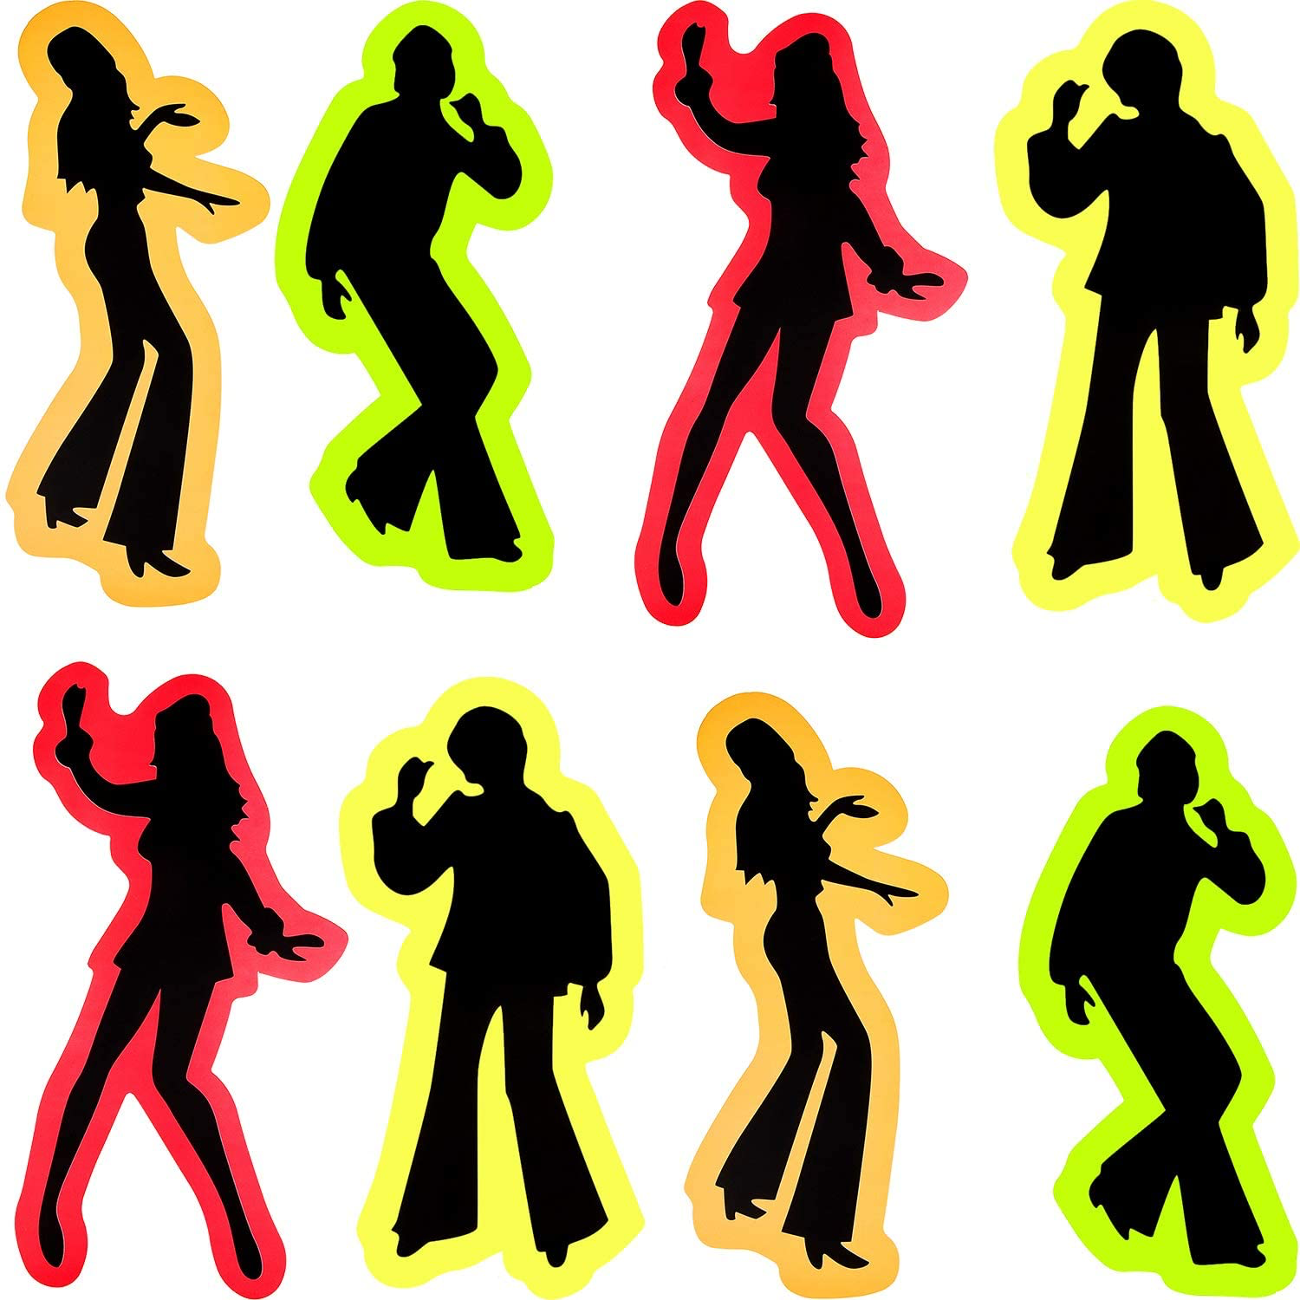
What was the style of music in the 1970s?
Funk
Soul
R&B
Pop
Hard Rock
Soft Rock
Disco

Slide 3
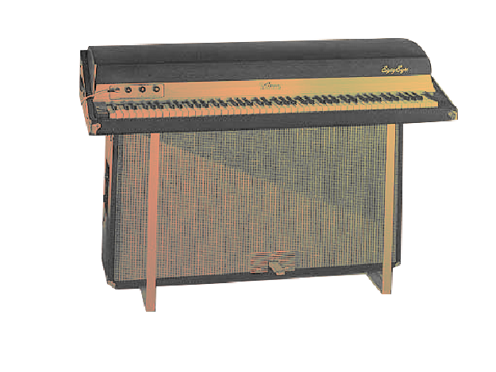
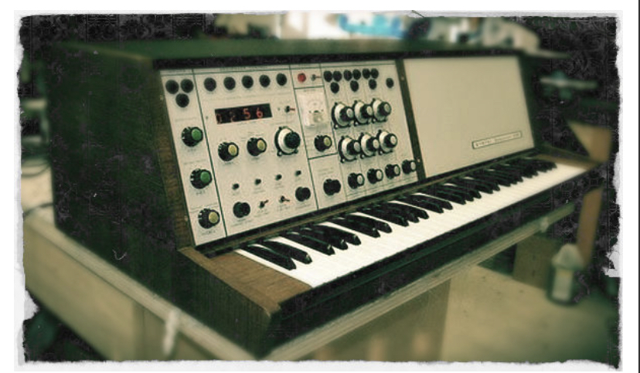
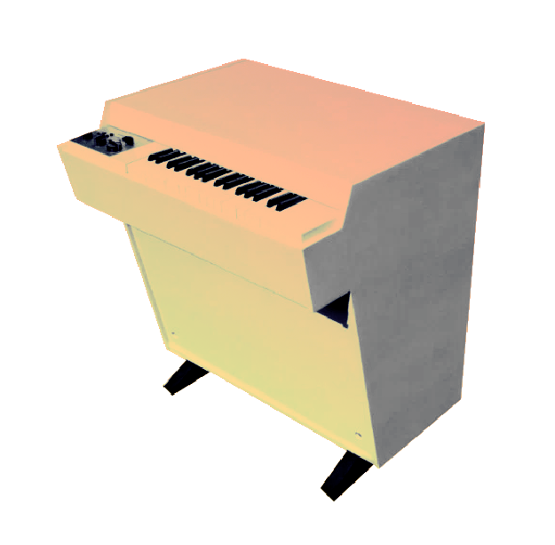
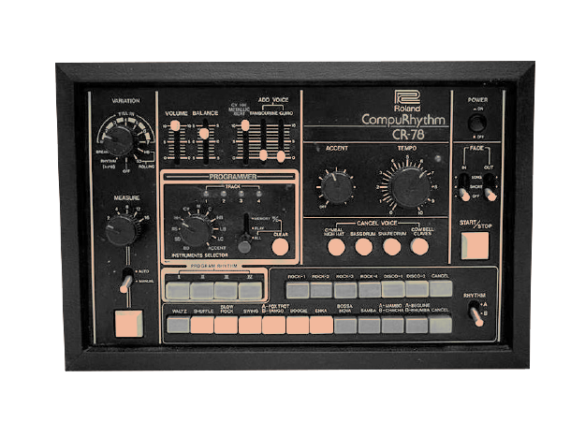
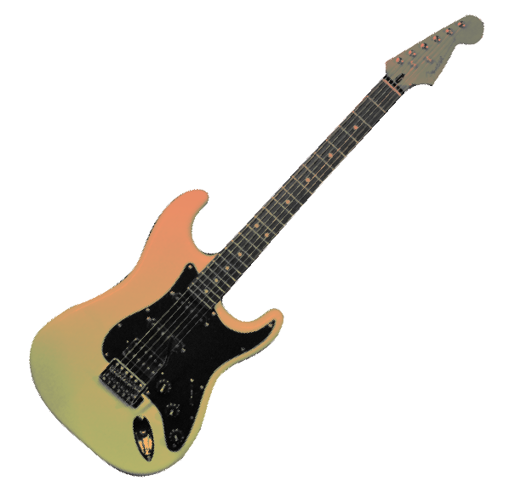
Which instruments did they use?
Can you guess which instrument matches with each picture?
Drum machine
Guitar
Synthesiser
Stage piano
Mellotron

Slide 4
Which instruments did they use?
Synthesiser
Stage piano
Mellotron
Drum machine
Guitar

Slide 5
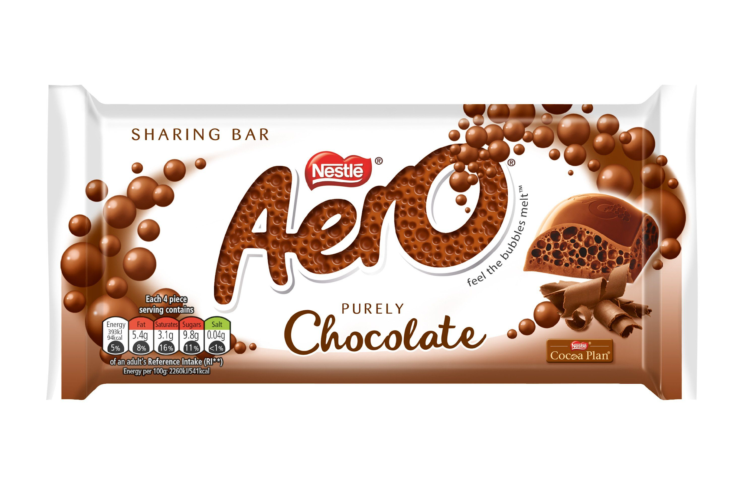


Guess the famous ’70s artists from these clues!
1.
3.
2.
Smith

Slide 6
Answers:
1.
3.
2.
Smith
1. KISS 2. The Rolling Stones 3. Aerosmith

Slide 7
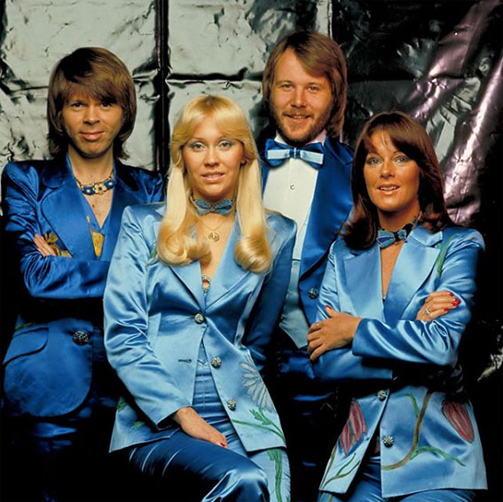
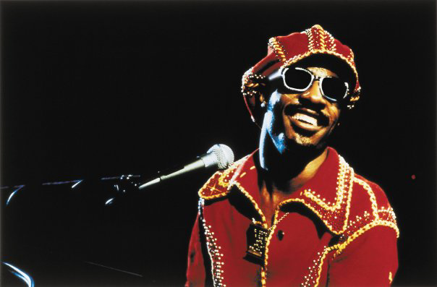
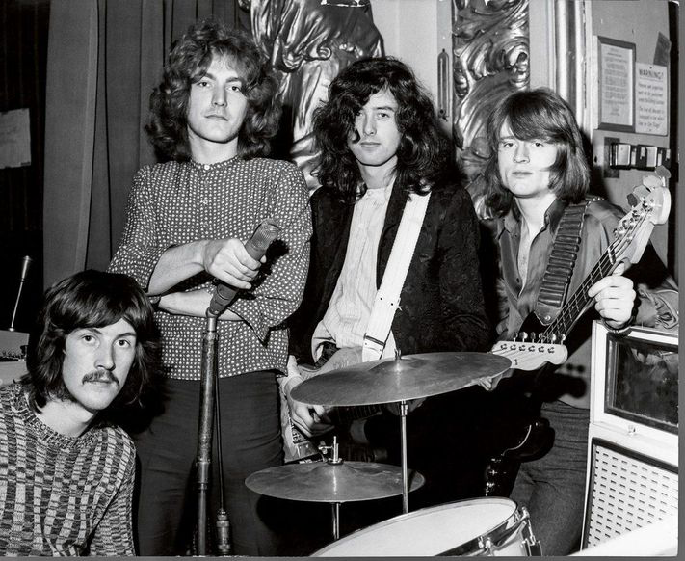
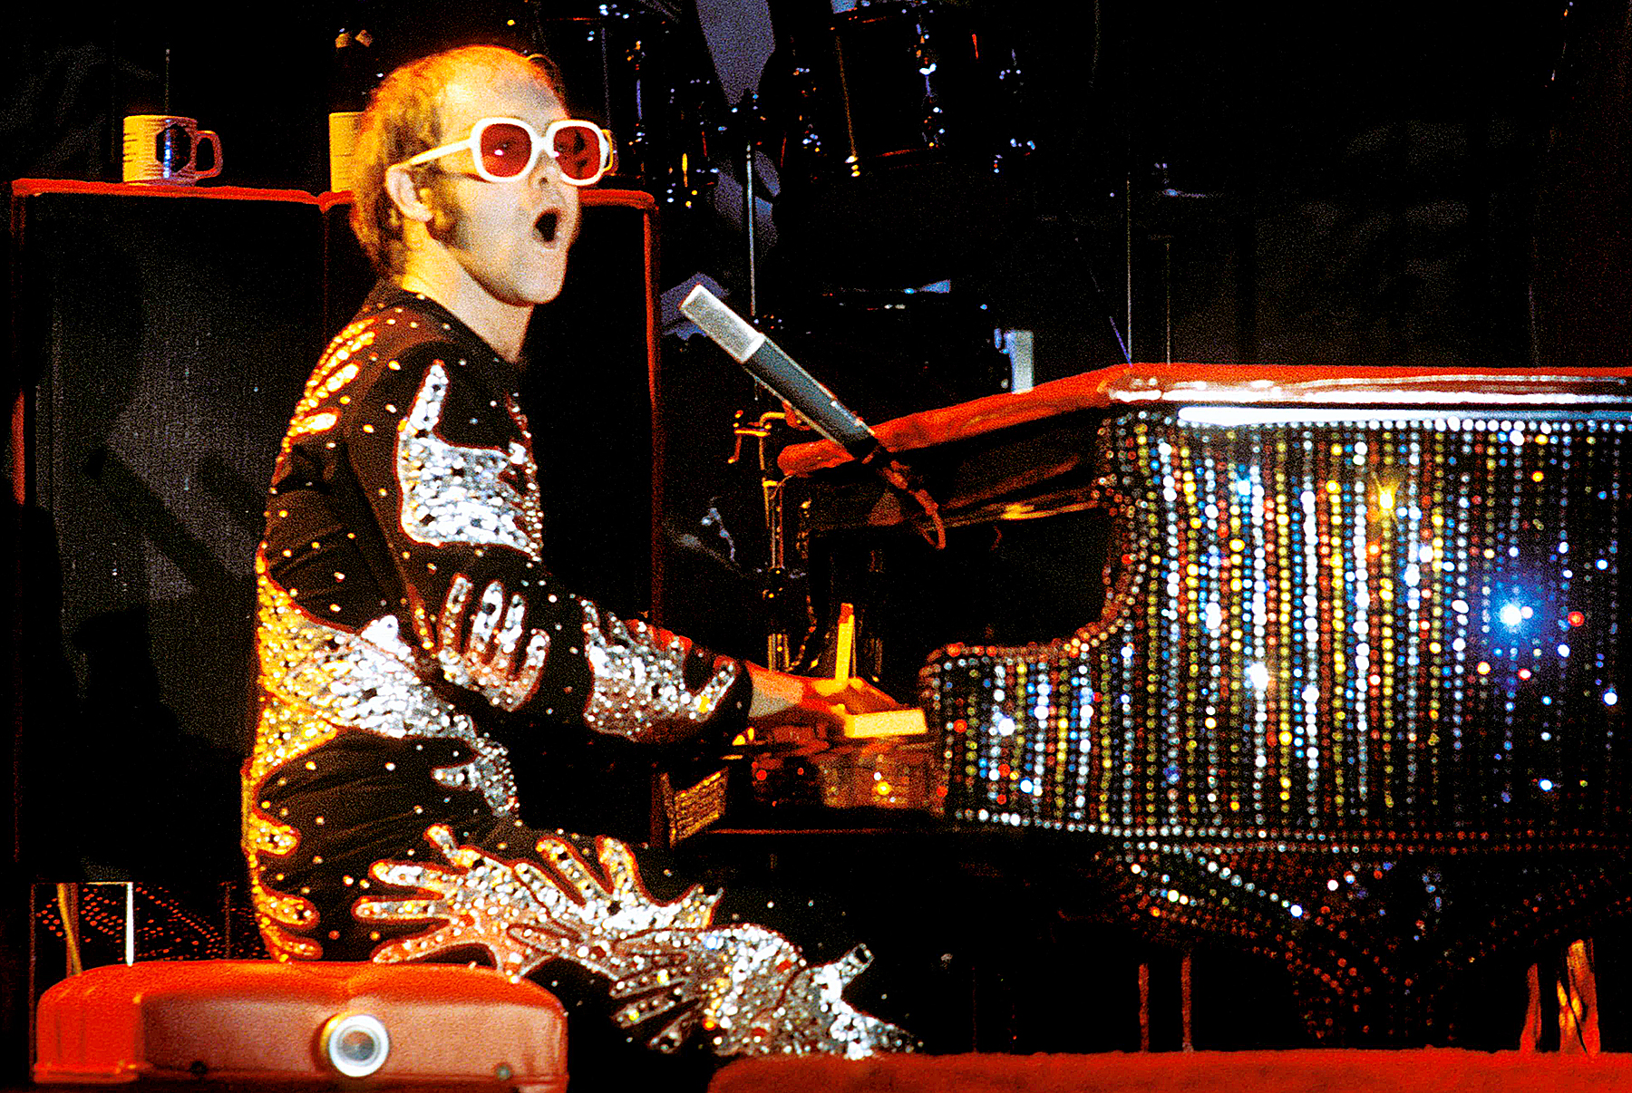
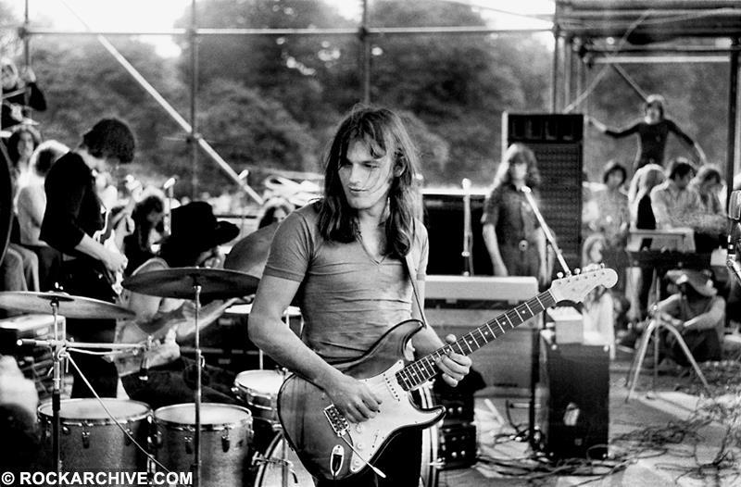
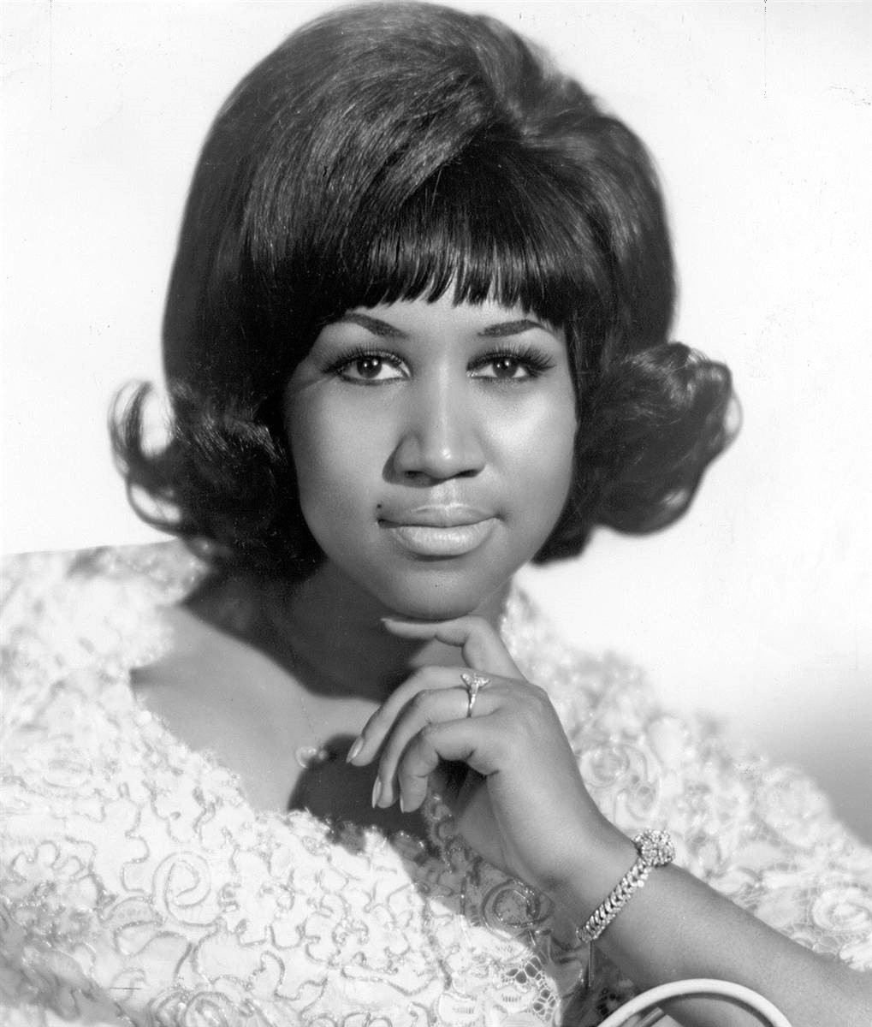
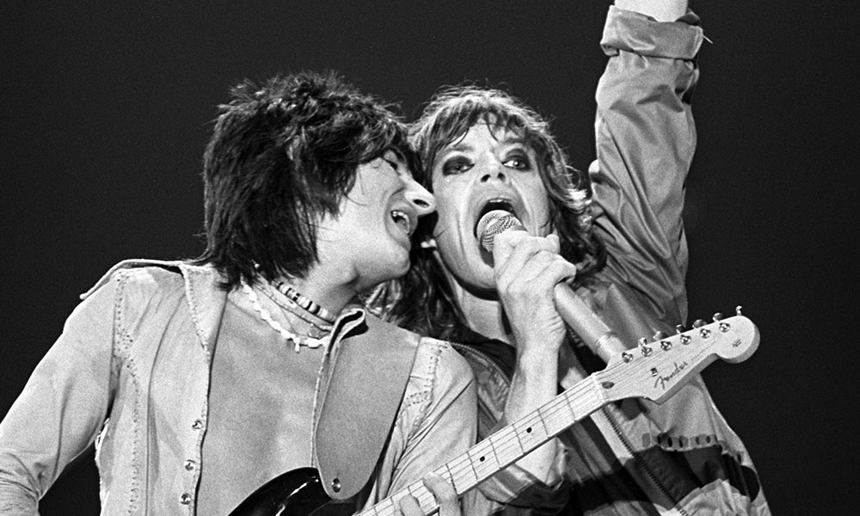
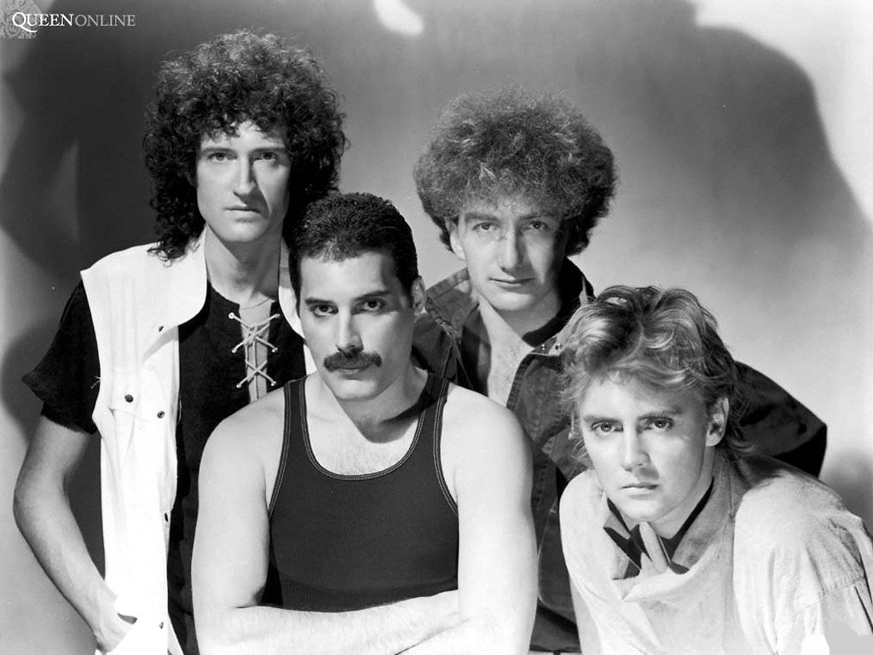
Famous artists from the 1970s:
Stevie Wonder
Led Zeppelin
ABBA
Fleetwood Mac
Elton John
Pink Floyd
The Rolling Stones
Eagles
Queen
The Who
Aretha Franklin

